Slide 1
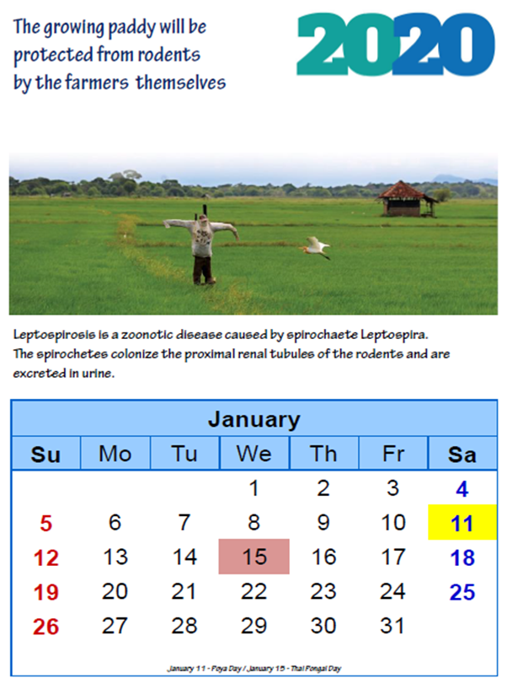
Activity | Target population | Mode of delivery
Weekly Short messages (SMS) and post cards | Farmers registered at “Govisamithi” (farmers groups) in the area | Twenty-one messages related to land preparation, maintenance period and harvesting period were developed and sent weekly. It was started a week before start of “Maha” season.
Weekly Announcements at “Sathi Pola” | General population | Announcements on basic epidemiology, transmission, prevention and non-intervention of leptospirosis were delivered at “Sathi pola” where farmers regularly attend to sell their crops.
Awareness through a desk calendar | General Practitioners (GPs) | Reminding of seasonal activities related to leptospirosis and about the people involved in those activities. GP can suspect, refer to hospital and educate the clients.
Educational Intervention Package to Increase Knowledge on Minimizing the Delays in Seeking Treatment of Leptospirosis in a District of Sri Lanka
INTRODUCTION
Leptospirosis, a potentially fatal infection often overlooked due to limited awareness. The objective of the study was to assess the effectiveness of an educational intervention for knowledge on minimizing the delays in seeking treatment of leptospirosis among farmers in Monaragala District, Sri Lanka which is a rural area where paddy farming is carried out by full time as well as part time farmers as their main income.
METHODS
A quasi-experimental study conducted in two Medical Officer of Health (MOH areas) of Monaragala district from September 2019 to March 2020. The intervention, crafted through Key Informant Interviews (KII), literature, and expert inputs. Intervention package, delivery method and the questionnaire to assess the effectiveness was finalized via the modified Delphi method with an expert group on Leptospirosis. The intervention delivered through different modes for 20 weeks started before the beginning of a major cultivation season (Maha). Administered to 158 farmers, its impact was assessed through pre-and post-intervention (two months after completing the intervention) awareness scores. Pared t-test was conducted to evaluate the effectiveness of pre and post awareness scores.
Variable | Non- intervention group |  | Intervention group |  | Mean difference (95% CI) | t - test
 | Mean | SD | Mean | SD
Pre intervention | 14.06 | 3.84 | 13.57 | 4.11 | 0.49 (-0.28 to 1.2) | t=1.24 P=0.290
Post intervention | 14.36 | 3.81 | 18.95 | 2.57 | -4.59 (-3.9 to -5.2) | t=14.114 P=0.000
Kumari AMUP, Vidanapathirana J, Amarasekara J and Karunanayake L
LIMITATIONS
CONCLUSIONS:
Epidemiology Unit, Ministry of Health, Sri Lanka
Policy Analysis & Development Unit, Ministry of Health, Sri Lanka
Anti Malaria Campaign, Ministry of Health, Sri Lanka
National Reference Laboratory for Leptospirosis, Department of Bacteriology, Medical Research Institute, Colombo, Sri Lanka
The intervention was delivered through various methods, making it challenging to pinpoint the specific approach that exhibited the highest effectiveness.
The implementation of interventions employing clear and culturally sensitive messages, conveyed in local languages and delivered through diverse channels, coupled with educational guidance provided by trusted community figures, has demonstrated noteworthy success in enhancing awareness and reducing delayed health-seeking behavior.
RESULTS
The pre- and post-intervention assessment revealed that awareness in seeking treatment of leptospirosis had significantly improved two months after intervention (OR = 4.59; CI = 3.9-5.2).
ACKNOWLEDGMENTS
Authors acknowledge the effort of Mr. Asantha Roshan Wadumulla (Epidemiology Unit, Ministry of health, Sri Lanka) in developing the “Leptospirosis Desk Calendar”. Gratitude is also extended to the KII participants, Expert team who finalized the intervention and general practitioners who actively participated in implementing the intervention in the Monaragala district.

