Slide 1
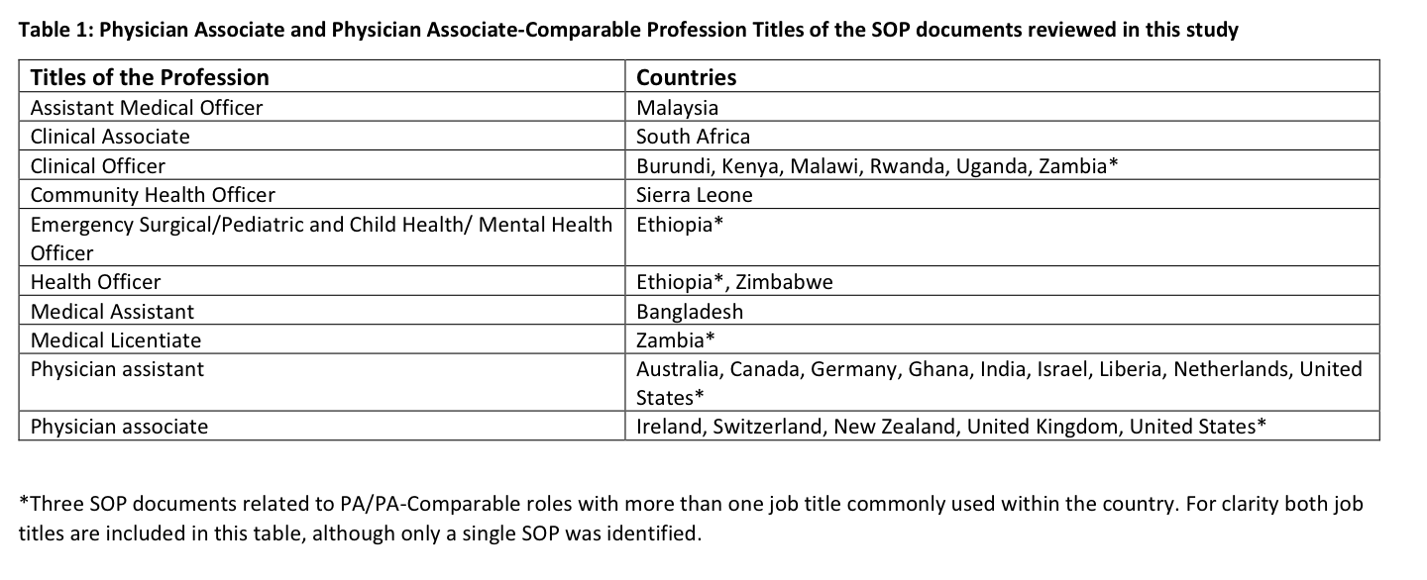
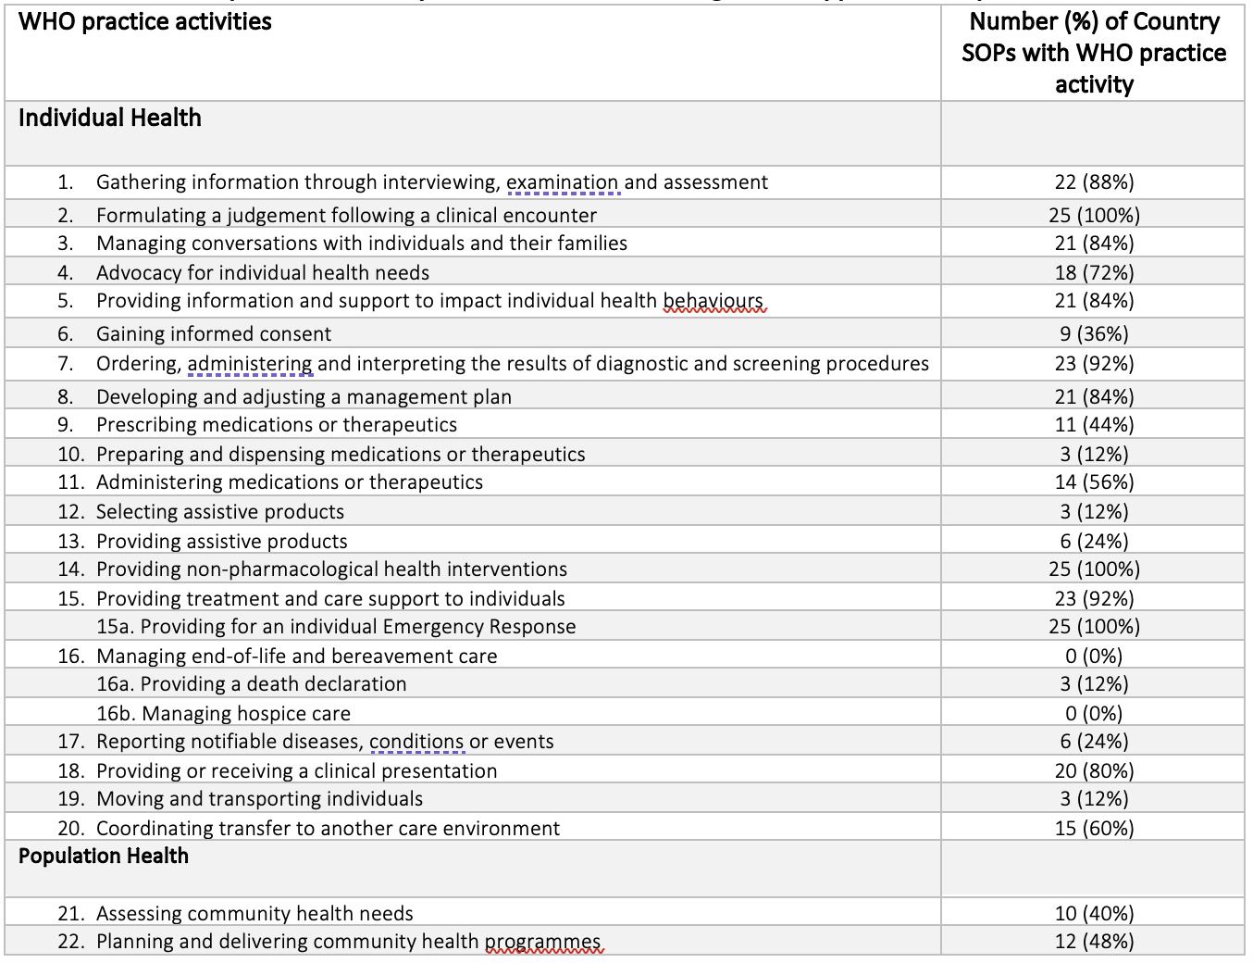
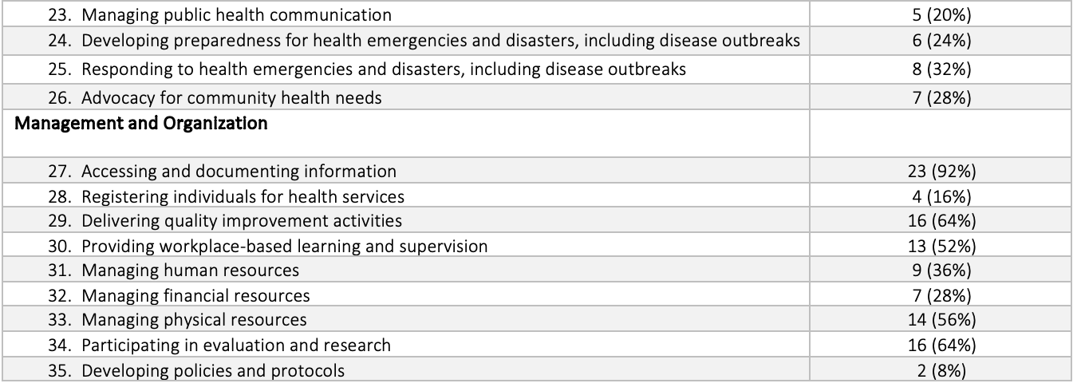
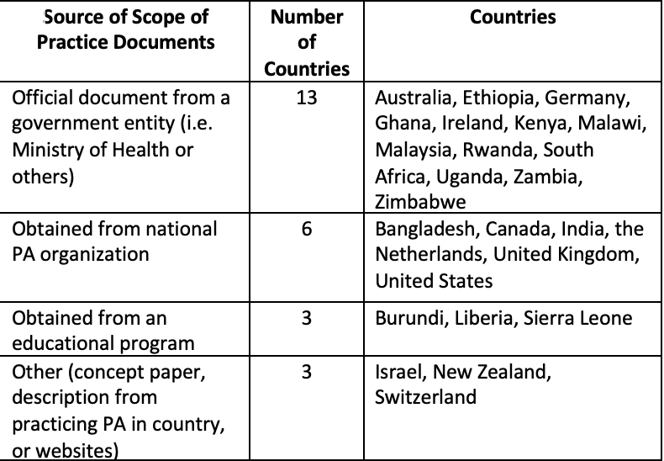
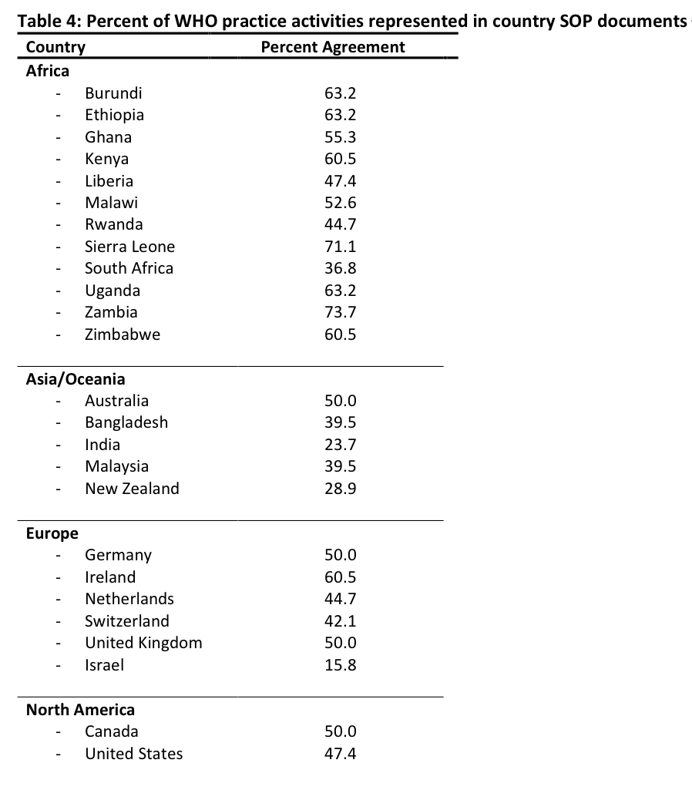
Understanding the scope of practice of physician associate/physician associate comparable professions using the World Health Organization global competency and outcomes framework for universal health coverage
Mary Showstark¹, Jami Smith², Trenton Honda³
¹ Yale School of Medicine Physician Assistant Online Program, ² Delaware Valley University Physician Assistant Program, ³School of Clinical and Rehabilitation Sciences, Northeastern University
Introduction
Table 1. Physician Associate and Physician Associate-Comparable Profession Titles of the SOP documents
Table 2. Number and percent of country SOP documents containing tasks mapped to WHO practice activities and 3 sub-categories
Discussion
Physician Associate and Physician Associate comparable (PA/PA-comparable) professions are classified by the 2012 International Labour Classification of Occupations within ISCO group 2240 paramedical practitioners. However, to date, there is no single global framework which categorizes and/or describes their scopes of practice, or a single unifying occupational group name. In 2022, the World Health Organization (WHO) published its Global Competency and Outcomes Framework for Universal Health Coverage which focuses on the practice activities for health workers with a pre-service training pathway of 12-48 months, thus including many PA/PA-comparable roles. In this study we describe the similarities and differences between the SOP documents for PA/PA-comparable professions with a pre-service pathway of 12-48 months, thus excluding any extra-training and specializations, from 25 countries using the WHO Framework as a frame of reference.
This is the first study to map a cohort of international PA/PA-comparable SOP documents with the WHO Framework. Using the WHO practice activities, we were able to explore the heterogeneity in SOP documents across various countries and geographic regions. We determined that the vast majority of SOP documents included most (and in some cases all) of the WHO Framework elements for “Individual health”. Interestingly, presence or absence of the “Individual Health” practice activities was independent of economic indicators in our statistical analyses. While “Population Health” and “Management and Organization” practice activities were less prevalent across the entirety of our sample, many of these practice activities were significantly and inversely associated with country-specific economic indicators. This suggests that in countries and regions with lower economic and healthcare resources, the SOP of the PA/PA-comparable profession reflects a role with a broader range of responsibilities than just provision of ‘Individual Health’ services.
Results
We identified significant heterogeneity between the WHO practice activities reported in the 25 SOP documents, particularly related to the provision of individual health services. We also identified statistically significant associations between World Bank economic indicators and country specific healthcare workforce metrics and presence/absence of the following seven practice activities relating to Individual Health, Population Health, and Management and Organization practice domains: (1) "Formulating a judgement following a clinical encounter," (2) "Assessing community health needs" (3) "Planning and delivering community health programmes," (4) "Managing public health communication," (5) "Developing preparedness for health emergencies and disasters, including disease outbreaks," (6) "Providing workplace-based learning and supervision," and (7) "Participating in evaluation and research." In each case, presence of the above practice activities was associated with lower health economic and workforce indicators, suggesting that these SOP practice activities are more common in lower income countries and countries with a smaller per-capita health workforce.
Conclusions
Methods and Materials
Table 3. Type of documentation provided by each country
Table 4. Percent of WHO practice activities represented in country SOP documents
The WHO practice activities provide an effective framework to catalogue and compare the responsibilities of PA/PA-comparable professions recorded by country specific SOP documents. This approach could also be used to compare different occupational SOPs within a country, as well as SOPs between countries. The authors propose that additional information relating to the types of procedures and the level of supervision or autonomy would enable a more comprehensive comparison of SOPs, going beyond the granularity offered by the WHO framework. At that level, the evaluation could then be used to inform gap analyses for training needs in the context of migration, or to better understand the health team skill mixes across different countries. The study also offers reflections on the importance of clarity of intended meaning within the SOP documents.
SOP documents were collected from 25 countries and mapped to the WHO Framework by 3 independent reviewers. We used descriptive statistics to examine the percent agreement between the WHO Framework and SOP documents by country, as well as the ubiquity of each WHO practice activity across the examined documents. To test the hypothesis that country-specific economic indicators and healthcare workforce metrics may be linked to the presence or absence of specific SOP elements, we utilized Wilkoxon and Fisher Exact tests to examine associations between World Bank economic indicators and country specific healthcare workforce metrics and presence/absence of specific WHO Framework practice activities within each SOP.
Contact
References
Mary Showstark
Yale University Online Physician Assistant Program
Email: Mary. Showstark@yale.edu
Website: https://paonline.yale.edu
Mullan F, Frehywot S. Non-physician clinicians in 47 sub-Saharan African countries. Lancet (London, England). 2007;370(9605):2158-2163. doi:10.1016/S0140-6736(07)60785-5
Cubaka VK, Schriver M, Flinkenflögel M, Cotton P. The evolving role of physicians - Don’t forget the generalist primary care providers: Comment on “non-physician clinicians in sub-Saharan Africa and the evolving role of physicians.” Int J Heal Policy Manag. 2016;5(10):605-606. doi:10.15171/ijhpm.2016.773.
Bergström S. “Non-physician clinicians” in low income countries. Bmj. 2011;342(7807):1-2. doi:10.1136/bmj.d2499
Eyal N, Cancedda C, Kyamanywa P, Hurst SA. Non-physician Clinicians in Sub-Saharan Africa and the Evolving Role of Physicians. Int J Heal policy Manag. 2015;5(3):149-153. doi:10.15171/ijhpm.2015.215
Monekosso GL. Have non-physician clinicians come to stay?: Comment on “non-physician clinicians in sub-saharan Africa and the evolving role of physicians.” Int J Heal Policy Manag. 2016;5(11). doi:10.15171/ijhpm.2016.86
Showstark M, Hix LR, Kereto L, John S, Uakkas S, Berkowitz O. IFPACS: Creating a Global Federation of Physician Assistant and Comparable Students. J Physician Assist Educ. 2021;32(1):65-69. doi:10.1097/JPA.0000000000000346
International Standard Classifi Cation of Occupations. Accessed October 6, 2020. https://www.ilo.org/wcmsp5/groups/public/--- dgreports/---dcomm/---publ/documents/publication/wcms_172572.pdf

