Slide 1
Main Results Insulin Resistance Intervention after Stroke (IRIS) Trial
Walter N. Kernan, MD
Professor of Medicine
Yale School of Medicine
February 17, 2016

Slide 2
U.S. National Institute of
Neurological Disorders and Stroke
(Grant # U01NS044976)
Pioglitazone, Matching Placebo and
Funds for Blood Storage Provided by
Takeda Pharmaceuticals International, Inc.

Slide 3
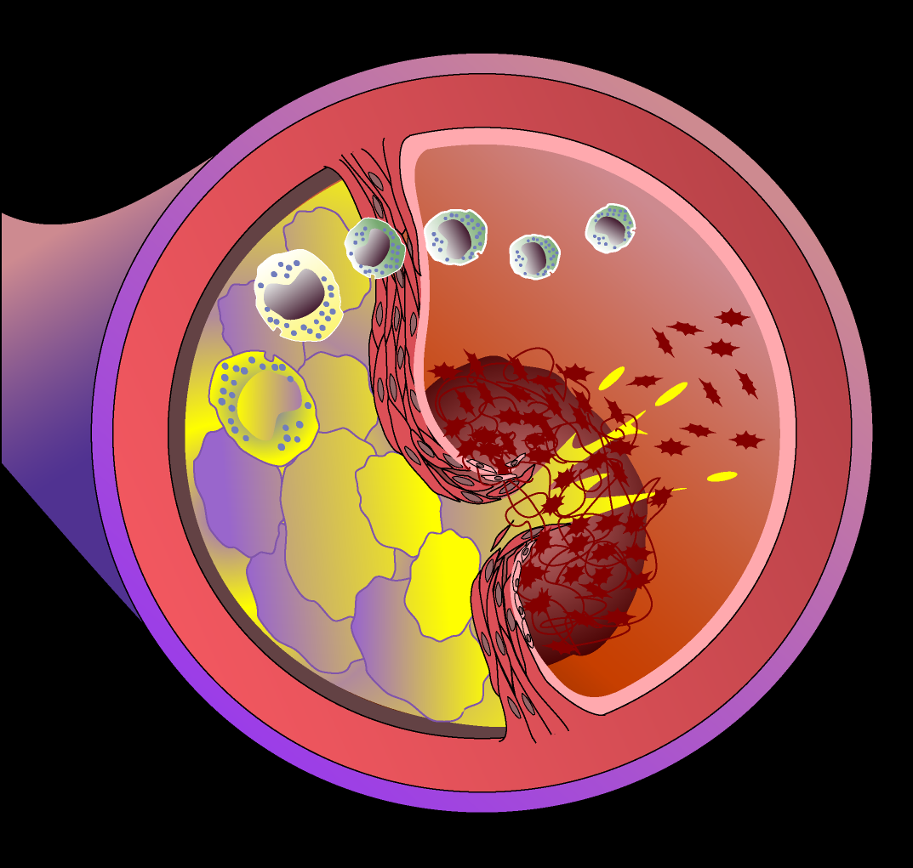
Background - 1
Insulin resistance
A physiological state in which a normal amount of insulin produces a subnormal cellular response.
Consequences:
Hyperinsulinemia
Hyperglycemia
Dyslipidemia
Inflammation
VSMC Proliferation
Endothelial Dysfunction
WN Kernan Neurology 2002;59:809

Slide 4
Background - 2
Insulin resistance
Is associated with increased risk for:
Stroke
Myocardial infarction
Diabetes
Affects > 50% non-diabetic stroke patients
Affects almost all patients with Type 2 DM

Slide 5
Research Aims
Among insulin resistant, non-diabetic patients with a recent ischemic stroke or TIA, to determine if the TZD, pioglitazone, compared with placebo, reduces risk for:
 | Primary Aim Stroke or MI | Secondary Aims Stroke alone Acute Coronary Syndrome Stroke, MI, or heart failure Diabetes Cognitive decline All-cause mortality

Slide 6
Design:
Randomized Clinical Trial
Eligibility: Ischemic stroke or TIA within 6 months
Age ≥ 40 years
Insulin resistance
No diabetes
No heart failure
No bladder cancer
Placebo
Pioglitazone
15mg→45 mg
5 years
Randomize
Outcomes
5 years

Slide 7
Homeostasis Model Assessment of Insulin Resistance (HOMA-IR)
HOMA-IR =
Fasting insulin (μU/ml) x Fasting glucose (mmol/L)
22.5
For IRIS, insulin resistance = HOMA-IR > 3.0

Slide 8
7634 Screened with HOMA Blood Test
2796 (37%)
Not Insulin Resistant
4865 (63%)
Insulin Resistant
564 Retracted consent
379 Excluded other reasons
3895 Randomized
1948 Pioglitazone
1947 Placebo
9 excluded
10 excluded
1939 Analyzed
1937 Analyzed

Slide 9
Baseline Features
 | Pioglitazone (N=1939) | Placebo (N=1937)
Age, mean years | 63.5 | 63.5
Male sex | 67% | 64%
Black race | 11% | 12%
Stroke at entry (vs. TIA) | 87% | 87%
NIHSS ≥ 5 | 5% | 4%
Atrial Fibrillation | 7% | 7%
Mean BMI, mean kg/m² | 29.9 | 30.0
Event to rand, median d. | 81 | 79

Slide 10
Primary Outcome
 | Pioglitazone (N=1939) |  | Placebo (N=1937)
 | % | (No.) | % | (No.) | Hazard Ratio (95% CI) | P
Stroke or MI | 9.0 | (175) | 11.8 | (228) | 0.76 (0.62, 0.93) | 0.007

Slide 11
Primary Outcome
Pioglitazone
Cumulative
Event-Free
Survival
Probability
Placebo
HR, 0.76; 95% CI, 0.62 to 0.93; P=0.007
0
Months in Trial

Slide 12
Secondary Outcomes
 | Pioglitazone (N=1939) |  | Placebo (N=1937)
Outcome* | % | (No.) | % | (No.) | Hazard Ratio (95% CI) | P
Stroke | 6.5 | (127) | 8.0 | (154) | 0.82 | 0.19
ACS | 5.0 | (96) | 6.6 | (128) | 0.75 | 0.11
Stroke/MI/HF | 10.6 | (206) | 12.9 | (249) | 0.82 | 0.11
DM | 3.8 | (73) | 7.7 | (149) | 0.48 | <.0001
Death | 7.0 | (136) | 7.5 | (146) | 0.93 | 0.52
*ACS=Acute coronary syndrome (unstable angina or MI). HF=heart failure

Slide 13
Three Glucose-Related Subgroups (Out of 13 total subgroups examined)
P-Value For Interaction
All Participants
IFG (≥100 mg/dL)
Present
Absent
0.11
HOMA
≥4.6
< 4.6
0.10
Glycated Hgb
≥5.7%
<5.7%
0.85
Pioglitazone Better Placebo Better

Slide 14
Serious Adverse Events*
 | # Participants
 | Pioglitazone (N=1939) |  | Placebo (N=1937)
Event | % (N) |  |  |  | P
Bone fracture† | 5.1 | (99) | 3.2 | (66) | <0.01
Heart failure† | 2.6 | (51) | 2.2 | (42) | 0.35
Incident cancer | 6.9 | (133) | 7.7 | (150) | 0.29
*Serious=life threatening or resulting in death, hospitalization, or persistent disability. †Previously reported to be associated with pioglitazone or drugs in its class.

Slide 15
Non-Serious Adverse Events
 | Pioglitazone (N=1939) | Placebo (N=1937)
Event | % (No. Participants) |  | P
Weight Gain†
At Year 4, mean | 2.6 kg | -0.5 kg | <0.01
New or worse edema† | 36 (691) | 25 (483) | <0.01
New or worse SOB† | 18 (342) | 15 (292) | 0.03
†Previously reported to be associated with pioglitazone or drugs in its class.

Slide 16
Summary
Among insulin resistant, non-diabetic patients with ischemic stroke or TIA, pioglitazone prevented:
Stroke or MI
Absolute Risk Reduction = 2.9%
Relative Risk Reduction = 24%
Diabetes
Absolute Risk Reduction = 3.9%
Relative Risk Reduction = 52%
However, serious bone fracture was more common with pioglitazone:
5.1% vs. 3.2% over 5 years

Slide 17
Conclusion
Insulin resistance affects the majority of non-diabetic patients with ischemic stroke or TIA.
For the first time, a therapy directed at insulin resistance has been shown to prevent cardiac and cerebrovascular events for these patients.

