Slide 1
Alcohol Use in Chronic Hepatitis C Infection
Lamia Haque
WHAT-IF Session
July 2019

Slide 2
Background
Alcohol and hepatitis C infection (HCV) have synergistic effects
Risk of cirrhosis and HCC greater in patients with HCV who drink heavily^{1,2,3}
Patients with alcohol use disorder with HCV have poorer outcomes than those without HCV⁴
HCV-infected individuals in the US are more likely to drink unhealthy amounts of alcohol^{5,6}
¹Corrao and Arico, 1998
²Donato et al., 2002
³Hutchinson et al., 2005
⁴Tsui et al., 2006
⁵Armstrong et al., 2006
⁶Taylor et al., 2016

Slide 3
Background
Patient with HCV who drink alcohol are less likely to be treated for HCV⁷
Providers may not offer HCV treatment in patients who continue to drink⁸
Insurance companies may require period of sustained abstinence⁸
Evidence regarding the effect of alcohol on HCV treatment outcomes is mixed^{7,9,10,11}
Alcohol may increase the risk of liver cancer in the presence of HCV infection, diabetes, and tobacco exposure¹²
⁷Anand et al., 2006
⁸Barua et al., 2015
⁹Bruggmann et al., 2010
¹⁰Costentin et al., 2013
¹¹Russell et al., 2012
¹²Matsushita et al. 2019

Slide 4
HCV Treatment with Direct Acting Antivirals
https://www.hcvguidelines.org/

Slide 5
HCV Treatment with Direct Acting Antivirals
https://www.hepatitisc.uw.edu/go/treatment-infection/treatment-genotype-2/core-concept/all

Slide 6
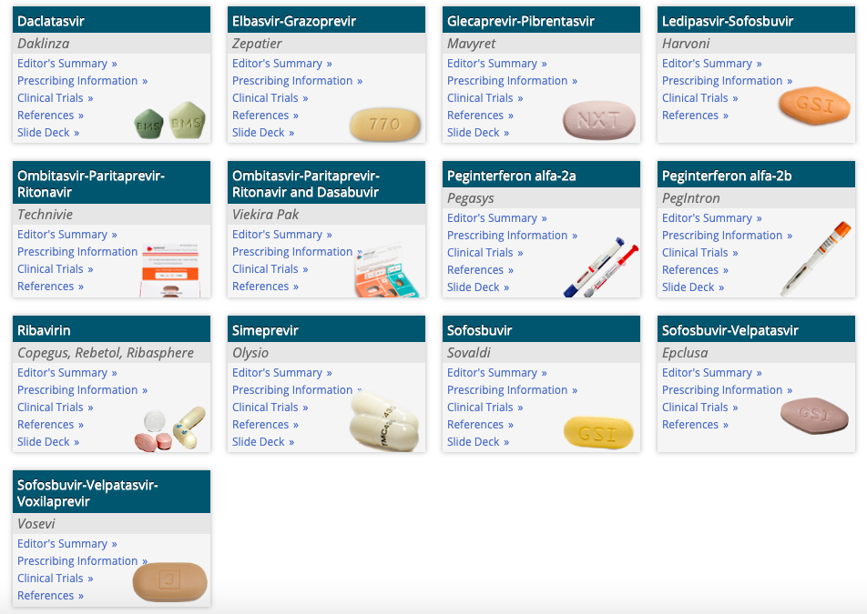
HCV Treatment with Direct Acting Antivirals

Slide 7
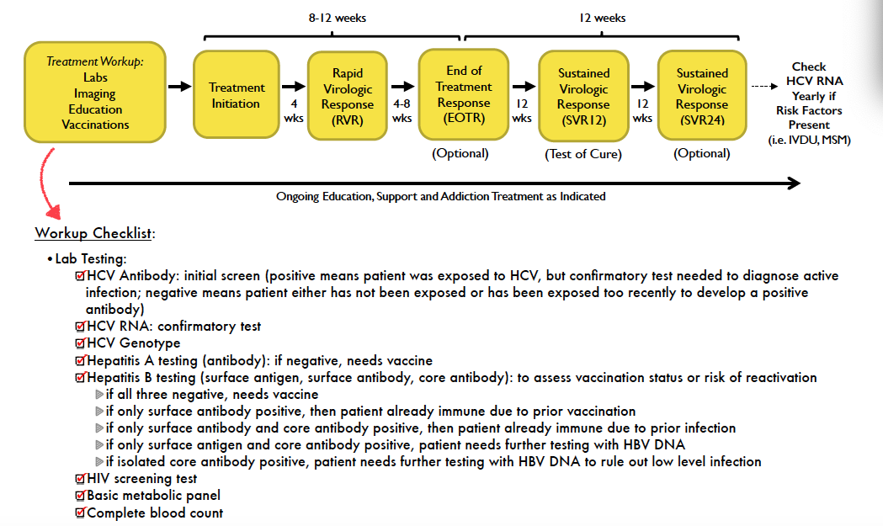
HCV Treatment with Direct Acting Antivirals

Slide 8
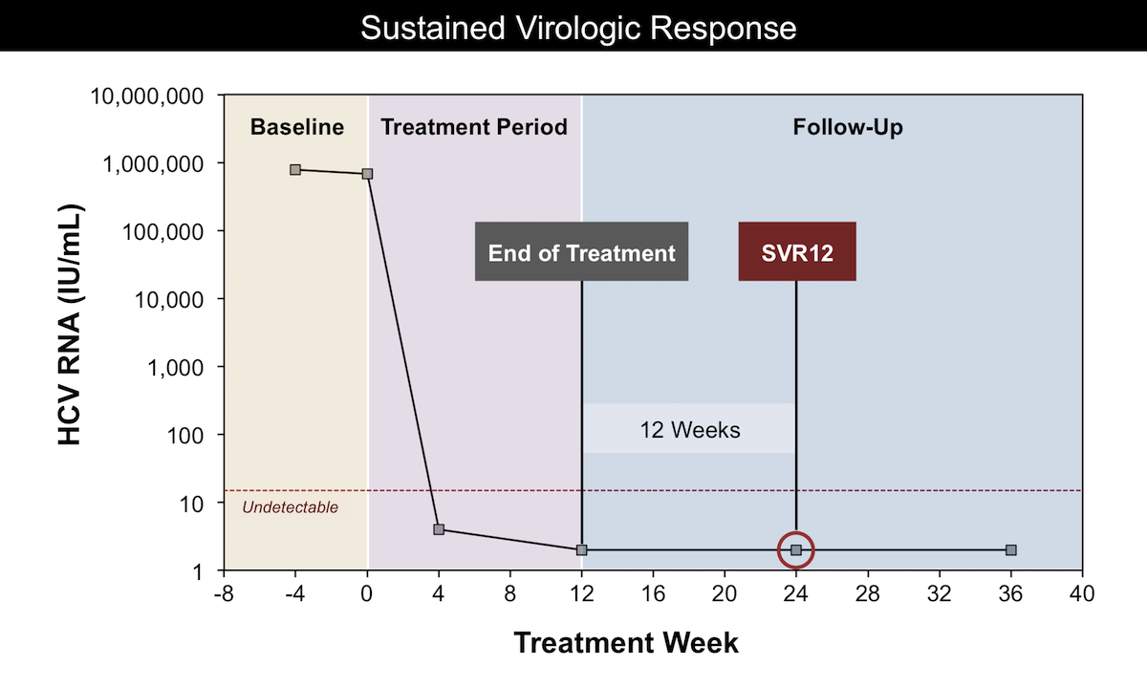
https://www.hepatitisc.uw.edu/go/evaluation-treatment/treatment-addressing-substance-alcohol-use/core-concept/all
HCV Treatment with Direct Acting Antivirals

Slide 9
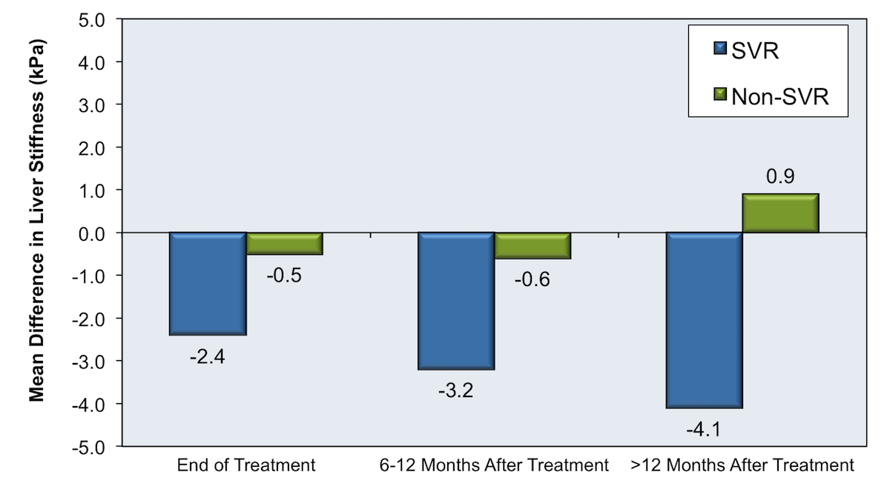
https://www.hepatitisc.uw.edu/go/evaluation-treatment/treatment-addressing-substance-alcohol-use/core-concept/all
HCV Treatment with Direct Acting Antivirals

Slide 10
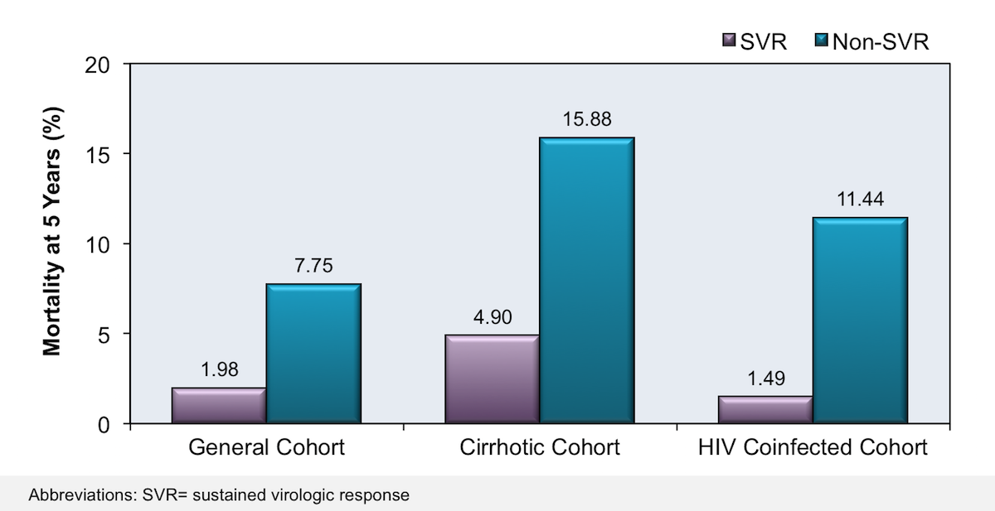
https://www.hepatitisc.uw.edu/go/evaluation-treatment/treatment-addressing-substance-alcohol-use/core-concept/all
HCV Treatment with Direct Acting Antivirals

Slide 11
HCV/HIV Co-infection
Both liver-related and overall mortality is higher in patients with HIV/HCV co-infection than in HCV mono-infected individuals
Presence of HIV independently associated with development of advanced fibrosis and cirrhosis
HCV treatment should be prioritized in HIV-infected patients
Efficacy and adverse event rates of DAA therapy are similar between HCV mono-infected and HIV/HCV co-infected individuals
Special attention should be paid to HCV medication interactions with antiretroviral medications as well as risk of HBV reactivation in previously exposed patients
https://www.hcvguidelines.org/unique-populations/hiv-hcv

Slide 12
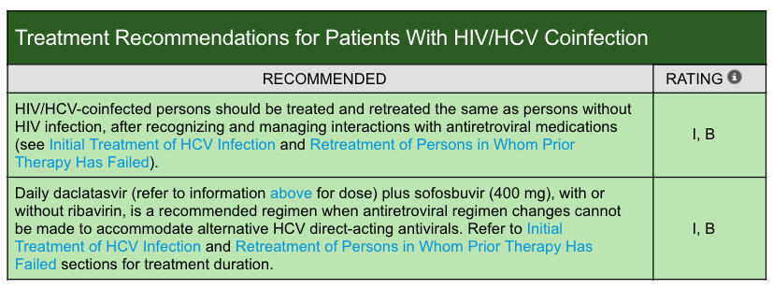
HCV/HIV Co-infection
https://www.hcvguidelines.org/unique-populations/hiv-hcv

Slide 13
HCV Infection and Alcohol Use

Slide 14
Study Question
What is the association between levels of alcohol intake and treatment outcomes among patients with HCV treated with DAAs?
J. Tsui, E. Williams, P. Green, K. Berry, F. Su and G. Ioannou, Drug and Alcohol Dependence, 2016

Slide 15
Study Design
Veterans Health Administration national sample
Largest integrated health care provider of patients with HCV
Annual alcohol screening in all patients since 2004
Data from VHA Corporate Data Warehouse mirrors medical record
Inclusion criteria
Active HCV infection
Initiated DAA therapy within 18-month period
Received sofosbuvir (SOF), ledipasvir/sofosbuvir, (LDV/SOF), or ombitasvir-paritaprevir- ritonavir/dasabuvir (PrOD) - all IFN free except SOF-IFN-RIBA for genotype 3
Completed standard alcohol screening with AUDIT-C within one year prior to initiating DAA
J. Tsui, E. Williams, P. Green, K. Berry, F. Su and G. Ioannou, Drug and Alcohol Dependence, 2016

Slide 16
AUDIT-C
Three item alcohol screen that identifies unhealthy drinking
Modified version of 10-question AUDIT instrument
Scored on scale of 0-12 (a = 0, b = 1, c = 2, d = 3, e = 4)
1. How often do you have a drink containing alcohol?
never b. monthly or less c. 2-4x/mo d. 2-3x/wk e. 4x or more/wk
2. How many standard drinks containing alcohol do you have on a typical day?
a. 1 or 2 b. 3 or 4 c. 5 or 6 d. 7 to 9 e. 10 or more
3. How often do you have six or more drinks on one occasion?
a. never b. less than monthly c. monthly d. weekly e. daily or almost daily

Slide 17
Outcomes
Primary outcome: SVR
Undetectable viral load at 12 or more weeks after treatment end
If SVR12 data missing, SVR at 4-12 weeks used
Primary independent variable: alcohol use severity
AUDIT-C validated screening tool for identifying unhealthy alcohol use
Annual screen for all outpatients at VHA
Higher score associated with likelihood of alcohol-related consequences
Abstinence = 0
Low Level Drinking = 1-3 for men, 1-2 for women
Unhealthy Drinking = 4-12 for men, 3-12 for women (further subdivided into 3 or 4 to 9 and 10-12)
J. Tsui, E. Williams, P. Green, K. Berry, F. Su and G. Ioannou, Drug and Alcohol Dependence, 2016

Slide 18
Variables Assessed
Demographics
Prior antiviral treatment
Duration of therapy
Genotype
HCV viral load
Presence of cirrhosis*
Presence of substance use disorders*
Other comorbidities*
*ICD9-based definitions validated in other VHA studies were used.
J. Tsui, E. Williams, P. Green, K. Berry, F. Su and G. Ioannou, Drug and Alcohol Dependence, 2016

Slide 19
Data Analysis
Unadjusted rates of SVR by level of alcohol use with 95% CI
Multivariate logistic regression to evaluate association between SVR rates and levels of alcohol use adjusting for variables associated with alcohol use and SVR including: age, gender, race/ethnicity, genotype, viral load, treatment regimen, cirrhosis, decompensated cirrhosis, HCC, liver transplant, prior treatment, platelet count, bilirubin, albumin, HIV, DM
Analyses done with and without missing SVR data using imputations
J. Tsui, E. Williams, P. Green, K. Berry, F. Su and G. Ioannou, Drug and Alcohol Dependence, 2016

Slide 20
Table 1: Baseline Characteristics
87% of all patients who initiated HCV tx completed AUDIT-C
J. Tsui, E. Williams, P. Green, K. Berry, F. Su and G. Ioannou, Drug and Alcohol Dependence, 2016

Slide 21
Table 1: Baseline Characteristics (continued)
J. Tsui, E. Williams, P. Green, K. Berry, F. Su and G. Ioannou, Drug and Alcohol Dependence, 2016

Slide 22
Figure 1: SVR Rates by AUDIT-C Category and Genotype
SVR data available for 91% of patients.
No significant difference between rates of SVR by level of alcohol use.
J. Tsui, E. Williams, P. Green, K. Berry, F. Su and G. Ioannou, Drug and Alcohol Dependence, 2016

Slide 23
Figure 1: SVR Rates by AUDIT-C Category by HIV Status and Presence of Cirrhosis
No significant difference in rates of SVR by level of alcohol use.
J. Tsui, E. Williams, P. Green, K. Berry, F. Su and G. Ioannou, Drug and Alcohol Dependence, 2016

Slide 24
Table 2: Proportion with SVR by AUDIT-C Category
J. Tsui, E. Williams, P. Green, K. Berry, F. Su and G. Ioannou, Drug and Alcohol Dependence, 2016

Slide 25
Table 2: Proportion with SVR by AUDIT-C Category (continued)
No significant difference between rate of SVR by level of alcohol use.
J. Tsui, E. Williams, P. Green, K. Berry, F. Su and G. Ioannou, Drug and Alcohol Dependence, 2016

Slide 26
Table 3: Adjusted Odds Ratio for SVR Associated with AUDIT-C
No significant difference between rate of SVR by level of alcohol use.
J. Tsui, E. Williams, P. Green, K. Berry, F. Su and G. Ioannou, Drug and Alcohol Dependence, 2016

Slide 27
Early Discontinuation of Therapy
Early discontinuation of treatment more common in unhealthy alcohol use (6.2%) compared to low level drinking (4.8%) or abstinence (5.7%).
For those with available SVR data (91%), early treatment discontinuation occurred more frequently in unhealthy alcohol use (3.1%) than low level drinking (2.8%) and abstinence (1.8%).
Mean duration of therapy similar among groups, ranging between 82 – 88 days.
J. Tsui, E. Williams, P. Green, K. Berry, F. Su and G. Ioannou, Drug and Alcohol Dependence, 2016

Slide 28
Missing SVR Data
Data missing for 1,409 out of 15,151 patients (9.3%).
Missing SVR data more common in patients with unhealthy alcohol use (12.9%) compared to low-level use (9.8%) or abstinence (8.7%).
Patients with missing SVR data similar to remainder of sample in regards to baseline characteristics.
Most patients with missing SVR data completed > 8 weeks of treatment (75%).
Multiple imputations done using logistic regression model that included duration of treatment in addition to variables in previous model.
SVR rates between patients with available data and patients with available + imputed data compared.
J. Tsui, E. Williams, P. Green, K. Berry, F. Su and G. Ioannou, Drug and Alcohol Dependence, 2016

Slide 29
Table 4: Comparison of Observed SVR among Patients with Available SVR Data and Combined Observed/Imputed SVR Among All Patients who Initiated Antiviral Therapy
J. Tsui, E. Williams, P. Green, K. Berry, F. Su and G. Ioannou, Drug and Alcohol Dependence, 2016

Slide 30
Table 5: Percentage Achieving SVR and AOR for SVR Associated with Levels of Drinking Among Patients with Observed SVR Data Compared to Observed/Imputed Data
Multivariate regression including imputed data showed that patients with unhealthy drinking were significantly less likely to achieve SVR than those with abstinence.
J. Tsui, E. Williams, P. Green, K. Berry, F. Su and G. Ioannou, Drug and Alcohol Dependence, 2016

Slide 31
Limitations of Data
Missing SVR data (addressed using imputation models)
AUDIT-C screening data may not reflect true levels of alcohol intake and may vary in quality
AUDIT-C not done immediately at time of HCV treatment initiation (although this may lead to more truthful answers)
Study sample predominantly male veterans
Observational design and unmeasured confounders
J. Tsui, E. Williams, P. Green, K. Berry, F. Su and G. Ioannou, Drug and Alcohol Dependence, 2016

Slide 32
Key Findings
Most patients in sample were abstinent (69%) but many were low level (23%) or unhealthy (9%) drinkers
High rates of cure overall despite degree of alcohol intake
92% in abstinent (91% with missing data)
93% in low-risk alcohol use (92% with missing data)
91% in unhealthy alcohol use (89% with missing data)
Unhealthy alcohol use associated with lower likelihood of SVR when taking into account missing data (AOR = 0.75)
Vast majority of patients will be cured despite drinking status
Evidence does not support excluding patients from HCV treatment based on drinking status
J. Tsui, E. Williams, P. Green, K. Berry, F. Su and G. Ioannou, Drug and Alcohol Dependence, 2016

Slide 33
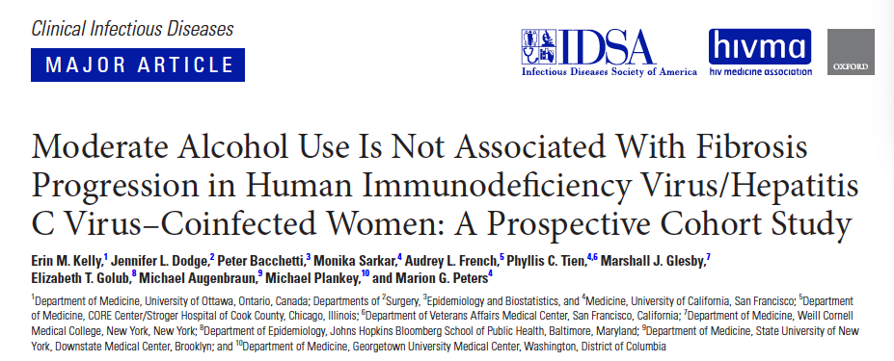
Alcohol Use in HIV/HCV Coinfection

Slide 34
Research Question
What is the impact of moderate alcohol use on liver fibrosis progression in a well-characterized cohort of women coinfected with HIV and HCV?
E. Kelly, J. Dodge, P. Bacchetti, M. Sarkar … and M. Peters, Clinical Infectious Diseases, 2017

Slide 35
Study Design
Women’s Interagency HIV Study (WIHS)
Prospective, multicenter, longitudinal observational cohort study
Adult women infected with HIV or at high risk of acquiring HIV
Subset of HIV/HCV coinfected participants included (n=686)
Methods
Patients seen every 6 months
Sociodemographic, medical and behavioral data collected
Creatinine, LFT, CBC, CD4, HIV viral load, HCV RNA checked every 6 months
Alcohol intake defined by average number of drinks per week in preceding 6-month interval
E. Kelly, J. Dodge, P. Bacchetti, M. Sarkar … and M. Peters, Clinical Infectious Diseases, 2017

Slide 36
Outcomes
Primary outcome: rate of fibrosis progression defined as change in FIB-4/year
Calculated annually
Considered invalid if AST or ALT > 10x upper limit of normal or platelet counts < 25,000
No fibrosis: <1.5
Significant fibrosis: >3.25
Primary independent variable: alcohol use
Light use: 1-3 drinks per week
Moderate use: 4-7 drinks per week
Heavy use: >7 drinks per week (sub-categorized into 8-14 drinks per week and >14 drinks per week)
Abstinent: no alcohol at entry and in all follow up visits
E. Kelly, J. Dodge, P. Bacchetti, M. Sarkar … and M. Peters, Clinical Infectious Diseases, 2017

Slide 37
https://www.hepatitisc.uw.edu/page/clinical-calculators/fib-4

Slide 38
Data Analysis
Modeled FIB-4 measurements as random-intercept, random-slope regression
Modeled effect of alcohol consumption in terms of cumulative years spent in each non-abstinent category up to each FIB-4 measurement
Imputation of missing data never exceeded one year
Excluded all observations that occurred after a woman started HCV treatment or had undetectable HCV viral load
E. Kelly, J. Dodge, P. Bacchetti, M. Sarkar … and M. Peters, Clinical Infectious Diseases, 2017

Slide 39
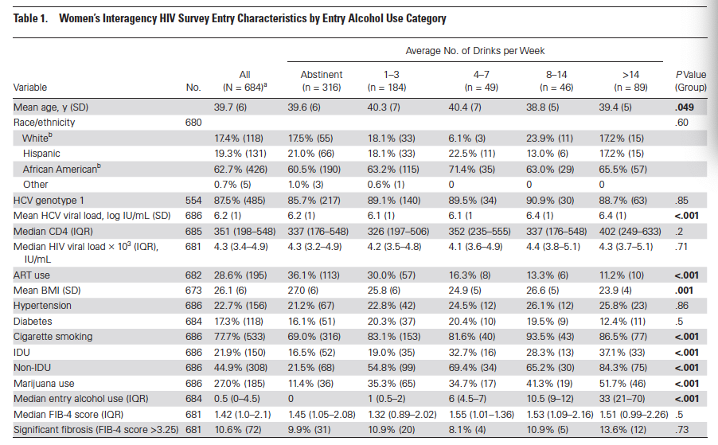
E. Kelly, J. Dodge, P. Bacchetti, M. Sarkar … and M. Peters, Clinical Infectious Diseases, 2017

Slide 40
E. Kelly, J. Dodge, P. Bacchetti, M. Sarkar … and M. Peters, Clinical Infectious Diseases, 2017

Slide 41
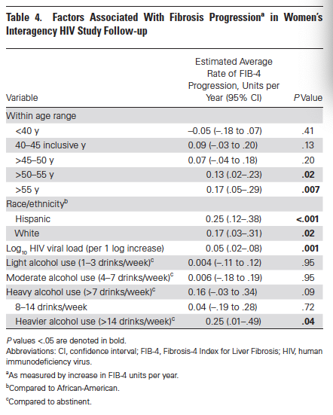
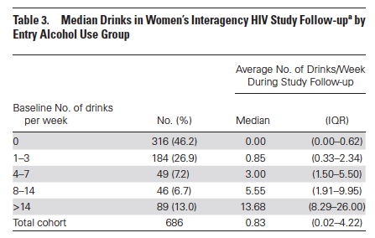
E. Kelly, J. Dodge, P. Bacchetti, M. Sarkar … and M. Peters, Clinical Infectious Diseases, 2017

Slide 42
Limitations of Data
Lifetime alcohol exposure not assessed
Women categorized as abstinent may have had prior exposure
Some may have been “sick abstainers” due to severity of illness
Alcohol intake determined via self report
FIB-4 is less accurate than transient elastography or liver biopsy
E. Kelly, J. Dodge, P. Bacchetti, M. Sarkar … and M. Peters, Clinical Infectious Diseases, 2017

Slide 43
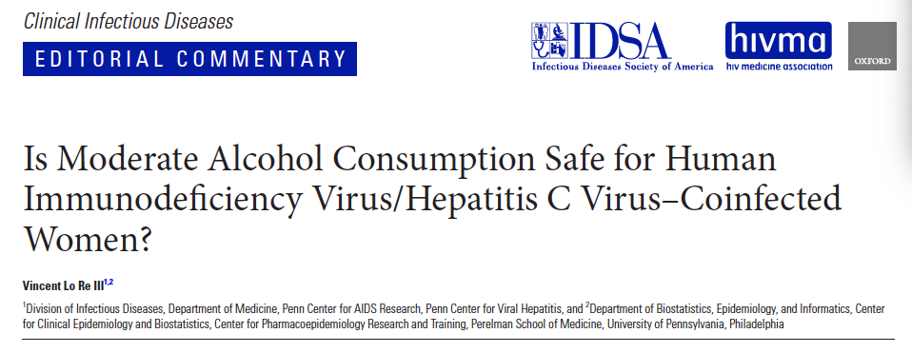
Key Findings
Light and moderate alcohol use (7 or fewer drinks per week) not shown to substantially increase liver fibrosis progression
Heavy alcohol use was associated with accelerated liver damage
E. Kelly, J. Dodge, P. Bacchetti, M. Sarkar … and M. Peters, Clinical Infectious Diseases, 2017

Slide 44
Conclusions
Patients with HCV infection have higher rates of alcohol use
Alcohol intake is not a contraindication to HCV treatment - unhealthy alcohol use may reduce likelihood of cure slightly but overall cure rates are still high
Heavy or unhealthy alcohol intake accelerates liver disease progression in HCV so patients should be counselled accordingly – abstinence is recommended since a safe limit has not been established
Harm reduction approaches are important in helping patients with HIV/HCV coinfection cut down on alcohol intake

Slide 45
References
AASLD and IDSA. (2018). HCV Guidance: Recommendations for Testing, Managing, and Treating Hepatitis C. Available at: http://www.hcvguidelines.org.
Anand BS, Currie S, Dieperink E et al. (2006). Alcohol use and treatment of hepatitis C virus: results of a national multicenter study. Gastroenterology. 130, 1607-16.
Armstrong GL, Wasley A, Simard EP et al. (2002). The prevalence of hepatitis C virus infection in the United States, 1999 through 2002. Annals of Internal Medicine. 144, 705-14.
Barua S, Greenwald R, Grebely J et al. (2015). Restrictions for Medicaid reimbursement of sofosbuvir for the treatment of hepatitis C virus infection in the United States. Annals of Internal Medicine. 163, 215-33.
Bruggmann P, Dampz M, Gerlach T et al. (2010). Treatment outcome in relation to alcohol consumption during hepatitis C therapy: an analysis of the Swiss Hepatitis C Cohort Study. Drug and Alcohol Dependence. 110, 167-71.
Corrao G, Arico S. (1998). Independent and combined action of hepatitis C virus infection and alcohol consumption on the risk of symptomatic liver cirrhosis. Hepatology. 27, 914-19.
Costentin CE, Trabut JB, Mallet V et al. Management of hepatitis C virus infection in heavy drinkers. Alcohol. 48, 337-42.
Donato F, Tagger A, Gelatti U et al. (2002). Alcohol and hepatocellular carcinoma: the effect of lifetime intake and hepatitis virus infections in men and women. American Journal of Epidemiology. 155, 323-31.

Slide 46
References
Hutchinson SJ, Bird SM, Goldberg DJ. (2005). Influence of alcohol on the progression of hepatitis C virus infection: a meta-analysis. Clinical Gastroenterology and Hepatology. 3, 1150-9.
Kelly EM, Dodge JL, Bacchetti P, Sarkar M, French AL et al. (2017). Moderate alcohol use is not associated with fibrosis progression in HIV/HCV-coninfected women: a prospective cohort study. Clinical Infectious Diseases. 65, 2050-6.
Matsushita H, Takaki A. (2019). Alcohol and hepatocellular carcinoma. BMJ Open Gastroenterology; 6:e000260.
Russell M, Pauly MP, Moore CD et al. (2012). The impact of lifetime alcohol use on hepatitis C treatment outcomes in privately insured members of an integrated health plan. Hepatology. 56, 1223-30.
Szabo G, Aloman C, Polyak SJ et al. (2006). Hepatits C infection and alcohol use: a dangerous mix for the liver and antiviral immunity. Alcoholism: Clinical and Experimental Research. 30, 709-19.
Taylor AL, Denniston MM, Klevens RM et al. (2016). Association of hepatitis C virus with alcohol use among U.S. adults: NHANES 2003-2010. American Journal of Preventive Medicine. 51, 206-15.
Tsui JI, Pletcher MJ, Vittinghoff E et al. (2006). Hepatitis C and hospital outcomes in patients admitted with alcohol-related problems. Journal of Hepatology. 44, 262-6.
Williams EC, Rubinsky AD, Lapham GT et al. (2014). Prevalence of clinically recognized alcohol and other substance use disorders among VA outpatients with unhealthy alcohol use identified by routine alcohol screening. Drug and Alcohol Dependence. 135, 95-103.

