Slide 1
Stigma and the Changing Language of Addiction
October 9, 2019
Kenneth Morford, MD, FASAM
WHAT-IF? Learning Collaborative

Slide 2
No conflicts of interest to disclose.
But…I’d like to acknowledge Drs. Jeanette Tetrault and Stephen Holt for helping develop the content for this talk.

Slide 3
What is addiction?
Notes:
Our understanding of addiction has changed dramatically over the past 100 years, so we’d like to start by taking on a brief journey into the past to see how it’s evolved.

Slide 4
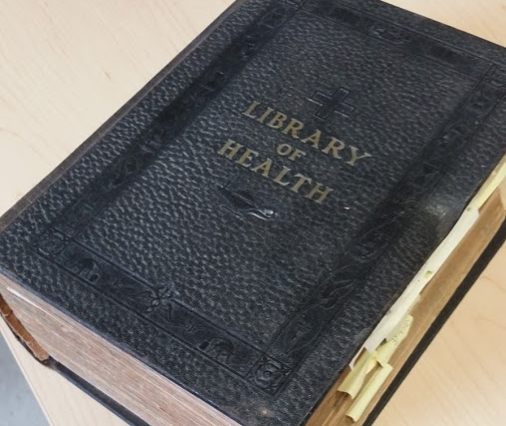
Notes:
The Library of Health, first published in 1916, essentially functioned as an early 20th century precursor of today’s WebMD. You can imagine it might have graced the bookshelves of many family homes across the country, serving as a trusted resource for how to diagnose and treatment countless ailments of the time. A whole section is devoted to “Alcoholism” – I’m going to read to you a brief excerpt

Slide 5
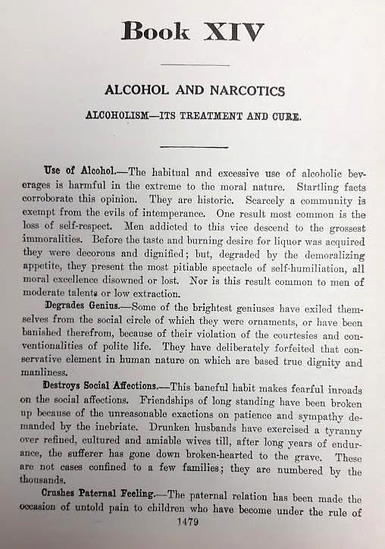
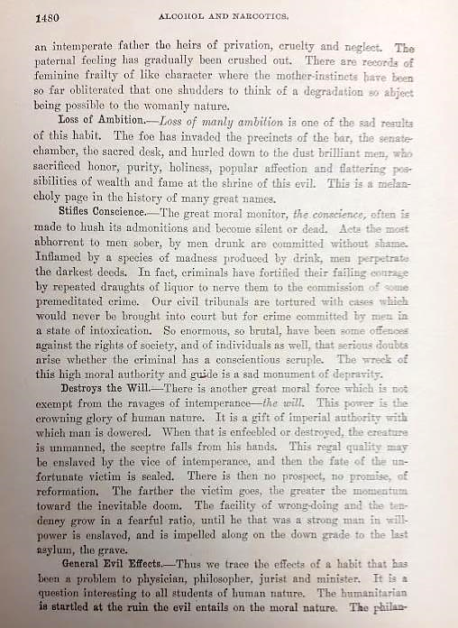
Notes:
While this passage accurately describes many of the very real consequences of severe AUD, in just a handful of sentences, you get a very clear sense of how society viewed AUD as a purely moralistic problem, a disease of the will and even the conscience. Today, despite over 60 years of research on the neurochemical changes that lead to sustained addiction, this moralistic perspective still in many ways contributes to the stigmatization of addiction, and hampers the acceptance of evidence-based treatment, by both patients and providers alike.

Slide 6
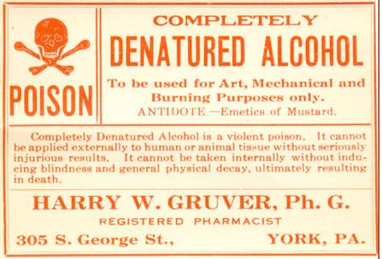
U.S. Prohibition Alcohol Deaths (1920-1933)
In 1927, the US government created a new formula for denaturing industrial alcohol doubling it’s toxicity:
“4 parts methanol (wood alcohol), 2.25 parts pyridine bases, 0.5 parts benzene to 100 parts ethyl alcohol”
“Three ordinary drinks of this may cause blindness.”
“The person who drinks this industrial alcohol is a deliberate suicide… To root out a bad habit costs many lives and long years of effort…” said Wayne B. Wheeler.
Large-scale fatalities followed. In 1928, 33 died in Manhattan in 3 days from drinking the new formula.
https://time.com/3665643/deadly-drinking/
Notes:
The whole thing started when Prohibition began in 1920. Despite the new law, unsurprisingly, people kept drinking. So, as TIME reported in the Jan. 10, 1927, issue, a solution emerged from the anti-drinking forces in the government: that year, a new formula for denaturing industrial-grade alcohol was introduced, doubling how poisonous the product became. The new formula included “4 parts methanol (wood alcohol), 2.25 parts pyridine bases, 0.5 parts benzene to 100 parts ethyl alcohol” and, as TIME noted, “Three ordinary drinks of this may cause blindness.” (In case you didn’t guess, “blind drink” isn’t just a figure of speech.)
Not everyone thought it was a good idea to make alcohol deadly, when making it illegal hadn’t stopped drinkers, and New Jersey Senator Edward I. Edwards called it “legalized murder.” However, the Anti-Saloon League persisted, arguing that legal alcohol had killed many more in its day than denatured alcohol would kill during the transition to a teetotaling world. “The Government is under no obligation to furnish the people with alcohol that is drinkable when the Constitution prohibits it,” said advocate Wayne B. Wheeler. “The person who drinks this industrial alcohol is a deliberate suicide… To root out a bad habit costs many lives and long years of effort…”

Slide 7
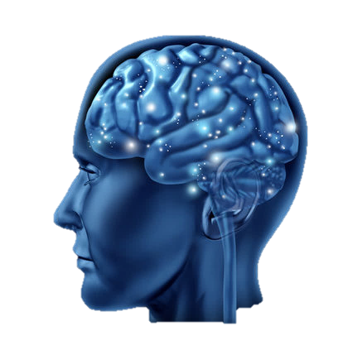
What is addiction?
Chronic disease
Dysfunction in neurobiogical circuits
Pathologic pursuit of reward
Impairment in behavioral control
Cycles of return to use and remission
Progressive
Disability or premature death
www.asam.org
Notes:
Addiction, as defined by the American Society of Addiction Medicine, is a primary, chronic disease of brain reward and related circuitry. Dysfunction in these neurobiological circuits leads to characteristic biological and psychological manifestations. This is reflected in pathologic pursuit of reward by substance use. Addiction is characterized by impairment in behavioral control and involves cycles of relapse and remission. Without treatment addiction is progressive and can result in disability or premature death.

Slide 8
Substance use disorder from DSM-5
Control
-Larger quantity over longer period of time
-Unsuccessful attempts to cutback or control
-Increased time spent
Consequences -Failure to fulfill major obligations
-Social/Interpersonal problems
-Activities given up
-Use in hazardous situations
-Physical & psychological consequences
Craving
-Craving
-Tolerance
-Withdrawal
The Three C’s
Diagnosis:
2 or more in the prior 12 months
Characterization:
2-3 = mild
4-5 = moderate
6 or more = severe
8
Notes:
SUD on the other hand, is a more technical term defined by the DSM 5. There are 11 criteria which can be thought of as the three C’s—craving or physiologic criteria of tolerance and withdrawal, loss of control, and consequences related to substance use. The disorder is characterized by mild, moderate or severe based on number of criteria a patient meets.

Slide 9
Definitions
Substance use = any use of a substance for medical or nonmedical purposes
Substance misuse = nonmedical use of substances
Addiction = Substance Use Disorder (SUD)
Person with SUD ✓
Addict, junkie, drug abuser, dope fiend
Alcoholic, drunk

Slide 10
Only 1 in 10 people with addiction receive care
Stigma
Lack of provider education

Slide 11
Only 1 in 10 people with addiction receive care
Stigma
Lack of provider education

Slide 12
Stigma
A mark or disgrace associated with a particular circumstance, quality or person
An attribute that is deeply discrediting and that reduces the bearer from a whole and usual person to a tainted, discounted one
Erving Goffman. Stigma: Notes on the Management of Spoiled Identity, 1963
Notes:
Stigma: Notes on the Management of Spoiled Identity
Erving Goffman, 1963

Slide 13
Process of Producing Stigma
STIGMA
Label Human Differences
“Them” vs. “Us”
Discrimination
Exercise of power
Stereotyping
Link, BG Lancet 2006
Notes:
5 interrelated components…
Identifying or labeling human differences—social selection process determining which differences are deemed relevant and consequential and which are not.
Process of stereotyping in which the labelled person is linked to undesirable characteristics
The group doing the labelling separates “them” from “us.”
Stigmatized people experience discrimination and loss of status
Exercise of power

Slide 14
The Importance of Language
The words we use to describe people with substance use disorder have an impact
Contribute to stigma
Create barriers to accessing effective treatment
Influence outcomes, including overdose
CORE

Slide 15
Not hard to find media sources with stigmatizing language
“Addict”
“Abuser”
“Junkie”
“Needs to get clean”
“Still using methadone”
“Addicted babies”
“He was kicked out for a dirty urine”

Slide 16
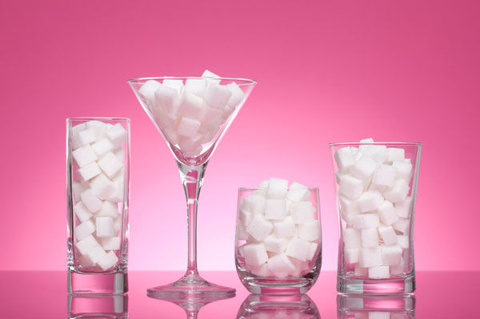
Is diabetes sugar abuse?

Slide 17
Does it really matter? Are we just being politically correct?

Slide 18
Do words matter to professionals?
516 mental health professionals read one of two vignettes and were asked to complete a questionnaire.
The vignettes were identical except in one vignette the individual is referred to as a “substance abuser” and in the other they are referred to as an “individual with a substance use disorder”
Kelly, JF,. 2010 Int Journal of Drug Policy

Slide 19
Yes…words matter to professionals
Mental health professionals who read the vignette of the patient identified as a “substance abuser” were more likely to agree that:
The person was culpable
Punitive measures should be taken
Kelly, JF,. 2010 Int Journal of Drug Policy
Notes:
No differences on the social threat or treatment subscales
the solution to his substance-related problems lie within the moral and not medical realm

Slide 20
Do words matter to the public?
314 lay persons were asked to complete a questionnaire comparing recommendations for two individuals.
One person in the narrative is identified as a “substance abuser” and the other is identified as having a “substance use disorder”.
Kelly JF et al, J Drug Issues 2010

Slide 21
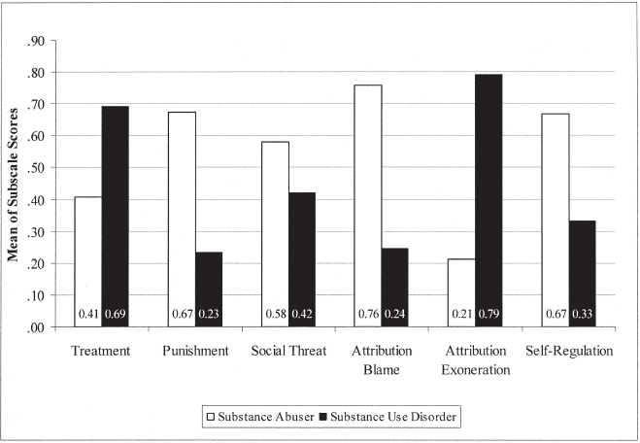
Yes…words matter to the public
“Substance Abuser”
Recommended for punishment - benefit from a jail “wake up call”
Perceived as a greater social threat
Have a personality problem
Should overcome problem without professional help
“Person with SUD”
Recommended for treatment or a psychiatrist
Have a problem that is related to genetics or chemical imbalance
Kelly JF et al, J Drug Issues 2010

Slide 22
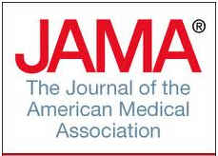
Efforts to Change Language
JAMA 2016 Oct 4;316(13):1361-1362
Notes:
Our duty as medical providers is to first….do no harm….primum non nocere.
As part of that, we need to recognize that our words matter. In this viewpoint piece published in the Journal of the American Medical Association, by the previous director of the ONDCP, Michael Botticelli, he states that in the scientific arena, the vocabulary of health care professionals and researchers frames illness and shapes medical judgements and when these terms enter the public arena they convey social norms and attitudes. In the wake of an addiction epidemic, it is imperative now, more than ever, that we are very careful to avoid stigmatizing language in BOTH the medical arena and the public arena-- as it is often this very stigma that serves as the barrier that prevents people suffering from this chronic brain disease from seeking treatment

Slide 23
Principles for Language in Addiction
Use person-first language
Avoid stigmatizing terminology
Use medically accurate terms for
The patient
The condition
The treatment
Notes:
A human is not defined by their disease.

Slide 24
Word choices
Avoid these terms… | Use these instead…
Addict, user, drug abuser, junkie, alcoholic | Person with opioid use or patient with alcohol use disorder
Addicted baby | Baby born with neonatal abstinence syndrome
Substance abuse or dependence | Substance use disorder
Habit | Drug addiction
Clean or dirty urine test | Negative (appropriate) or positive (inappropriate) urine drug test
Medication Assisted Treatment (MAT) | Medications for Addiction Treatment (MAT)
Opioid substitution therapy | Opioid agonist treatment -> Medications for OUD
Treatment failure | Treatment attempt
Being clean | Being in remission or recovery

Slide 25
Take Home Message
Use accurate language to describe patients, conditions, and treatments related to substance use
Notes:
Use accurate language when describing patients, conditions and treatments related to substance use and addiction. It decreases stigma and can promote access to treatment.

Slide 26
Questions, Comments and Discussion

