Slide 1
The Role of Advanced Practice Providers in Treating Opioid Use Disorder
Katie Clark CHER Solutions, LLC
MSPH, CADC
The George Washington University
Translational Health Sciences

Slide 2
Brief Intro
Social Service Provider 1998-2010
Formal Education
Research Consulting

Slide 3
Opioid Epidemic Background

Slide 4
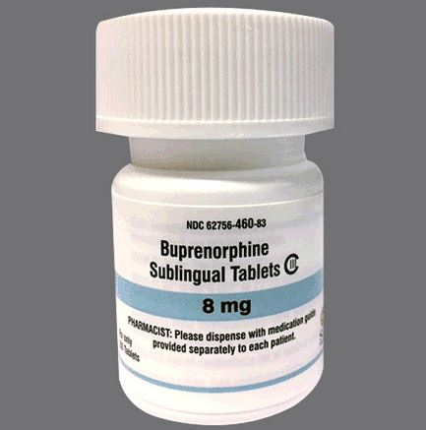
Brief History
DATA 2000
Office-based Opioid Treatment (OBOT)
2002
FDA approval buprenorphine for OBOT
Physician only
Limited uptake
Restricted access

Slide 5
Brief History-Cont.
TREAT Act 2015
NP/PA
“practice under the supervision of a licensed physician who holds an active waiver for opioid addiction therapy”
Prescribe opioid therapy “in collaboration with a physician who holds an active waiver.”
Advocacy for change
CARA 2016
NP/PA
“supervision if required by state law”
Waiver- 24 hours of training
2021 reevaluation of law

Slide 6
Opportunities
Practice Evaluation
Abilities of APP to manage OBOT
Expansion of treatment
Access to treatment
Policy Evaluation
24 hours?
8 hours?

Slide 7
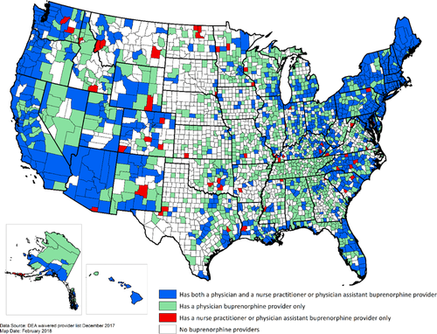
Geographic Distribution of Providers With a DEA Waiver to Prescribe Buprenorphine for the Treatment of Opioid Use Disorder: A 5‐Year Update
“NPs and PAs add otherwise lacking treatment availability in 56 counties (43 rural)”
The Journal of Rural Health, Volume: 35, Issue: 1, Pages: 108-112, First published: 20 June 2018, DOI: (10.1111/jrh.12307)
Notes:
US Counties With Providers With a DEA Waiver to Prescribe Buprenorphine.
IF THIS IMAGE HAS BEEN PROVIDED BY OR IS OWNED BY A THIRD PARTY, AS INDICATED IN THE CAPTION LINE, THEN FURTHER PERMISSION MAY BE NEEDED BEFORE ANY FURTHER USE. PLEASE CONTACT WILEY'S PERMISSIONS DEPARTMENT ON PERMISSIONS@WILEY.COM OR USE THE RIGHTSLINK SERVICE BY CLICKING ON THE 'REQUEST PERMISSIONS' LINK ACCOMPANYING THIS ARTICLE. WILEY OR AUTHOR OWNED IMAGES MAY BE USED FOR NON-COMMERCIAL PURPOSES, SUBJECT TO PROPER CITATION OF THE ARTICLE, AUTHOR, AND PUBLISHER.

Slide 8
APP Prescribing Buprenorphine
What successes have you had?
What challenges have you experienced?
Current projects, next steps, other comments?

Slide 9
Lit Review

Slide 10
Dissertation
Successful Buprenorphine Implementation:
A Qualitative Study of Primary Care Providers in Connecticut
September 2019-March 2020
Research Question:
What is the experience of healthcare providers as they prepare for and implement buprenorphine prescribing?
What other research do you think is needed in this area?

Slide 11
Dissertation Approach
Positive Deviance
50% APP
Qualitative
positivedeviance.org

Slide 12
Theoretical
Framework

Slide 13
Questions & Discussion
Katie’s Contact Information
chersolutions@gmail.com
Thank You!

