Slide 1
Central Lab Processing Workflow for Research Blood Samples Collected at Yale
Developed by Monique Hinchcliff MD MS
Associate Professor of Medicine
January 2023

Slide 2
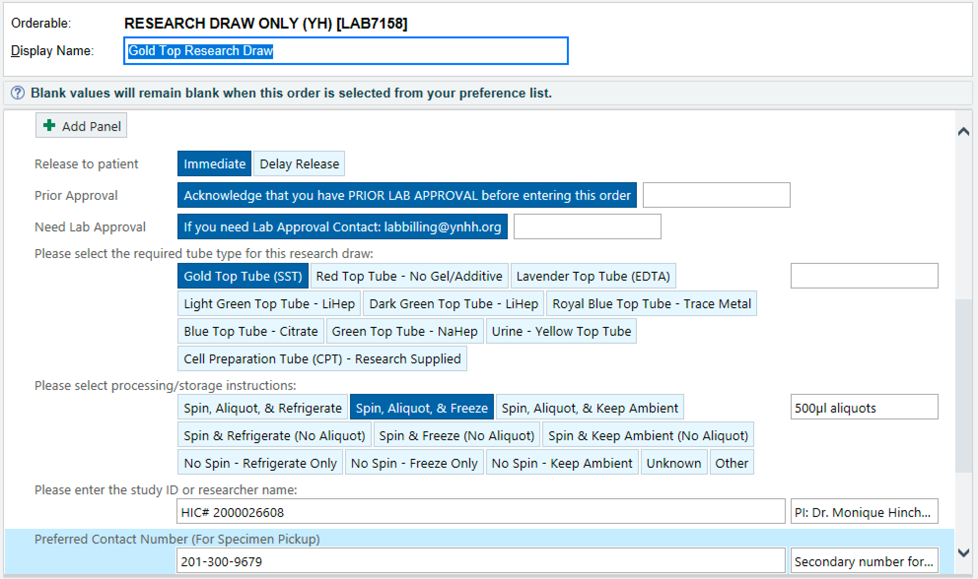
Epic Order to Collect Research Specimen
To tailor EPIC research specimen collection order: submit intake at YCCI
Link: https://ycci.co1.qualtrics.com/jfe/form/SV_1C9Xqb30laYT8Ox
You will need: number of tubes, study HIC, instructions
2-3 week turnaround, then will be visible in orders option in EPIC
Contact: Lynda Knaggs: lynda.knaggs@ynhh.org
Epic order entered for research participant
Patient entered into OnCore
research coordinator

Slide 3
Phlebotomy for SSc patients
Patient provided two tubes (Lavender and CPT) by research team and escorted to phlebotomy station by research coordinator
Phlebotomist confirms research draw and supplies third tube (SST)
Draw performed; tubes returned to research coordinator
CPT spun at 8 Devine Street centrifuge for 20 minutes at 1600rcf

Slide 4
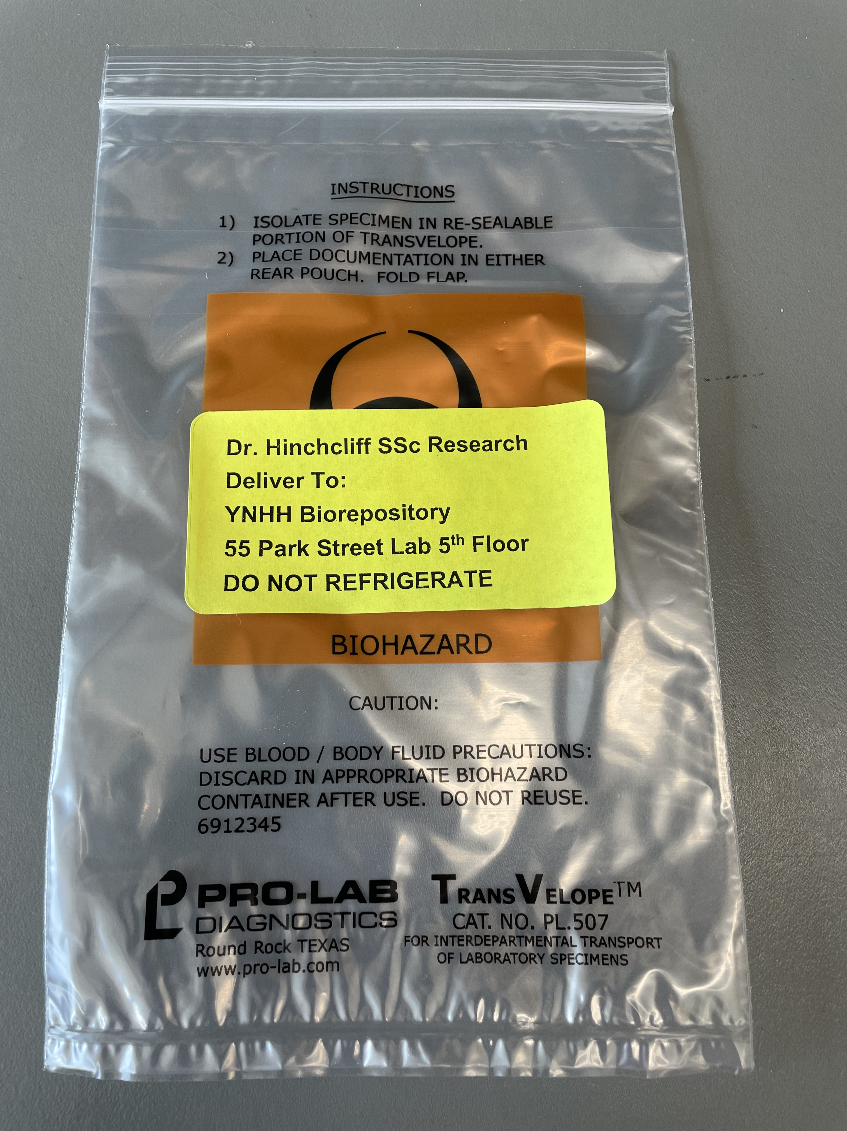
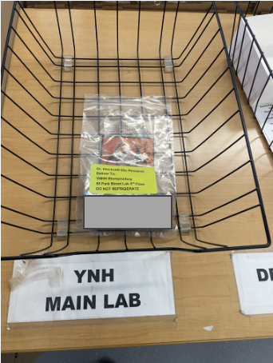
Courier
Research tubes (Lav, SST, spun CPT) placed into biohazard bag labeled “Dr. Hinchcliff SSc Research | Deliver To: YNHH Biorepository 55 Park Street Lab 5th Floor” and brought to fourth floor lab at 6 Devine Street by research coordinator
Biohazard bag left in tray for transport for YNH Main Lab
Courier brings bag to Central Lab
Pick-up times: 11:30am and 2:30pm

Slide 5
Central Lab
Upon arrival to Central Lab, biohazard bag is routed to Biorepository
Samples processed by Biorepository staff
Lav and SST: spun at 2000g for 10 minutes, then 0.5mL aliquots placed into cryovials and stored at -80C
CPT: spun at 450 rcf for 15 minutes then washed with PBS (x2), resuspended in 2mL freezing media (90%FBS + 10% DMSO), then 0.5mL aliquots placed into cryovials and stored at -80C
20uL aliquot separated and provided for cell counting by research coordinator
Materials (FBS, DMSO, cyrovials) provided by study team
Aliquots picked up next day by research coordinator

Slide 6
Other users
Francis P Wilson, MD MS
Melissa Shaw

Slide 7
Interested?
Contact David Ferguson: david.ferguson@yale.edu

