Slide 1
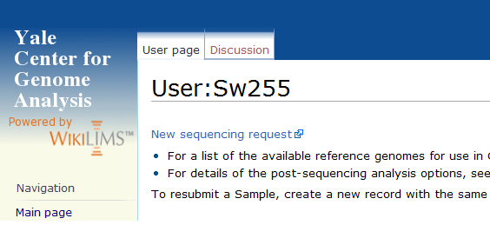
How you submit samples to YCGA (1 of 3)
Log in and browse to your account page
Select ‘New sequencing request’

Slide 2
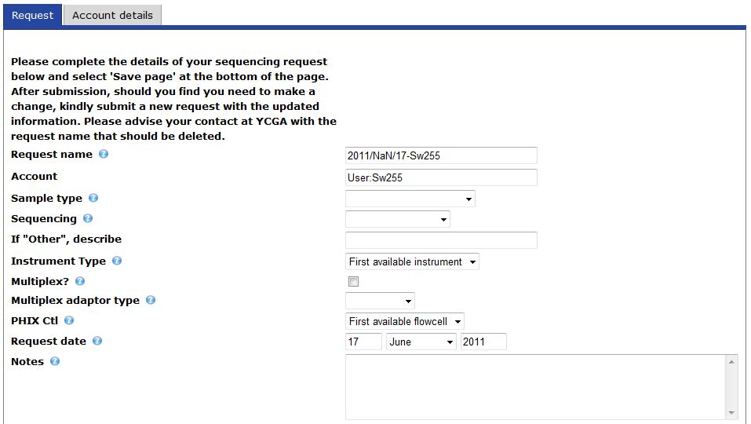
How you submit samples to YCGA (2 of 3)
▪ The account details tab is where you may change PTAEOs for each request.
Please use thebuttons found next to each field to reveal helpful tips.

Slide 3
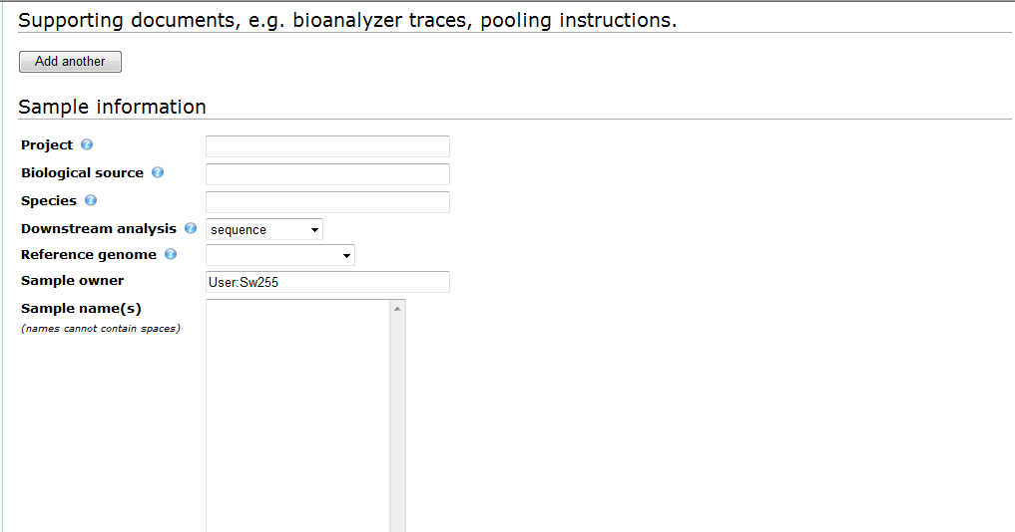
How you submit samples to YCGA (3 of 3)
◎ This button allows you to include multiple documents with your request.
◎ Downstream analysis types are described on our website.
◎ Paste sample names here in a single column.
Selecting ‘Watch this page’ sends an email when this request is updated.
‘Save page’ will submit your samples. ‘Cancel’ will cancel the page.

