Slide 1
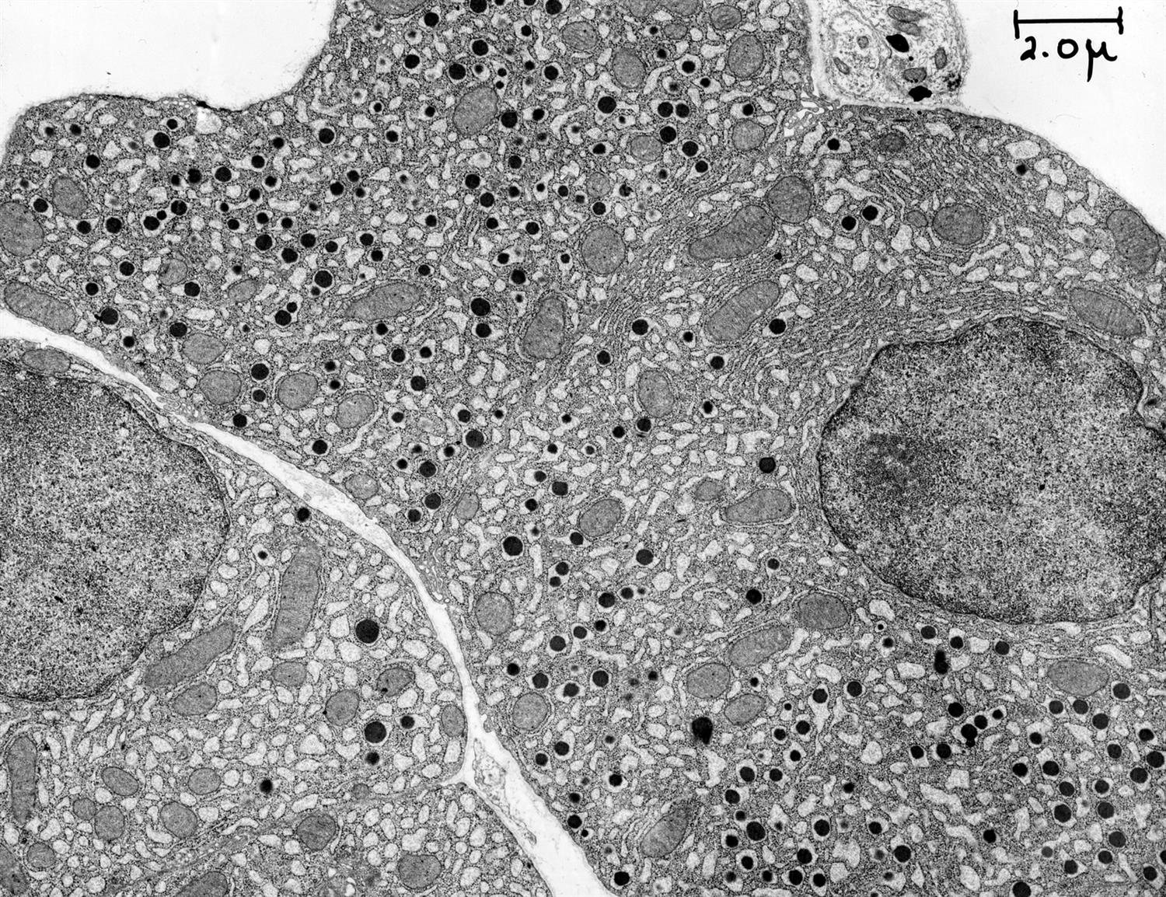
Welcome to YSM’s Dept. of Cell Biology
From George E. Palade EM Slide Collection

Slide 2
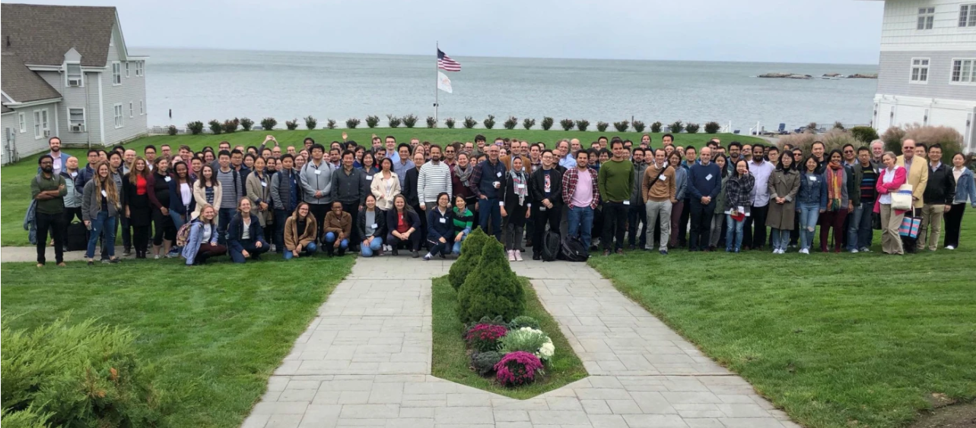
We can’t wait to meet you! The Yale School of Medicine is considered to be one of the birthplaces for modern Cell Biology; to this day it remains one of the top Cell Biology centers in the world.

Slide 3
We are glad that YOU are here
YSM and the Department are working to make this a better place to do science for all people, especially for scientists from historically underrepresented minority (URM) groups
Commitment to Diversity
In order to meet the immense challenge of deciphering the complexity of biology, it is essential to harness the ideas of people of all backgrounds. However, we recognize that many groups have been historically marginalized in both society and science. We recognize these challenges and historical inequities and are committed to making our community welcoming to scholars and staff with diverse backgrounds.
Cell Biology’s Diversity Equity and Inclusion (DEI) Committee
A group of department members working to remove the systemic barriers that have historically prevented individuals from all groups from doing great science in our department. Information about current goals can be found here.
Participation is always welcome!
YSM’s Strategic Initiatives for Diversity
A list of specific plans from the School of Medicine to increase diversity via policies aimed at recruitment, retention, and inclusion.
Look for other Resources at Yale in later slides

Slide 4
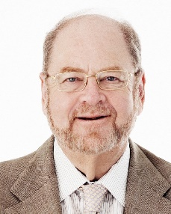
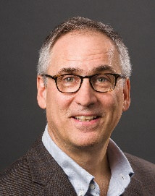
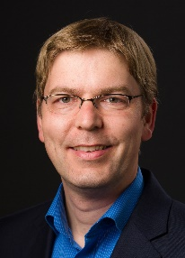
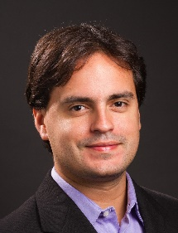
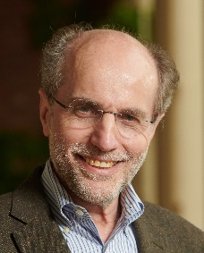
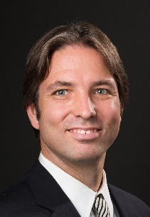
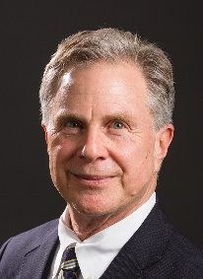
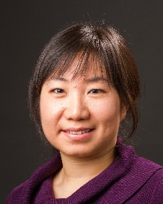
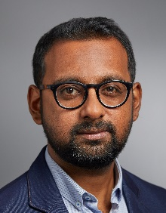
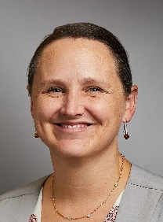
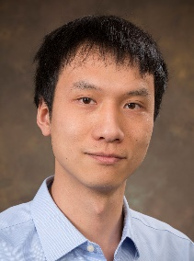
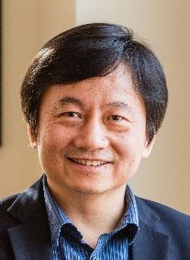
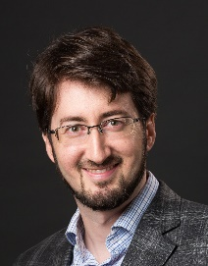
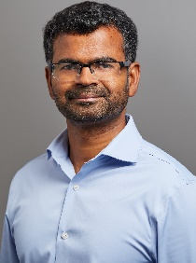
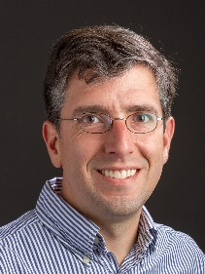
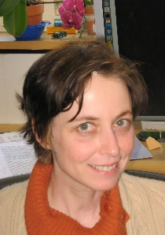
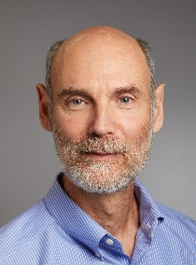
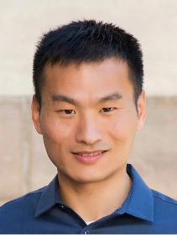
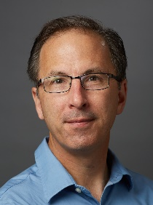
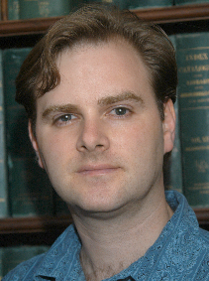
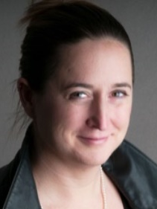
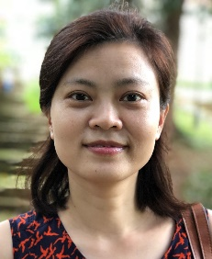
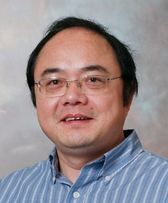
Meet your Cell Biology Faculty!
Jim
Rothman
Professor,
Chair
Chris
Burd
Professor,
Dep. Chair
Joerg
Bewersdorf
Professor
Daniel
Colón-Ramos
Professor
Pietro
De Camilli
Professor
Shawn
Ferguson
Associate
Professor
Fred
Gorelick
Professor
Shangqin
Guo
Associate
Professor
Kallol
Gupta
Assistant
Professor
Megan
King
Associate
Professor
Chenxiang
Lin
Associate
Professor
Haifan
Lin
Professor
Patrick
Lusk
Associate
Professor
Mals
Mariappan
Associate
Professor
Tom
Melia
Associate
Professor
Karin
Reinisch
Professor
Martin
Schwartz
Professor
Xiaolei
Su
Assistant
Professor
Peter
Takizawa
Assistant
Professor
Derek
Toomre
Professor
Julia
von Blume
Associate
Professor
Min
Wu
Associate
Professor
Yongli
Zhang
Associate
Professor

Slide 5
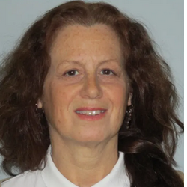
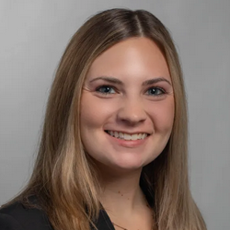
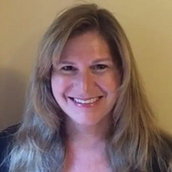
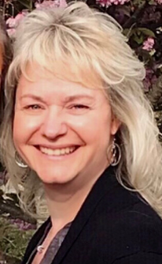
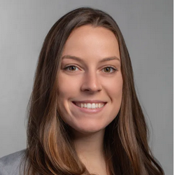
Your key department contacts
They make everything happen, much of it behind the scenes
Lisa Crotty
Graduate Registrar/ Senior Administrative Assistant
Lauren Bussell
Portfolio & Grant Analyst
Emily Dering
Senior Administrative Assistant
Wendy DiBenedetto
Senior Administrative Assistant
Maracate Sassone-McHugh
Human Resources Manager
Click here for the full department administrative staff

Slide 6
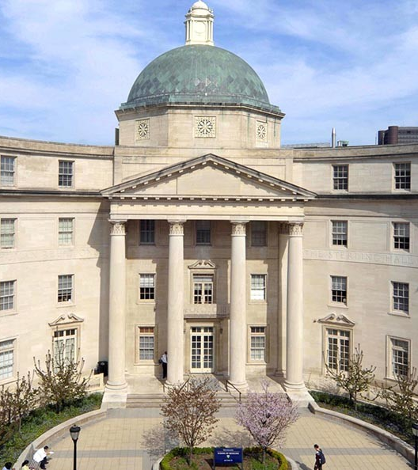
Welcome meeting
New members who have joined our department will be invited to a group meeting where they will have an opportunity to meet one another and network.
For all hires, we will hold a Meet & Greet event that will be scheduled twice a year and will include one faculty member along with the Senior Administrative Assistants who support your lab.

Slide 7
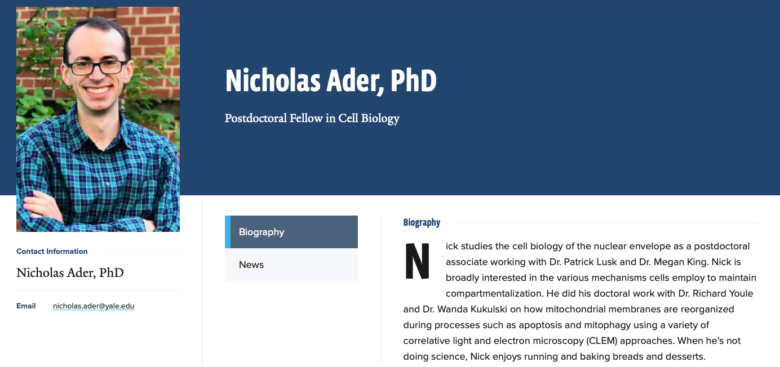
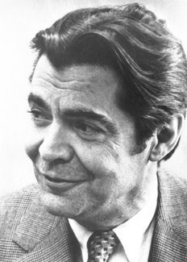
Time to update your Yale Profile
Your Yale profile is your way of presenting yourself as a person at Yale. Include a nice photo and add some information about what you do!
Go here to update your Yale profile.
To be added to the Cell Biology Website, please email both Emily (emily.dering@yale.edu) and Lisa (lisa.crotty@yale.edu)
George E. Palade
George E. Palade
Professor of Cell Biology; Former Chair, Cell Biology
Professor of Cell Biology; Former Chair, Cell Biology
George E. Palade
George E. Palade
george.palade@yale.edu
george.palade@yale.edu
Britannica, The Editors of Encyclopaedia. "George E. Palade". Encyclopedia Britannica, 15 Nov. 2020, https://www.britannica.com/biography/George-E-Palade. Accessed 10 May 2021.

Slide 8
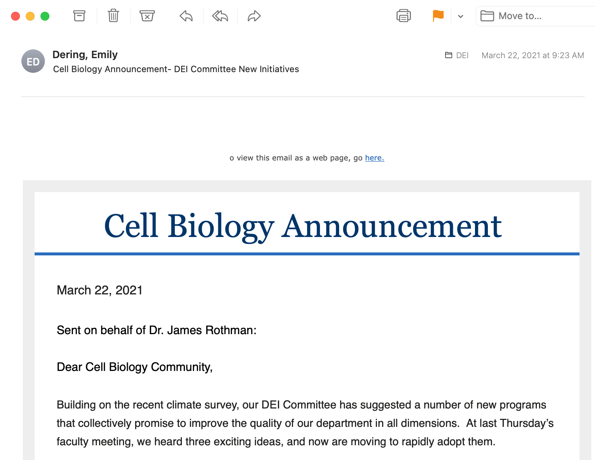
Make sure to stay in touch with…
Email!
You can be notified of so many things going on all across Yale! Go here to change your email subscriptions.
If you are not receiving Cell Biology Department notices please email: Wendy (wendy.debenedetto@yale.edu),
Emily (emily.dering@yale.edu), and
Lisa (lisa.crotty@yale.edu)

Slide 9
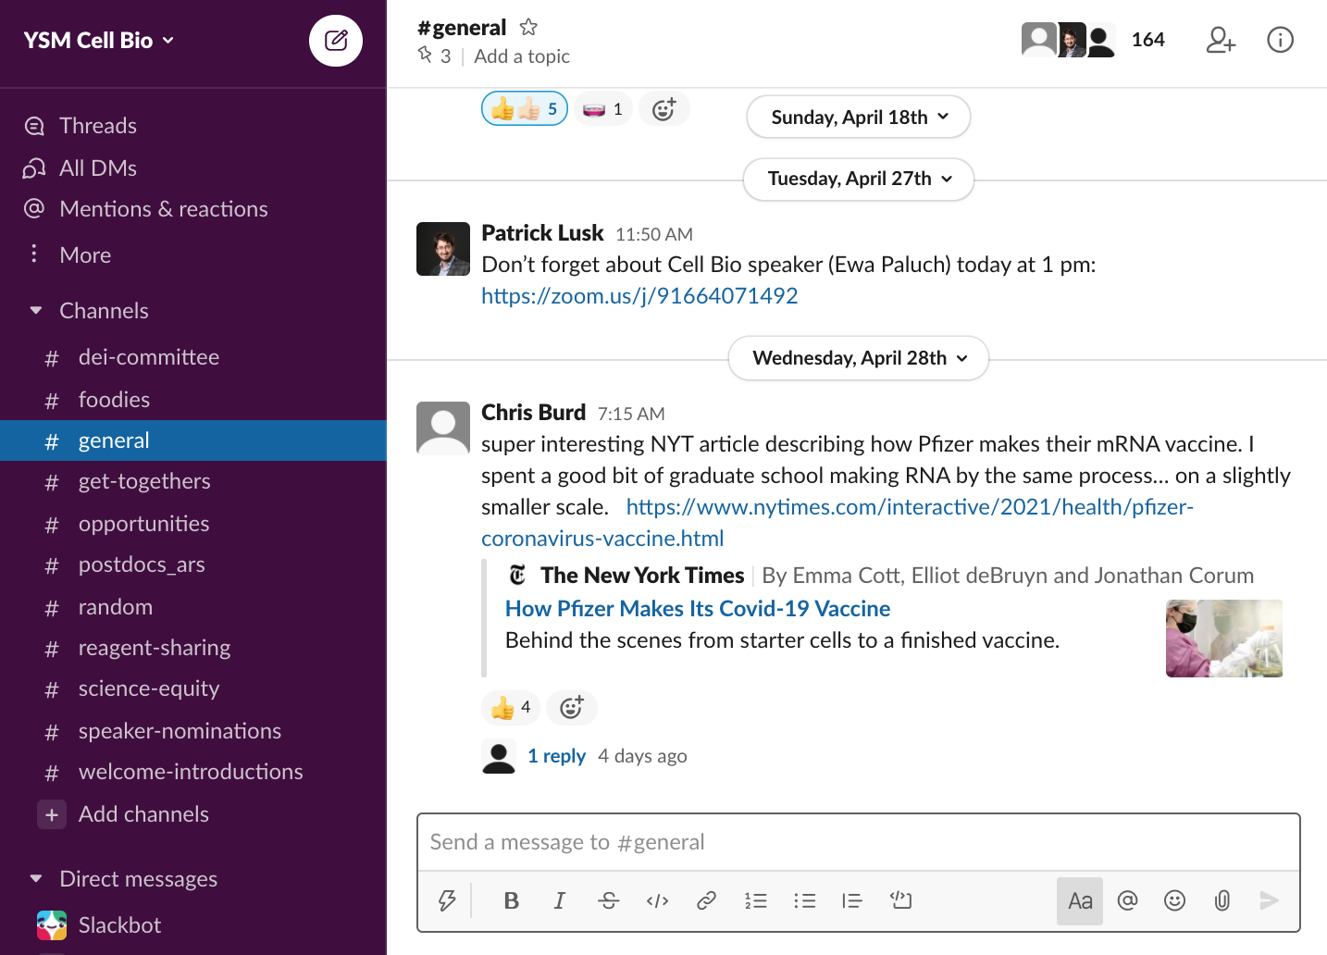
Make sure to stay in touch with…
Slack
Our department community extends into the virtual world with Slack!
It’s a great way to meet people, find reagents, hear about job opportunities and seminars, or even just check out what your colleagues cook or bake on #foodies!
Join here!

Slide 10
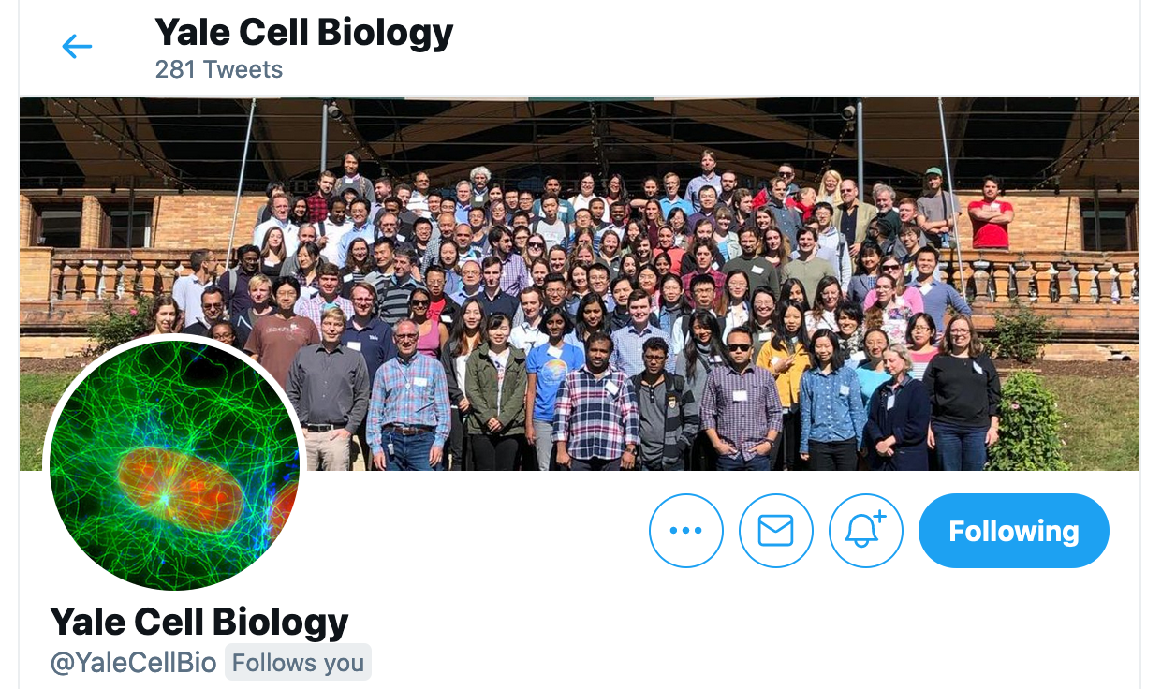
Make sure to stay in touch with…
Twitter
A great way to see what your colleagues are working on and to have the department highlight your work!
Click here to see a list of all the Cell Biology labs in our department that are on Twitter!

Slide 11
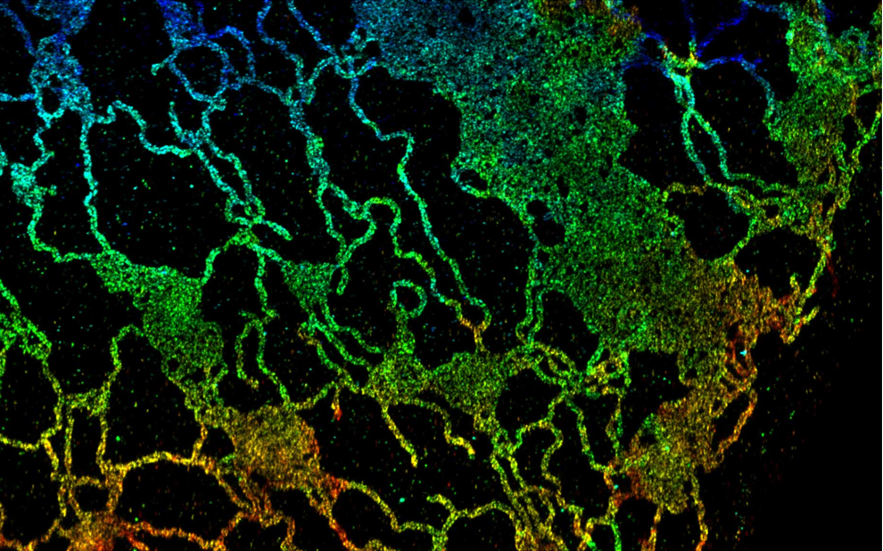
What do we do in the department?
Research in Progress
(RIP) Talks
Come see what your colleagues have been up to and share your own work!
Check out the schedule here!
3D fluorescence super-resolution image of the endoplasmic reticulum by the Bewersdorf lab in collaboration with the Bahmanyar lab. (Schroeder et al., J. Cell Biol. 2019; https://doi.org/10.1083/jcb.201809107)

Slide 12
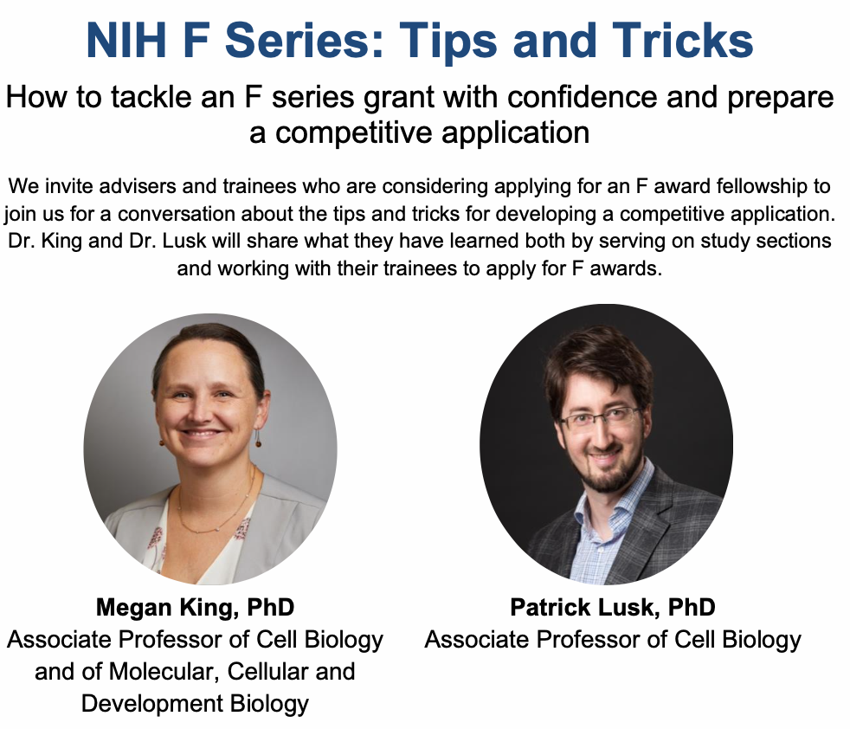
What do we do in the department?
Beyond the Bench Seminars
Monthly seminars hosted by the department on skills you need to succeed!
Check out the schedule and contact if you would like to be involved here!

Slide 13
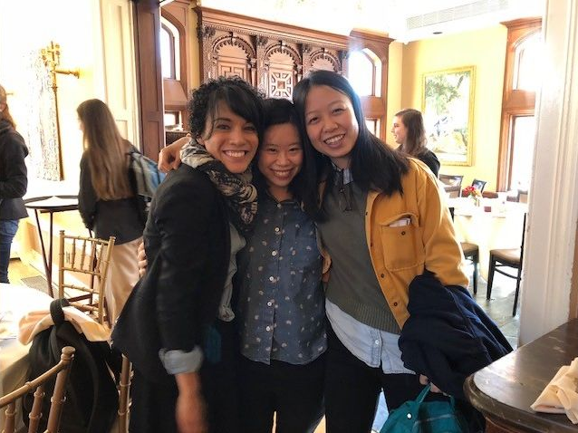
What do we do in the department?
Annual Retreat
Two days every year where we dive into the science of the department and make new friends and collaborators!
Check out the upcoming dates and old photos here!

Slide 14
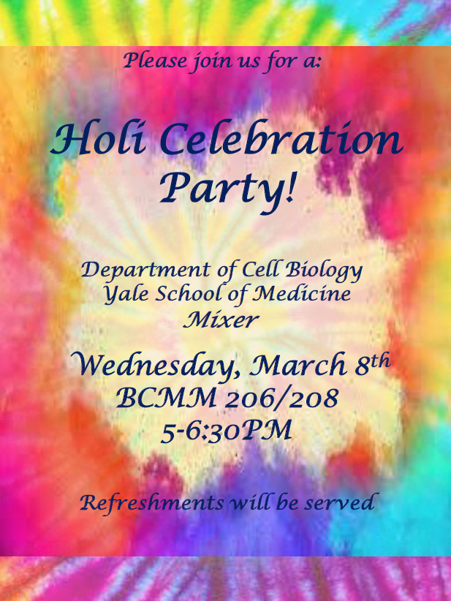
What do we do in the department?
Department Socials
Once a month opportunities for you to grab a drink and make some new connections!
Look for invites via email!

Slide 15
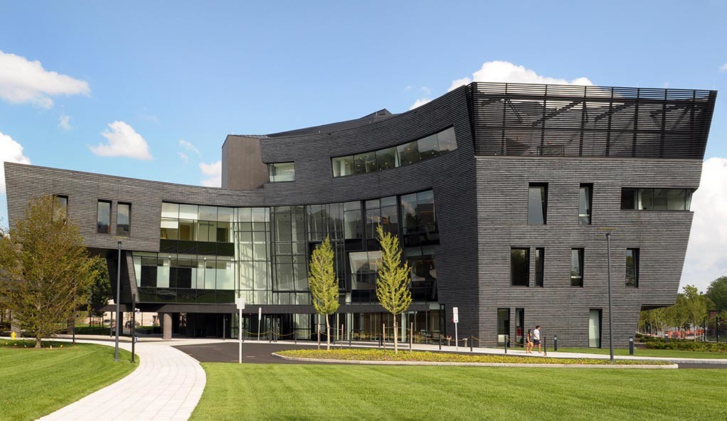
Your resources at Yale
Physical and mental health
Know your coverage!
For example, did you know that grad students and postdocs can see a weekly therapist for FREE?
Click here for health coverage, and here for full benefits info!
Yale Health Center

Slide 16
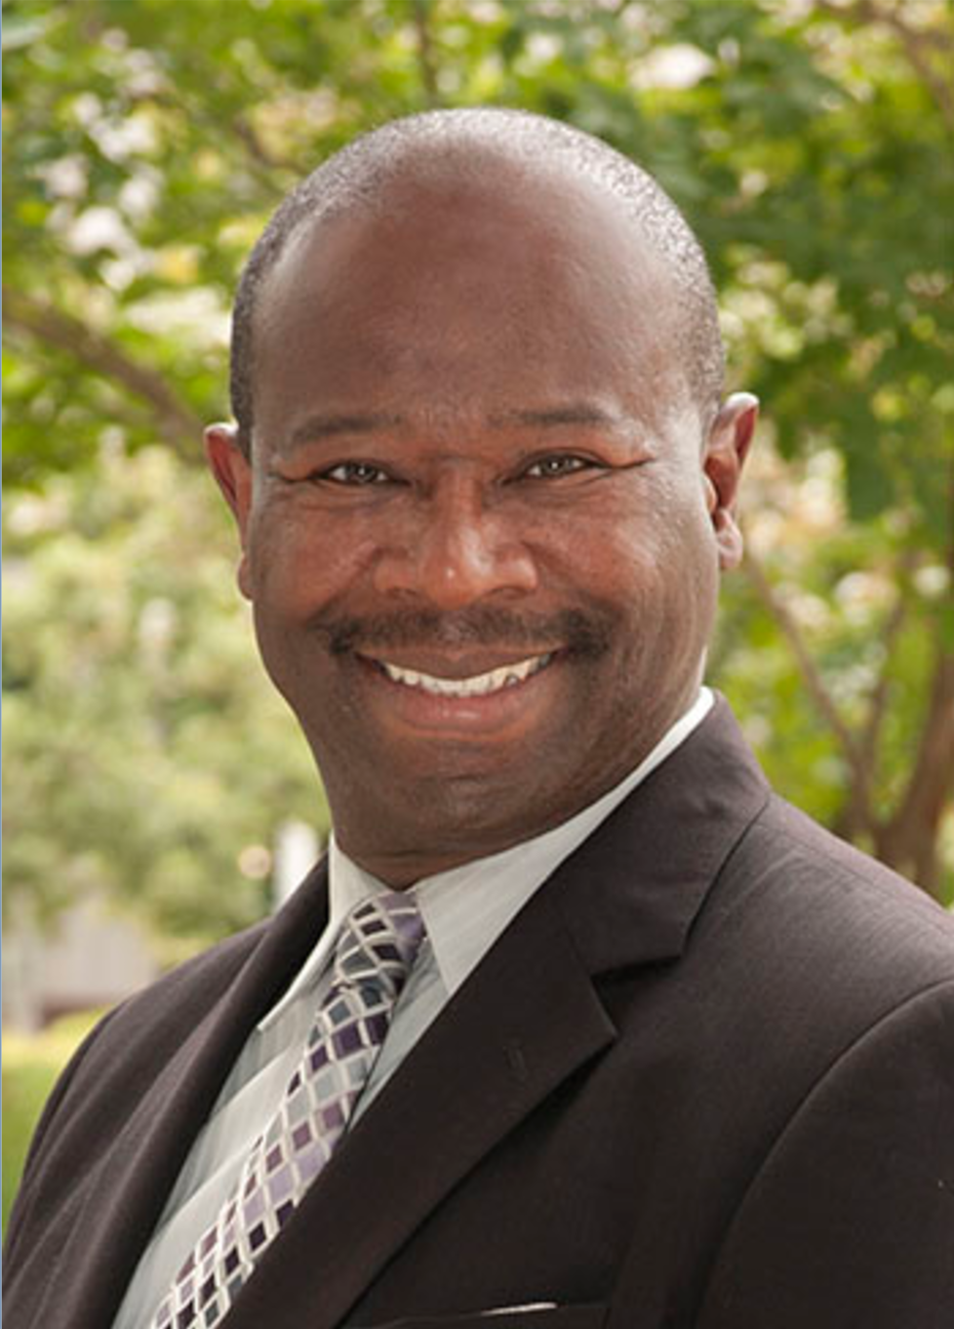
Your resources at Yale
Office for Diversity, Equity, and Inclusion
A great resource for information on DEI policies, resources, and all sorts of information.
You can report professionalism or academic integrity concerns here as well!
DEI reporting resources
1. Bias or discrimination on the basis of sex or gender
Title IX office
2. Bias or discrimination on the basis of race, religion, age, nationality, disability, sexual orientation and gender identity and expression
Office of Institutional Equity and Access
Dean’s Designees for Yale School of Medicine
3. Professionalism or academic integrity concerns about a faculty member or researcher
Yale School of Medicine Professionalism Concern Form
4. Informal advising options for graduate students
Office for Graduate Student Development and Diversity (OGSDD)
Darin Latimore, MD, Deputy Dean

Slide 17
Offices and Affinity Groups at Yale
1. General
Yale School of Medicine Office of Diversity, Equity and Inclusion
Diversity, Inclusion, Community Engagement and Equity (DICE) Office
Yale Ciencia
Women in Science at Yale
Yale SACNAS Chapter
Yale School of Medicine Outlist
oSTEM
Office of LGBTQ Resources
2. For Students
Yale BBS Diversity and Inclusion Collective (YBDIC)
Office of Graduate Student Development and Diversity (OGSDD)
Office of International Students and Scholars
Student Accessibility Services and Resource Office on Disabilities
3. For Postdocs, Employees and Faculty
Yale Black Postdoctoral Association
Asian Network at Yale
DiversAbility at Yale
Future Leaders of Yale
Working Women’s Network
Yale African American Affinity Group
Yale Latino Networking Group
Yale Lesbian, Gay, Bisexual, Transgender and Queer Affinity Group (LGBTQ)
Yale Veterans Networking

Slide 18
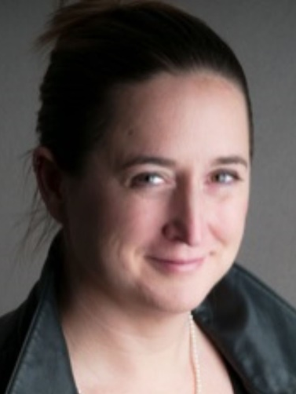
Your resources at Yale
Julia
von Blume
Associate
Professor
Mentorship
Yongli
Zhang
Associate
Professor
Cell Bio has a Postdoc and Associate Research Scientist mentoring program which pairs postdocs with faculty members in the Department and across Yale.
Click here to sign up!
For help with choosing a mentor, contact yongli.zhang@yale.edu and julia.vonblume@yale.edu

Slide 19
Your resources at Yale
MORE Mentorship
GSAS 4-Tier Mentoring Program
Graduate-Undergraduate Mentoring Program (GUMI)
Yale Mentorship for Minority Students in STEM (YMMSS)
Women in Science at Yale (WISAY) 3-Tier Mentoring Program
Yale BBS Diversity and Inclusion Collective
Yale Cytoskeleton Club Mailing List
Yale Cryo-EM Journal Club
RNA Club

Slide 20
Exploring New Haven
There’s so much to do here!
Calendar of Events in Greater New Haven Area
Events at Yale

Slide 21
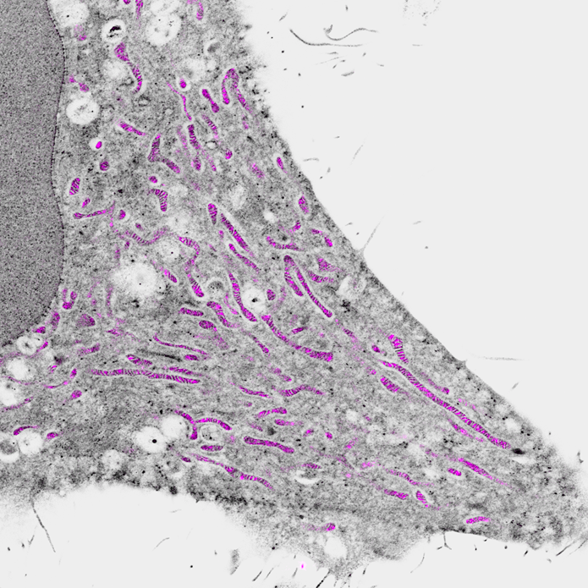
Want more info?
A massive list of all the resources on “It’s Your Yale” can be found here!
Pan-Expansion Microscopy from the Bewersdorf lab (M’Saad & Bewersdorf, Nat. Comm. 2020; https://www.nature.com/articles/s41467-020-17523-8)

