Slide 1
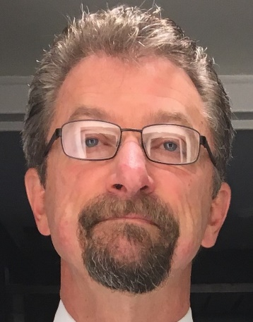
Module 1 Introduction to Modules and Repayment Reminders Yale University School of Medicine Class of 2024
Paul S. Garrard
Founder and President, PGPresents, LLC
Independent Student Loan Consulting
Spring 2024
www.PGPresents.com

Slide 2
Modules
Topical by design, watch what you want when you want
We suggest you watch in order, as information tends to build from one module to the next
Most of the information should apply to those of you in the Campus and Online PA programs
Feedback and suggestions welcome
Tell your Financial Aid Office what you think about modules
Send comments to paul@PGPresents.com

Slide 3
Reminders
Keep your initial strategy simple
Choose repayment plan with required minimum payment you can comfortably afford, then decide whether or not to overpay
You can change strategies and plans
Be careful where you get information on repayment
Your loans and strategy are your own

Slide 4
END OF MODULE 1
PGPresents, LLC
Independent Student Loan Consulting
www.PGPresents.com

