Slide 1
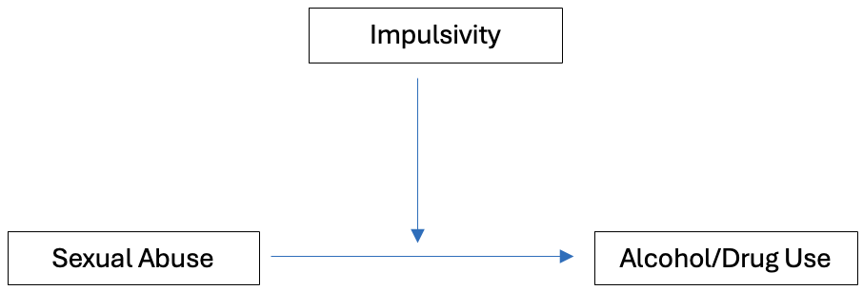
Impulsivity moderates the link between history of sexual abuse and problematic alcohol and drug use: Insights from a large, multi-national, and gender-diverse sample
Damla E. Aksen, PhDª, Marc N. Potenza, MD, PhD^{b}, Sarah Lichenstein, PhD^{c}, Joël Billieux, PhD^{d}, Loïs Fournier, M.Sc.^{e}, Léna Nagy, M.A.^{f}, International Sex Survey Consortium (ISS) Consortium, Beáta Bőthe, Ph.D.^{g}
Background
Methods
Results
Conclusion
Sexual abuse history (SAH), in particular childhood sexual abuse (CSA) and adolescence and adulthood sexual abuse (AASA), has been linked to problematic alcohol and substance use.^{1, 2, 3, 4}
Investigations of the moderating role of impulsivity in the relationship between sexual trauma history and substance use are with small samples from Western populations and are unrepresentative of sexual and gender minority populations.
Although impulsivity has been found to moderate relationships between SAH and substance use³, more refined examinations in gender and sexual minority populations are warranted.
The ISS is an international, multi-language, cross-sectional, self-report study among a community sample of adults across 42 countries (N= 82,243).⁵
Recruitment was conducted between October 2021 and May 2022.
Anonymous survey on the Qualtrics Research Suite (25 -45 minutes).
The impulsivity measure was only validated in 26 countries; therefore, analyses utilized participants from both the 42 countries and 26 countries.
Measures
Sociodemographic Characteristics
Sexual Abuse History Questionnaire (SAHQ)⁶
Short Urgency-Premeditation-Perseverance-Sensation Seeking-Positive Urgency Scale (SUPPS-P)⁷
Alcohol, Smoking, and Substance Involvement Screening Test (ASSIST)⁸
AUDIT: Alcohol Use Disorders Identification Test (AUDIT)⁹
Statistical Analyses Plan
All analyses will be performed in Python
Correlations
Moderations
Latent variable interaction modeling
Chi-square difference tests
We anticipate results based on latent variable interaction modeling and moderation analyses to provide fine-grained findings that clarify the mechanisms of problematic alcohol and other substance use among individuals with a history of sexual trauma.
Anticipated results will also provide insight into facets of impulsivity in relation to SAH and substance use concerns in diverse groups globally.
We predict moderate positive correlations between SAH and problematic substance and alcohol use within the total ISS sample.
We predict that the magnitude of these associations will be greater in sexual and gender minority populations due to potential minority stress and effects of cumulative stress.
We predict that negative and positive urgency (other facets will be exploratory) facets of impulsivity will moderate the relationships between SAH and alcohol and other substance use disorders in both gender and sexual minority majority groups collapsed across all countries.
We anticipate results will differ by timing of individuals’ sexual abuse (i.e., CSA, AASA, CSA+AASA).
We anticipate that our results will inform targeted public health initiatives, focusing on prevention and intervention efforts aimed at mitigating the adverse effects of SAH and impulsivity on alcohol and substance use behaviors in multiple global jurisdictions.
References
¹ al’Absi, M., DeAngelis, B., Borodovsky, J., Sofis, M. J., Fiecas, M., & Budney, A. (2023). Early life adversity and substance use: The mediating role of mood and the moderating role of impulsivity. Journal of Psychiatric Research.
² Arwood, Z., & Nooner, K. B. (2023). Adverse Childhood Experiences and Binge Drinking in Adolescence: the Role of Impulsivity and PTSD Symptoms. Journal of Pediatric Neuropsychology, 9(1), 30-41.
³ Felton, J. W., Shadur, J. M., Havewala, M., Gonçalves, S., & Lejuez, C. W. (2020). Impulsivity moderates the relation between depressive symptoms and substance use across adolescence. Journal of Clinical Child & Adolescent Psychology, 49(3), 365-377.
⁴ Oshri, A., Kogan, S. M., Kwon, J. A., Wickrama, K. A. S., Vanderbroek, L., Palmer, A. A., & MacKillop, J. (2018). Impulsivity as a mechanism linking child abuse and neglect with substance use in adolescence and adulthood. Development and psychopathology, 30(2), 417-435.
⁵ Bőthe, B., Koós, M., Nagy, L., Kraus, S. W., Potenza, M. N., & Demetrovics, Z. (2021). International Sex Survey: Study protocol of a large, cross-cultural collaborative study in 45 countries. Journal of behavioral addictions, 10(3), 632-645.
⁶ Leserman, J., Drossman, D. A., & Li, Z. (1995). The reliability and validity of a sexual and physical abuse history questionnaire in female patients with gastrointestinal disorders. Behavioral Medicine, 21(3), 141-150.
⁷ Billieux, J., Rochat, L., Ceschi, G., Carré, A., Offerlin-Meyer, I., Defeldre, A. C., & Van der Linden, M. (2012). Validation of a short French version of the UPPS-P Impulsive Behavior Scale. Comprehensive Psychiatry, 53(5), 609-615.
⁸ World Health Organization. (2002). The Alcohol, Smoking and Substance Involvement Screening Test (ASSIST): Development, reliability and feasibility. World Health Organization.
⁹ Saunders, J. B., Aasland, O. G., Babor, T. F., De la Fuente, J. R., & Grant, M. (1993). Development of the alcohol use disorders identification test (AUDIT): WHO collaborative project on early detection of persons with harmful alcohol consumption‐II. Addiction, 88(6), 791-804.
Questions
Will there be correlations among SAH and problematic substance/alcohol use in both the general and minority populations globally?
Will findings in the total sample extend to associations within the individual countries encompassed in the International Sex Survey (ISS) dataset?
What facets will be the strongest moderators?
Will these relationships vary based on the timing of individuals’ sexual abuse history (i.e., CSA, AASA, CSA+AASA)
Affiliations
ª Radiology and Biomedical Imaging, Yale School of Medicine
^{b} Department of Psychiatry, Yale School of Medicine; Department of Neuroscience, and Wu Tsai Institute, Yale School of Medicine and University; Child Study Center, Yale School of Medicine; Connecticut Mental Health Center
^{c} Department of Psychiatry, Yale School of Medicine
^{d} Institute of Psychology, University of Lausanne
^{e} Swiss National Science Foundation
^{f} Department of Clinical Psychology and Addiction, ELTE Eötvös Loránd University
^{g} Department of Psychology, University of Montreal
Notes:
Specifically, individuals with sexual abuse history will have higher scores of AUD and SUDs.
We predict that the negative and positive urgency (other facets will be exploratory) facets of impulsivity will moderate the relations between sexual abuse and AUD/SUDs in both gender and sexual minority majority groups collapsed across all countries, such that individuals with higher impulsivity sub-facet scores compared to lower will demonstrate stronger associations between the study variables.
Different impulsivity sub-facets may moderate the relations between SAH and alcohol/substance use within each sexual and gender minority group of each country

