Slide 1
Identification and Treatment of Alcohol Problems in Primary Care
E. Jennifer Edelman, MD, MHS
Assistant Professor of Medicine
Yale University School of Medicine
September 18th, 2013

Slide 2
Learning Objectives
Classification of Alcohol Use
Epidemiology and Health Consequences
Screening Strategies in Primary Care
Treatment Options

Slide 3
Case
JB, a 49 yo gentleman with HIV on combination antiretroviral therapy, tobacco dependence, presents for routine care. He is concerned that he is sleeping more than normal and he was told that his blood pressure was elevated. Recent labs revealed a detectable HIV-1 viral load of 110 copies.
He admits to drinking 1 pint of vodka daily.
How do you quantify his alcohol use?

Slide 4
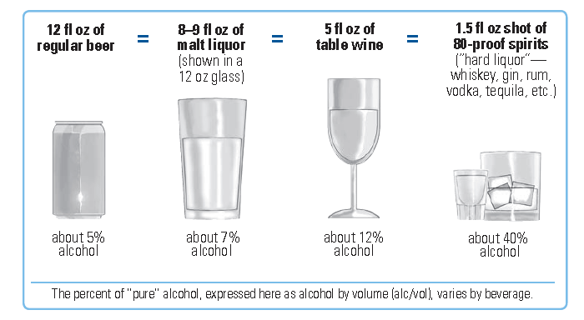
What is a Standard Drink?
NIAAA, NIH Publication No. 10-3770. 2010
Notes:
1 pint or 16 ounces of vodka daily → 1.5 fluid oz of vodka is equal to a standard drink → a little more than 10.5 drinks daily

Slide 5
What is a Standard Drink?
Approximately 10.5 drinks daily!
NIAAA, NIH Publication No. 10-3770. 2010
Notes:
1 pint or 16 ounces of vodka daily → 1.5 fluid oz of vodka is equal to a standard drink → a little more than 10.5 drinks daily

Slide 6
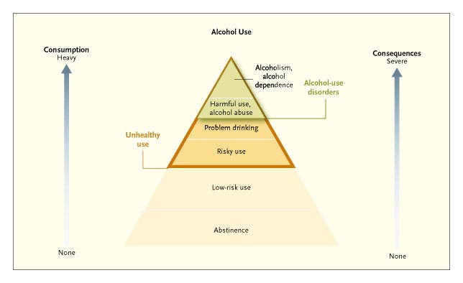
The Spectrum of Alcohol Use
Saitz R. NEJM 2005
Notes:
Figure 1. The Spectrum of Alcohol Use. The spectrum of alcohol use extends from abstinence and low-risk use (the most common patterns of alcohol use) to risky use, problem drinking, harmful use and alcohol abuse, and the less common but more severe alcoholism and alcohol dependence.10 Consumption and the severity of consequences increase from low-risk use through dependence. The areas of the pyramid reflect the approximate prevalence of each category. Clinicians and public health practitioners should be most concerned with the categories in the shaded upper portions of the pyramid (representing unhealthy alcohol use).

Slide 7
Classification of Alcohol Use
Alcohol Pattern | Characteristics
Low-Risk (Moderate) Drinking | Men < 65 years old: <4 on any day <14 per week Men > 65 years old and all Women: <3 on any day <7 per week Lower thresholds or abstinence might be appropriate based on prescribed medication; health conditions; pregnancy)
At-Risk(Heavy) Drinking | Men < 65 years old: >4 on any day >14 per week Men > 65 years old and Women: >3 on any day >7 per week
Notes:
Low risk or moderate drinking when men < 65 years old report less than 4 drinks on any day or less than 14 drinks per week.
For men over 65 years old and all women, thresholds are slightly different due to differences in metabolismm.

Slide 8
Classification of Alcohol Use
Alcohol Pattern | Characteristics
Alcohol Use Disorder | At least 2 of the following criteria over the past year: Recurrent use in hazardous situations Loss of control of use (quantities or duration) Trying to cut down Much time spent using or recovering from use Use despite interpersonal problems Failing obligations in work, home or school Activities given up to use Use despite physical/psychological problems related to use Withdrawal Tolerance Craving
DSM-V criteria, May 2013
Notes:
Formerly alcohol abuse and dependence were separate diagnoses – changed with DSM-V.

Slide 9
Epidemiology: Unhealthy Alcohol Use
Outpatients: 7 - 20%+
Emergency Departments: 30 – 40%
Trauma Patients: 50%
Saitz, R. NEJM 2005
Notes:
Unhealthy alcohol use is common –
Depending on the sample: among outpatients there is a reported prevalence of 7 to 20%
Emergency Departments 30 to 40% and trauma patients 50%

Slide 10
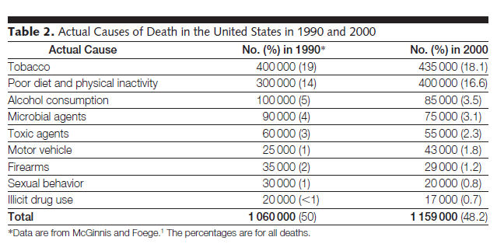
Alcohol and All-Cause Mortality Risk
Mokdad AH et al. JAMA 2004
Notes:
And this is relevant!
One study which looked at factors contributing to all cause mortality found that alcohol consumption, that following tobacco use, poor diet and physical inactivity, alcohol was the third most common cause of death and contributes to 85000 deaths in a one year time period.

Slide 11
Alcohol and All-Cause Mortality Risk
Mokdad AH et al. JAMA 2004
Notes:
And this is relevant!
One study which looked at factors contributing to all cause mortality found that alcohol consumption, that following tobacco use, poor diet and physical inactivity, alcohol was the third most common cause of death and contributes to 85000 deaths in a one year time period.

Slide 12
Alcohol-Attributable Diseases
Cancers
Chronic Liver Disease
Unintentional Injuries
Alcohol-Related Violence
Neuropsychiatric Conditions
Cardiovascular Disease
Ezzati M and Riboli E. NEJM 2013
Notes:
And this is related to impact on a variety of disease conditions:
Cancers: esophagus, larynx, mouth, breast
Chronic liver disease
Unintentional injuries
Alcohol related violence
Neuropsychiatric conditions
and cardiovascular disease

Slide 13
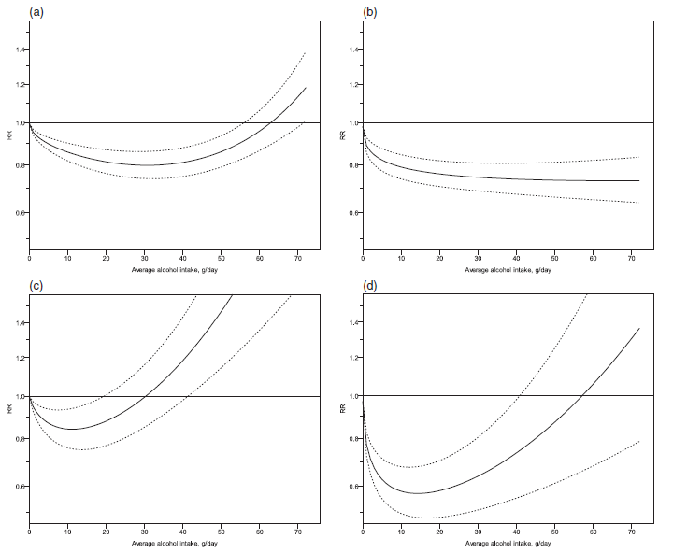
Alcohol and Ischemic Heart Disease
Mortality
Morbidity
Men
Women
Roerecke M and Rehm J. Addiction 2012
Notes:
And these relationships vary based on level of alcohol consumption and by gender. Results from meta-analysis of high-quality observational studies demonstrate the association of average daily alcohol intake and risk of ischemic heart disease where a) ischemic heart disease mortality in men; b) ischemic heart disease morbidity in men; c) ischemic heart disease mortality in women; d) ischemic heart disease morbidity in women.

Slide 14
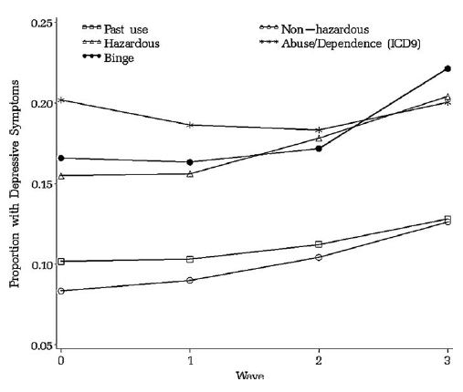
Alcohol and Mental Health
Sullivan LE et al. DAD 2011
Notes:
And alcohol impacts mental health.
Observational data indicate that there is a consistent association between unhealthy levels of alcohol use and depressive symptoms. Data from VACS, using data from over 2000 patients 2002-2008 demonstrates that hazardous and binge drinkers have depressive symptoms similar to those with alcohol abuse and dependence – significantly higher than past drinkers and non-hazardous drinkers, which persists over time.
Notably, there is no difference in depressive symptoms between the groups and hazardous drinking vs. abuse/dependence, between the groups with binge vs. hazardous drinking or between the groups with past drinking vs. non-hazardous drinking.

Slide 15
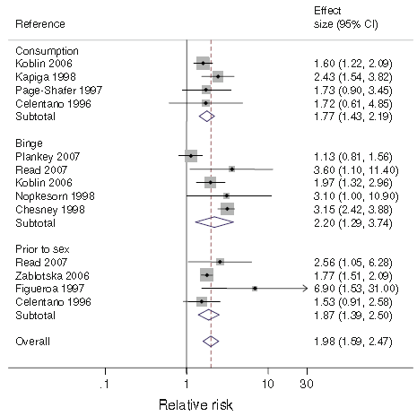
Alcohol and Risk of Incident HIV
Alcohol consumers overall had a significantly increased risk of becoming HIV positive
This held true for each consumption-type specific analysis:
Any consumption
Binge
Alcohol prior to sex
Baliunas, D. Int J Pub Health. 2010.
Notes:
The impact of alcohol extends to increased risk associated with the acquisition of infectious diseases.
Meta-analysis including 10 studies looking at risk of incident HIV found that alcohol consumers overall had a significantly increased risk of becoming HIV positive. And this held true for each consumption-type specific analysis, when looking at any consumption, binge use, or alcohol prior to sex.

Slide 16
Alcohol Impacts ART Adherence
Cook RL, et al. Journal of General Internal Medicine 2001
Notes:
Alcohol consumption temporally impacts medication adherence with a dose-response effect making it harder to treat comorbid conditions.
Data from one study of 212 patients found that even after adjusting for clinically relevant variables, patients with hazardous drinking were 2.64 times more likely to take their medication off schedule during the previous week; similarly, this was 4.70 more likely among patients with heavy drinking.
Temporally impacts medication adherence and dose-response effect
212 pts, outpatient clinics between 1997-1998
Variables: age, race, crack/cocaine use, popper use, intravenous drug use, treatment for depression/anxiety, belief that it is dangerous to miss medications.

Slide 17
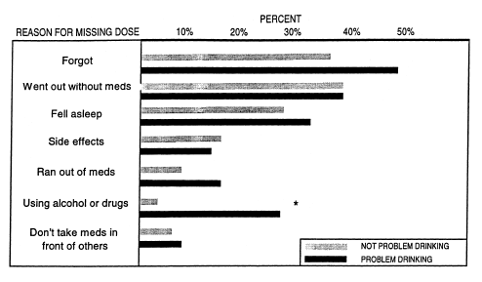
Alcohol Impacts ART Adherence
48% vs. 35%, p=0.10
*
15% vs. 8%, p=0.16
*
26% vs. 3%, p<0.001
*
Cook RL, et al. Journal of General Internal Medicine 2001
Notes:
The same study evaluated reasons for missing medication;
Compared to patients who did not have problem drinking, patients with problem drinking were more likely report missing a dose of medication because they were using alcohol or drugs, ran out of their medications or forgot.

Slide 18
Addressing Alcohol Use Disorders
BUT. . . how effective are physicians in speaking about alcohol?
McCormick KA et al. JGIM 2006

Slide 19
Screening for Alcohol Use Disorders
Routine examination
Before prescribing a medication that interacts with alcohol
Emergency Department
Pregnant
Likely to drink (smokers, young adults)
Alcohol-induced health problem
Chronic illness not responding to treatment
Notes:
Antibiotics, antidepressants, pain medications
Chronic illness not responding to treatment: chronic pain, depression, diabetes, heart disease, GI, HTN

Slide 20
Screening for Alcohol Use Disorders
“The USPSTF recommends that clinicians screen adults aged 18 years or older
for alcohol misuse and provide persons engaged in risky or hazardous drinking
with behavioral counseling interventions to reduce alcohol misuse. (Grade B
recommendation.)”
Notes:
In May 2013, the United State Preventive Services Task Force updated their recommendations for screening and behavioral counseling interventions in primary care.

Slide 21
Screening Tests
AUDIT – 10 item
AUDIT-C – 3 items to quantify consumption
Single question screening
“How many times in the past year have you had 5 (for men) or 4 (for women and all adults older than 65 yo) or more drinks in a day?”
Moyer V. Annals Internal Medicine 2013

Slide 22
NIAAA-Screening Approach
1. Do you sometimes drink beer, wine, or other alcoholic beverages?
2. How many times in the past year have you had 5 (for men) or 4 (for women, all over 65 years old) or more drinks in a day?
3. Quantify:
On average, how many days a week do you have an alcoholic drink?
On a typical drinking day, how many drinks do you have?
4. Assess for Alcohol Use Disorders

Slide 23
Case continued
What do you want to do now for JB?

Slide 24
Case continued
He drinks alone daily; used to drink at bars but moved and worried about driving.
He has tried to cut down in the past but has been unsuccessful; attended AA meetings briefly after leaving jail.
Last blackout one year ago; no withdrawal but drinks daily.

Slide 25
Case continued
So, now what. . . ?

Slide 26
Treatment Goals and Options
At-Risk Drinking
Decrease drinking to below NIAAA-levels
Brief Interventions
Alcohol Use Disorders
Abstinence
Multi-Modal Approach

Slide 27
At-Risk Drinkers: Brief Interventions
10 – 15 minutes
Components:
Feedback about drinking
Advice and goal setting
Follow-up contact
Motivational interviewing principles
Empathic listening
Patient autonomy
Patient-identified reasons for change
Saitz R NEJM 2005

Slide 28
Implementing Brief Interventions
Elicit patient view about the problem
Express concern and provide clear advice
Provide feedback and norms, link to current problems
Express empathy, reinforce change as possibility, and acknowledge patient’s responsibility
Provide menu of options for promoting change
Anticipate and discuss difficult situations
Set goal and arrange follow-up
Saitz R NEJM 2005

Slide 29
Project TrEAT: A Trial for Early Alcohol Treatment
Outcome | Control | Intervention | p
Hospital days | 663 | 420 | < 0.05
ED Visits | 376 | 302 | < 0.08
Motor Vehicle Accidents | 31 | 20 | <0.05
Risky drinking ♂ >20 drinks/wk ♀ >13 drinks/wk | 35% | 23% | < 0.001
Cost of intervention: $166 per patient Net benefit: $546 in medical costs, $7780 if societal costs included
Fleming MF. Alcohol Clin Exp Res 2002
Notes:
Landmark trial involving 64 community-based primary care physicians – all patients ages 18 to 65 years old were recruited. Patients with at-risk drinking
Randomized controlled trial general health booklet vs. brief intervention + booklet – two 15 minute sessions at one month intervals and two 5 minute follow-up phone calls from a nurse
37% fewer hospital days, 20% fewer ED visits and
Also fewer deaths in intervention group 3 vs. 7 in control group but this was not statistically significant

Slide 30
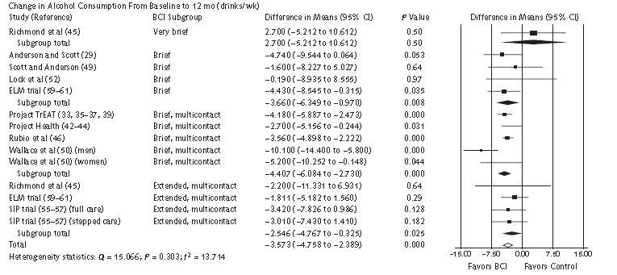
Evidence for Brief Interventions
Jonas DE et al. Annals Internal Medicine 2012
Notes:
Results from a systematic review for the United States Preventive Task Force, published in Annals in 2012 – here is the forest plot indicating point estimates for each study and those falling to the left of zero favoring the brief counseling intervention vs the control – the pooled estimate indicates that compared to the control condition, brief interventions were associated with a change in alcohol consumption from baseline to the 12 month follow-up.

Slide 31
Alcohol Use Disorders: Multi-Pronged Approach
Counseling
Self-Help
Pharmaco-therapy

Slide 32
Counseling
12-Step Facilitation
Encourages acceptance of having chronic disease, loss of control and encourages abstinence
Alcoholics Anonymous
Cognitive Behavioral Therapy
Functional analysis: identify thoughts, feelings and circumstances of the patient before and after drinking
Skills training: unlearn bad habits and learn new skills for coping with problems
Motivational Enhancement Therapy
“Stages of change”
ACP 2009

Slide 33
Pharmacotherapy: Withdrawal
>20 drinks per day, symptomatic withdrawal is likely with abstinence
Characterize with standardized instruments
Clinical Institute Withdrawal Assessment Scale for Alcohol
Benzodiazepines – decrease symptoms, risk of seizures and delirium tremens
Adjunctive therapy – β-blockers, α-agonists, neuroleptics, etc.
Saitz R NEJM 2005; NIAAA guidelines; ACP 2009

Slide 34
Pharmacotherapy: Relapse Prevention
Minimum of three months of treatment
Four FDA-approved treatment options
No guidelines regarding combining medications or order in which treatments provided

Slide 35
Disulfiram
Property | Description
Mechanism | Blocks aldehyde dehydrogenase causing build-up acetaldehyde with alcohol consumption
Effect | Unpleasant feeling with alcohol consumption (flushing, headache, vomiting, dyspnea, confusion)
Dosing | Initial dose 250mg daily → 500 mg
Side Effects | Idiosyncratic fulminant hepatitis, neuropathy, psychosis and symptoms that resolve with stopping the medication (headache, drowsiness, fatigue, rash, pruritus, dermatitis, garlicky taste in mouth)
Cautions | Increased reaction in patients with CAD, receiving treatment for HTN, or with esophageal varices; need to understand effects of medication; avoid if rubber, cobalt or nickel allergy; pregnancy
Administration | Goal is abstinence; supervised dosing most effective
Clinical Effectiveness | Limited efficacy in clinical practice
Saitz R NEJM 2005; Franck J Current Opinion Neurobio 2013
Notes:
FDA approved in 1951

Slide 36
Acamprosate
Property | Description
Mechanism | NMDA modulator to promote glutamate and GABA balance; decreases dopamine excitability
Effect | Decreasing craving
Dosing | 666mg three times daily
Side Effects | Diarrhea
Cautions | Contraindicated in renal insufficiency (creatinine clearance < 30 ml/min); half a dose in those with creatinine clearance >30-50 ml/min
Clinical Effectiveness | Variable data (negative results COMBINE and PREDICT); most effective with detoxification prior to treatment initiation and goal of promoting and maintaining abstinence
Saitz R NEJM 2005; Franck J Current Opinions in Neurobiol 2013;
Maisel NC Addiction 2013
Notes:
FDA approved in 2004

Slide 37
Naltrexone
Property | Description
Mechanism | μ-opioid receptor antagonist
Effect | Decreases euphoria with alcohol Decreases alcohol craving
Dosing | Oral: initial dose 12.5mg or 25mg daily → 50mg daily Injectable: 190-380mg
Side Effects | Nausea, headache, dizziness, nervousness, fatigue, insomnia, vomiting, anxiety, somnolence, dry mouth, dyspepsia, elevated LFTs, depression
Cautions | Contraindicated in patients with opioid dependence or prescribed opioids; relatively contraindicated in patients with hepatitis or cirrhosis
Suggested Monitoring | Symptoms and periodic LFTs
Administration | Appropriate for those not committed to abstinence and does not require abstinence prior to initiation
Saitz R NEJM 2005
Notes:
FDA approved 1994; injectable formulation

Slide 38
Acamprosate vs. Naltrexone
Need to treat 8 people with acamprosate to achieve an additional case of abstinence
Need to treat 9 people with naltrexone to prevent an additional case of return to heavy drinking
Maisel NC Addiction 2012

Slide 39
Limited Prescribing
Veterans with alcohol use disorders, FY2010
Excluded patients with opioid medications
Only 2.75% were prescribed naltrexone!
Patients most likely to be prescribed naltrexone
Substance abuse outpatient visit: AOR=4.9
Any non-substance abuse psychiatric visit: AOR=2.6
Any mental health hospitalization: AOR=1.93
Other: comorbid depression or anxiety disorder
Iheanacho T et al. DAD 2013

Slide 40
Mutual Help Groups: Alcoholics Anonymous
One membership requirement: desire to stop drinking
Supports use of medications but some members disapprove
Meeting types vary
Data demonstrates that participation is associated with decreased drinking and abstinence especially as part of primary outpatient treatment
Saitz R NEJM 2005; Magura JSAD 2012

Slide 41
Alcoholics Anonymous
Prescribe a certain number of meetings a week
Ask about patient’s sponsor
Know how to access meeting schedules:
www.alcoholics-anonymous.org
Encourage patients to try a different meeting type or place if initially unsuccessful
Attend a meeting yourself!

Slide 42
Summary
Alcohol has a major impact on health conditions of our patients
Screening for alcohol use disorders is an important first step
Treatment approaches should be tailored based on alcohol consumption

Slide 43
Summary
Despite effectiveness of treatments, there is variable implementation
Internists are well positioned to deliver these treatments!

Slide 44
Acknowledgements
Dr. David Fiellin

Slide 45
Questions/Comments?
Jen Edelman
ejennifer.edelman@yale.edu
203-737-7115

