Slide 1
Ten simple rules for predictive modeling
Dustin Scheinost, Ph.D.
Assistant Professor of Radiology & Biomedical Imaging, Biomedical Engineering, Statistics & Data Science, and in the Child Study Center
Yale School of Medicine, New Haven, CT
^{Twitter: @Dscheinost,} Email: dustin.scheinost@yale.edu

Slide 2

10 simple rules for predictive modeling

Slide 3
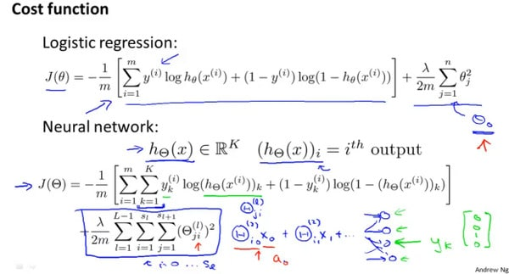
Complex math?

Slide 4
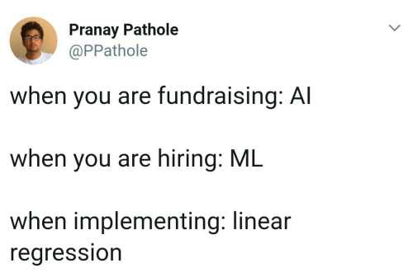
Complex math?

Slide 5
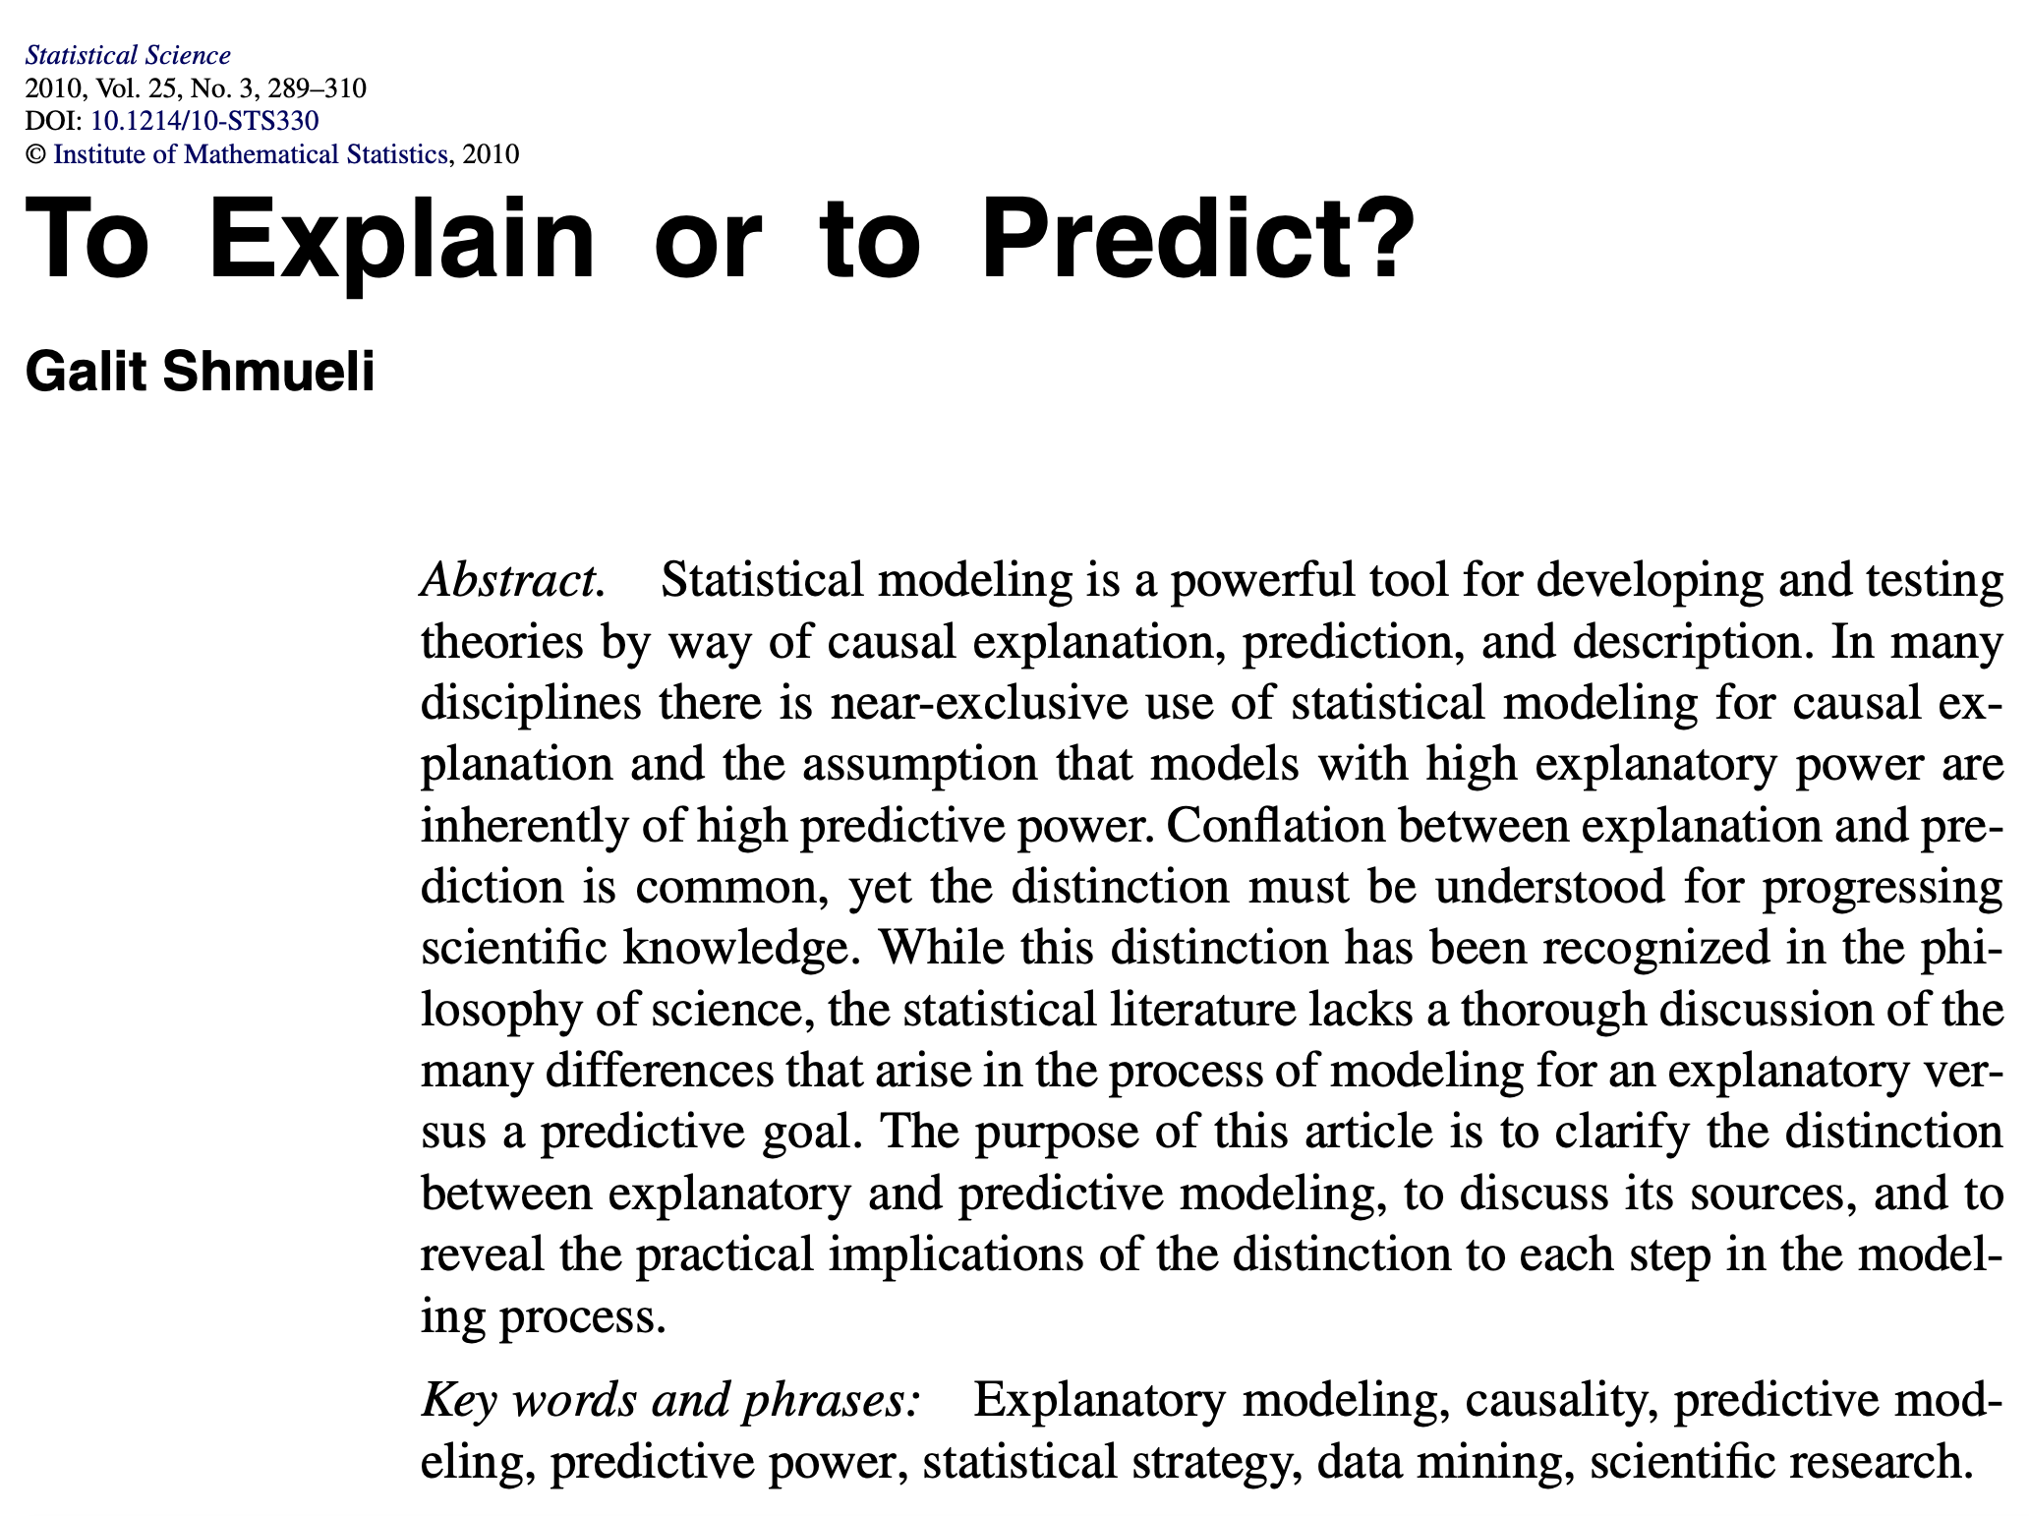
Understanding the fundamentals

Slide 6
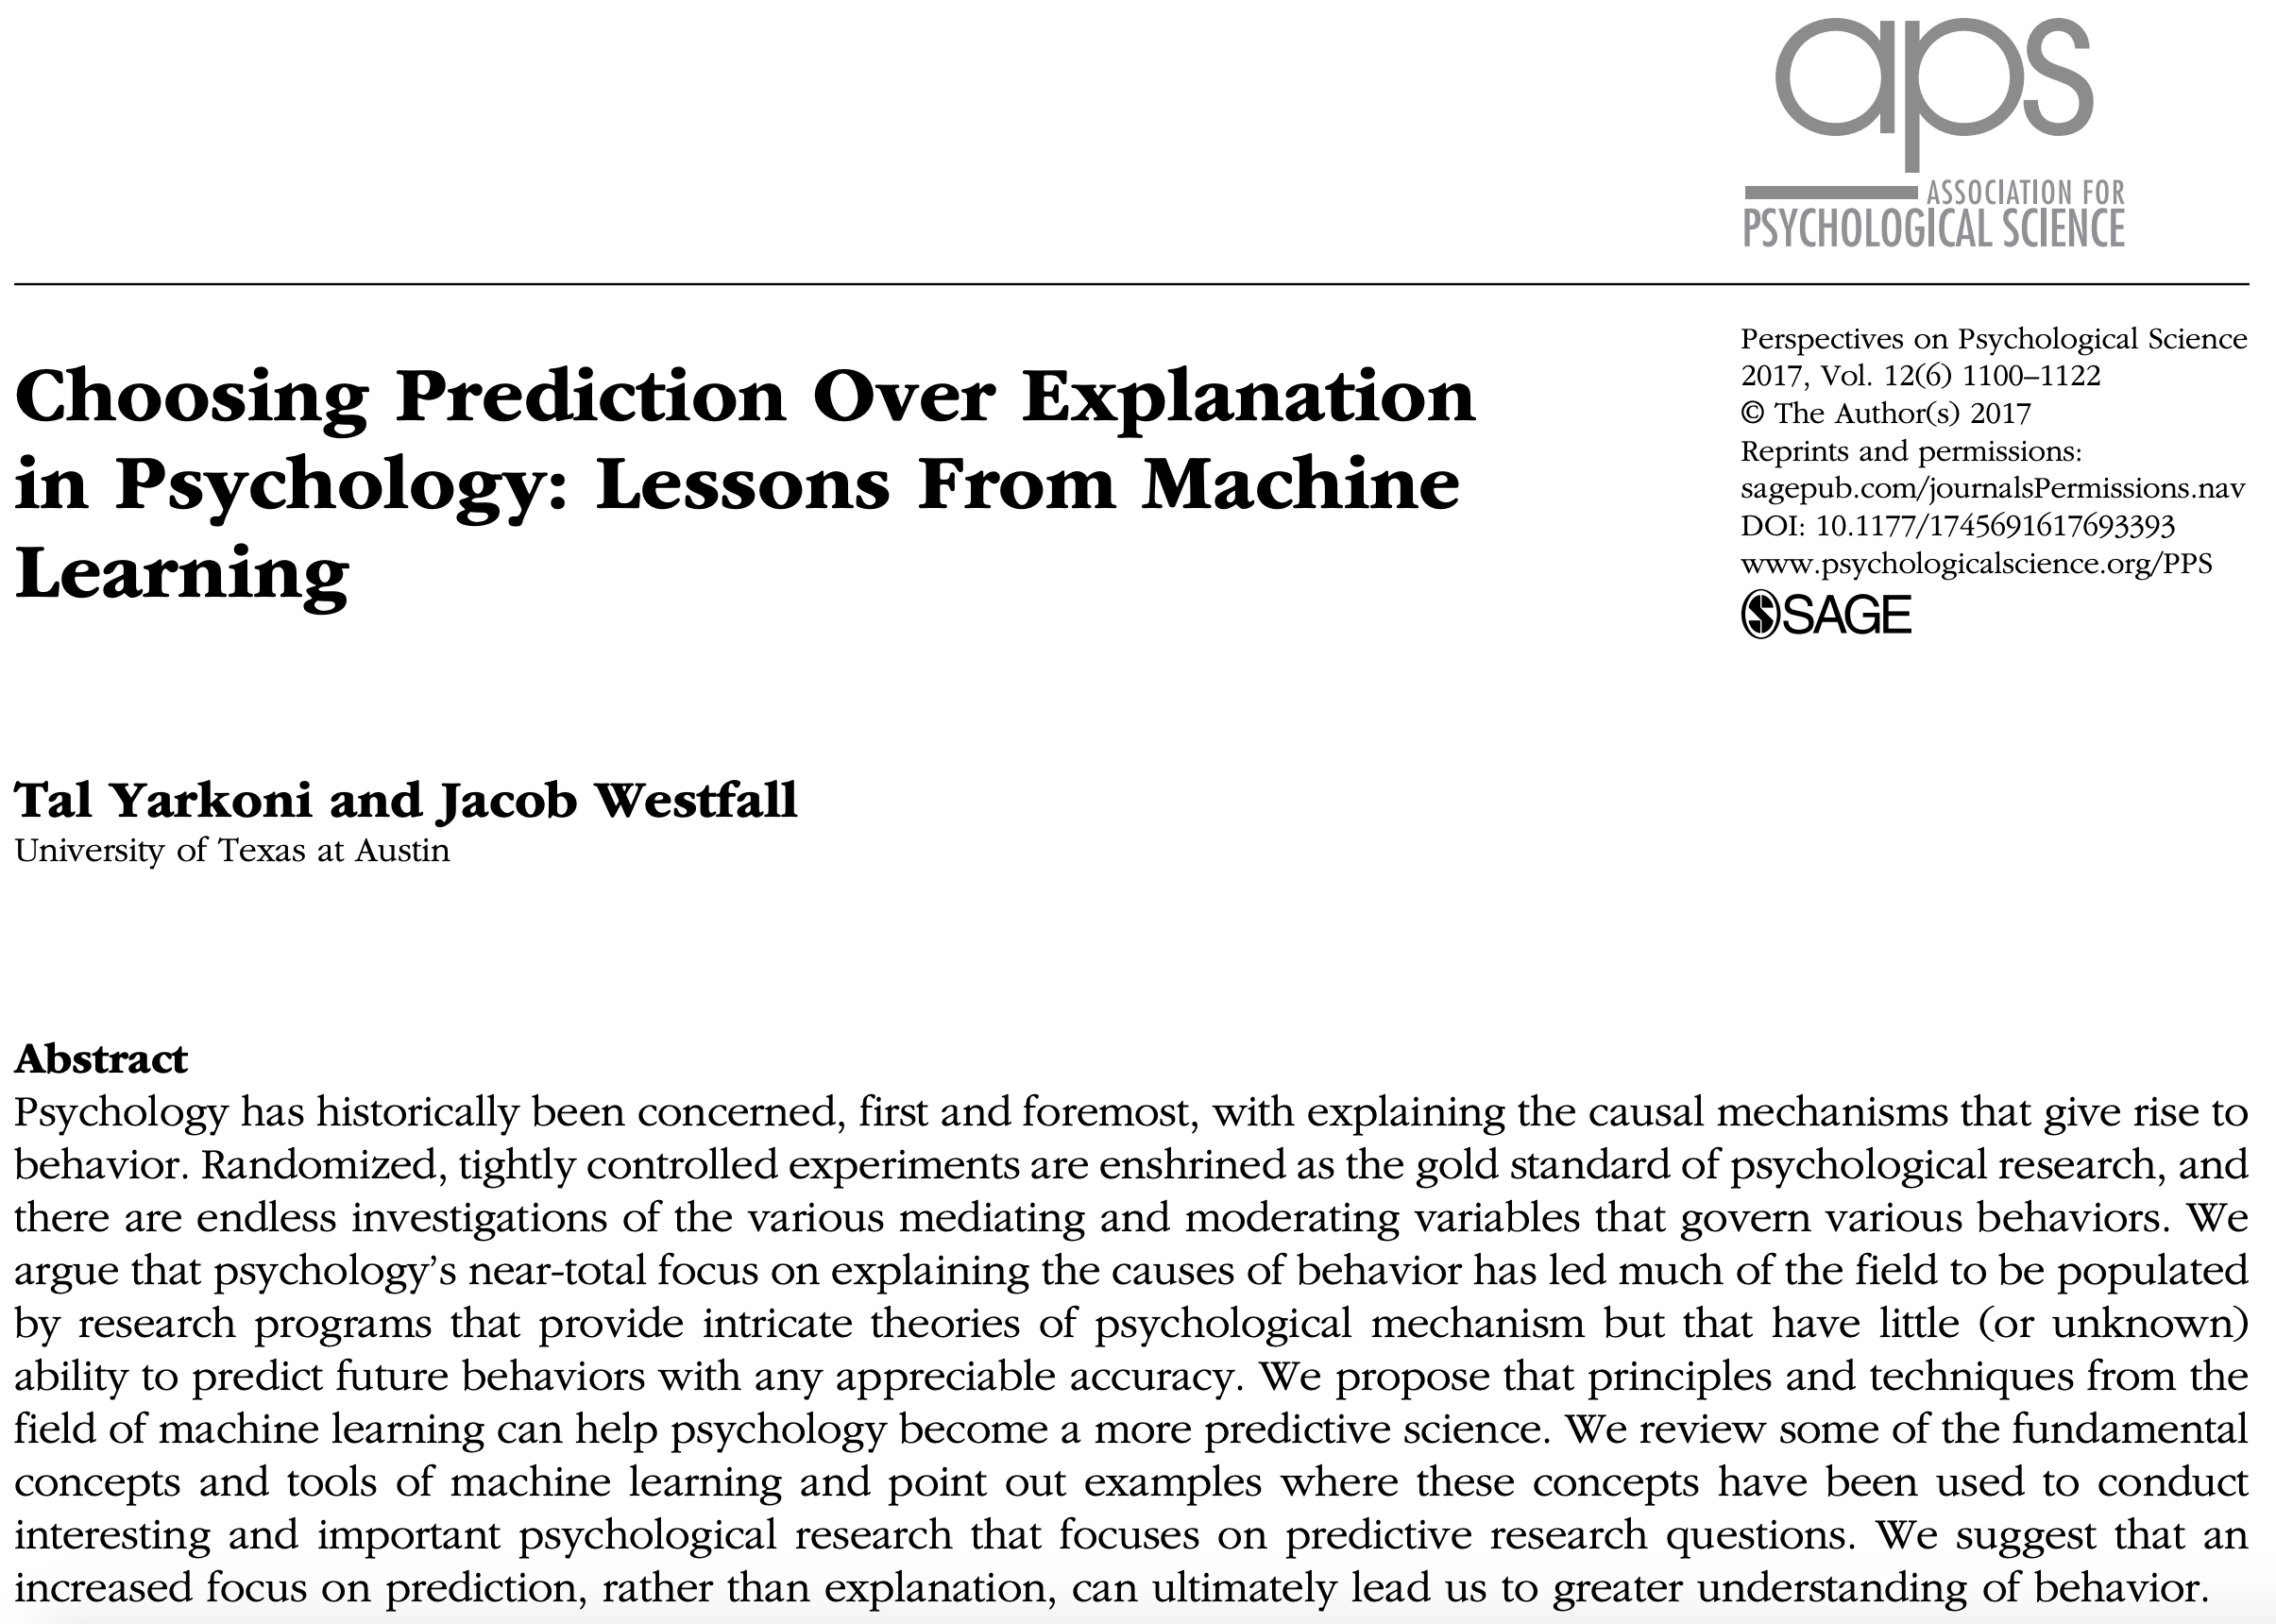
Understanding the fundamentals
  Independent of algorithm

Slide 7
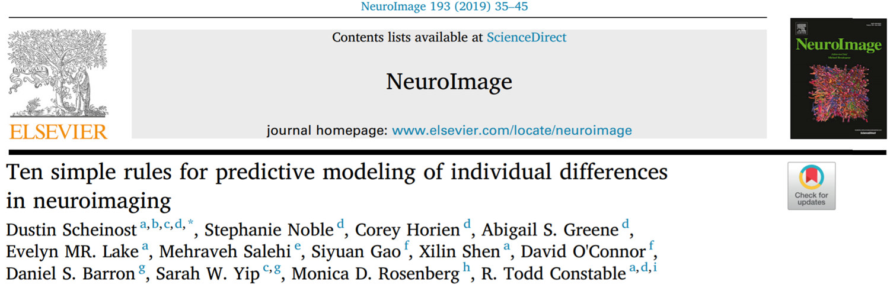
10 simple rules for predictive modeling
  Validating predictive models with independent data: why and how?
  Measuring model performance
  Accounting for confounds and interpreting results

Slide 8
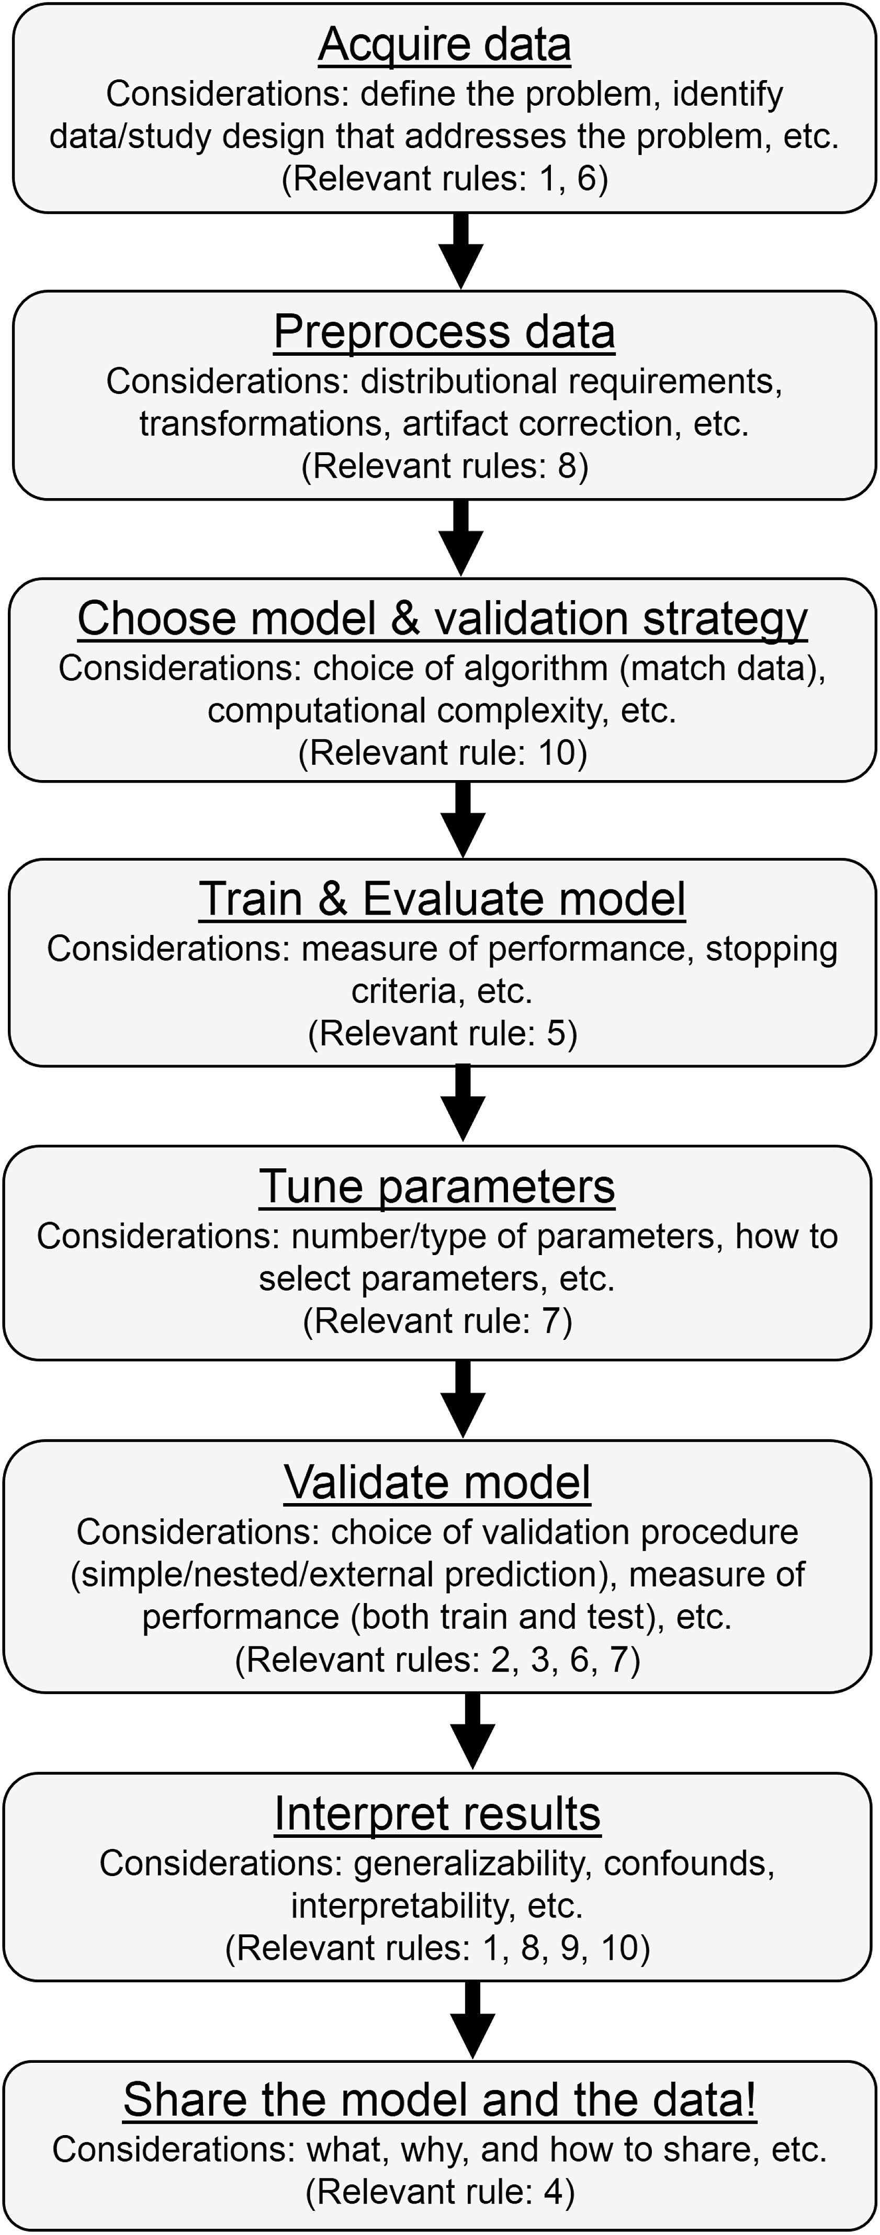
General workflow

Slide 9
Validating predictive models with independent data: why and how?
  Rule #1: use out-of-sample prediction to generate more accurate and generalizable models
  Rule #2: keep training and testing data independent
  Rule #3: use internal validation (i.e., cross-validation) as a practical solution for validating predictive models
  Rule #4: share data, code, and models to facilitate external validation and open science

Slide 10
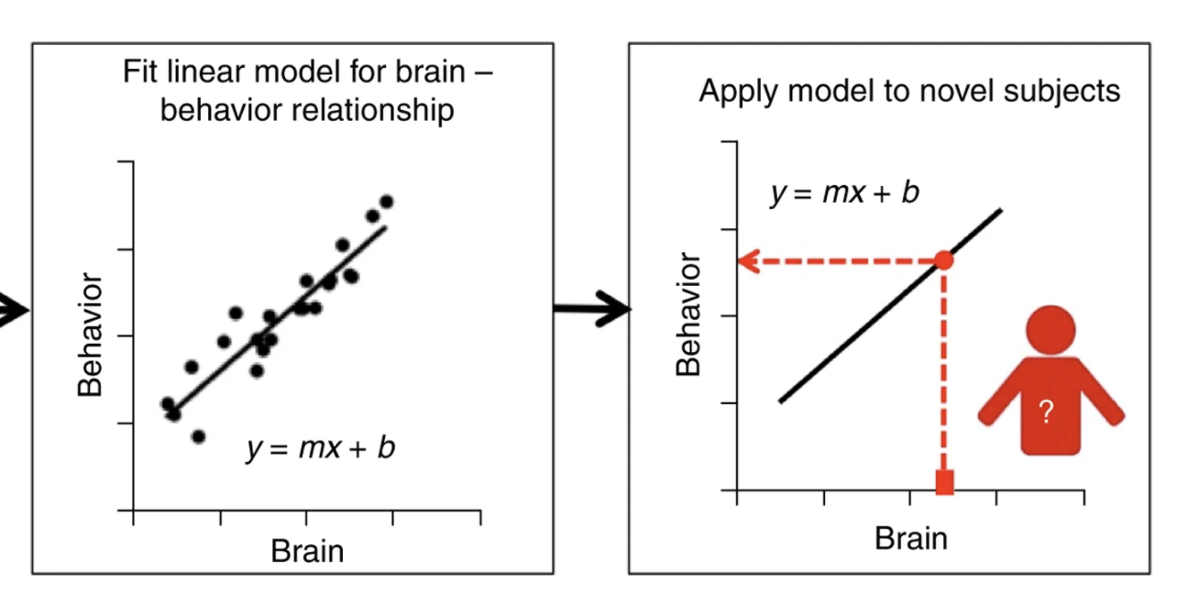
Rule #1: use out-of-sample prediction to generate more accurate and generalizable models

Slide 11
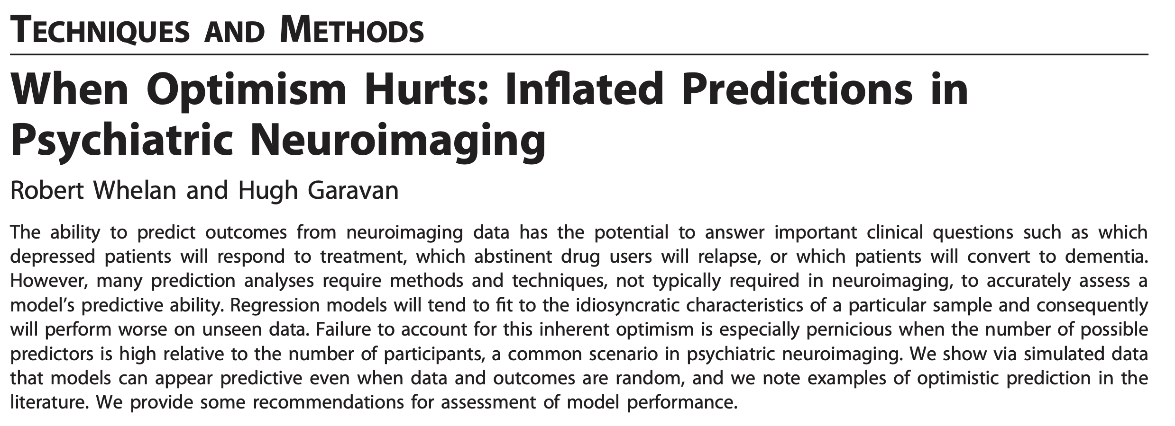
Rule #1: use out-of-sample prediction to generate more accurate and generalizable models
  Overfitting and small, homogeneous dataset yield large effects size
    But in many cases fail to generalize

Slide 12
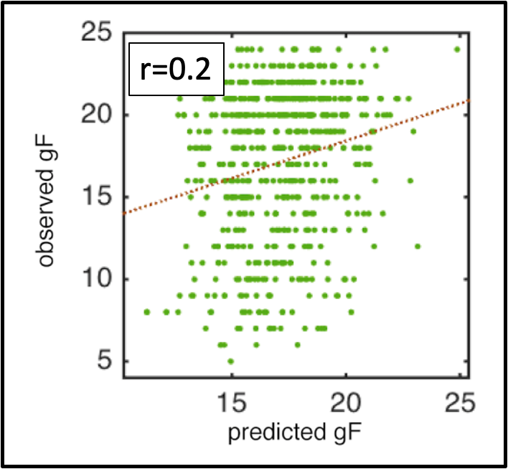
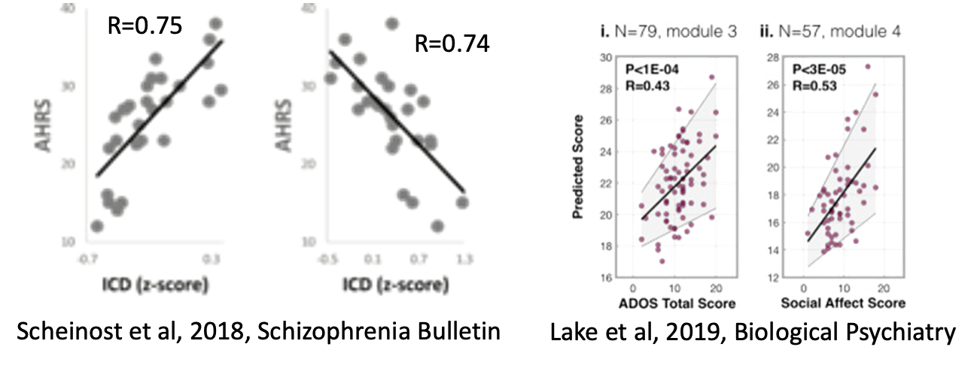
Rule #1: use out-of-sample prediction to generate more accurate and generalizable models
  Out-of-sample prediction improve generalization
    But effects size are smaller

Slide 13
Rule #1: use out-of-sample prediction to generate more accurate and generalizable models
  Prediction is hard
    Need to recalibrate what a “good result” is
  Similar measures of effect sizes
  Be wary of too good results

Slide 14
Rule #2: keep training and testing data independent
  Training data: data used to create a model
  Testing data: data held aside for testing a model's generalizability
  Can do anything with the training data, except
    Mix with testing data (i.e. data contamination)
  Had test data never been collected at all, would the model differ in any way?

Slide 15
Rule #2: keep training and testing data independent
Data
Z-score
Training
Testing
Z-score
Data
Training
Testing
Z-score

Slide 16
Rule #3: use internal validation (i.e., cross-validation) as a practical solution for validating predictive models
  Cross-validation: strategies that divide a single dataset into independent samples
    training data
    testing data
Data
Training
Testing

Slide 17
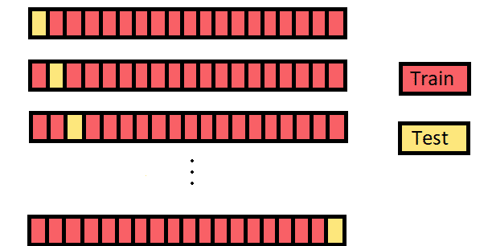
Rule #3: use internal validation (i.e., cross-validation) as a practical solution for validating predictive models
  Leave one out (LOOCV)
    Exhaustive—every combination of training and testing split

Slide 18
Rule #3: use internal validation (i.e., cross-validation) as a practical solution for validating predictive models
  K-fold
    10-fold
    Split-half (2-fold)
    LOOCV (n-fold)
    Generally, not exhaustive
  Choice based on sample size
    Smaller size: leave one out
    Larger size: K-fold
    10-fold: current recommendation

Slide 19
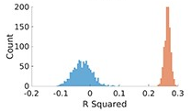
Rule #3: use internal validation (i.e., cross-validation) as a practical solution for validating predictive models
  Repeat splitting several times (100-1000X)

Slide 20
Rule #4: share data, code, and models to facilitate external validation and open science
  External validation: testing model generalizability on a independently collected dataset
Data
Training
Testing
Data
Data
  External dataset are typically shared or opensource
  Share data, code, and models!

Slide 21
Measuring model performance
Rule #5: consider the question of interest when choosing a performance metric and properly assess statistical significance
    Rule #5A: evaluating continuous predictions
    Rule #5B: evaluating categorical predictions
    Rule #5C: assessing significance
  Rule #6: be mindful of sample characteristics
  Rule #7: apply nested cross-validation or multiple comparisons correction when testing multiple models and parameters

Slide 22
Rule #5: consider the question of interest when choosing a performance metric and properly assess statistical significance
  Quantifying differences in observed and predicted values
  Unstandardized or standardized measures
    Unstandardized: direct comparison and has units
    Standardized: remove units to improve interpretability
  Depends on the task at hand
    Prediction of continuous and categorical variables have different measures and considerations

Slide 23
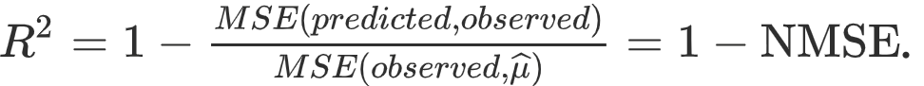
Rule #5A: evaluating continuous predictions
  Mean square error
  normalized MSE
  Cross-validation R^2 (Q^2)
  Correlation between observed and predicted

Slide 24
Rule #5A: evaluating continuous predictions
Good correlation: r=0.51
Poorer MSE: ~20
Predicted
Observed

Slide 25
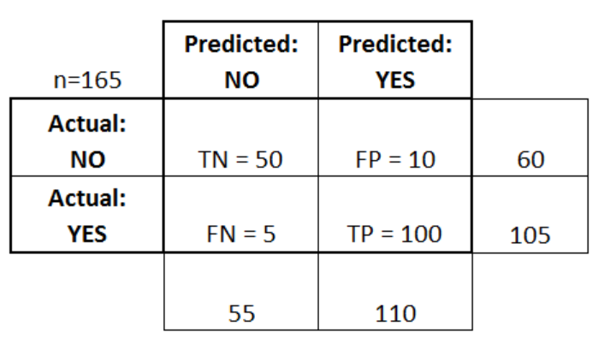
Rule #5B: evaluating categorical predictions
  Overall accuracy: the proportion of correct classifications across observations
  Sensitivity: When it's actually yes, how often does it predict yes?
  Specificity: When it's actually no, how often does it predict no?

Slide 26
Rule #5C: assessing significance
  When using external validation, parametric statistics are ok
  When using cross-validation, permutation testing is needed.

Slide 27
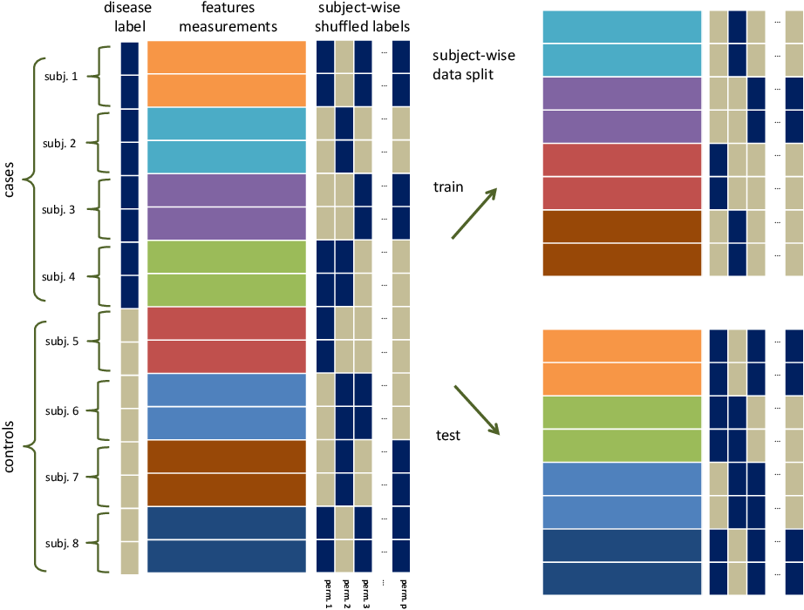
Rule #5C: assessing significance

Slide 28
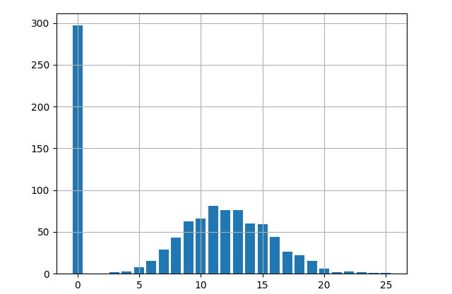
Rule #6: Be mindful of sample characteristics
  Distribution of the phenotypic measures
    Match methods to distributions
    Be careful of ceiling or floor effects

Slide 29
Rule #6: Be mindful of sample characteristics
  Sample size: More is better

Slide 30
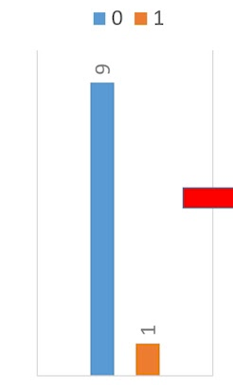
Rule #6: Be mindful of sample characteristics
  Unequal group sizes
    Chance may not be 50%
    60/40 or more
    Sub-sample to balance

Slide 31
Rule #7: Apply nested cross-validation or multiple comparisons correction when testing multiple models and parameters
  P-hacking: cannot simply run a bunch of algorithms and choose the best
  Multiple comparisons correction
    Standard methods: Bonferroni and False Discovery Rate

Slide 32
Rule #7: Apply nested cross-validation or multiple comparisons correction when testing multiple models and parameters
  nested cross-validation: data is divided into three subsets: training, validation, and testing data
    Many algorithm have free parameters
    Training and validation data are used to train model and select free parameters
      An extra cross-validation step
    Testing data is the same as normal cross-validation

Slide 33
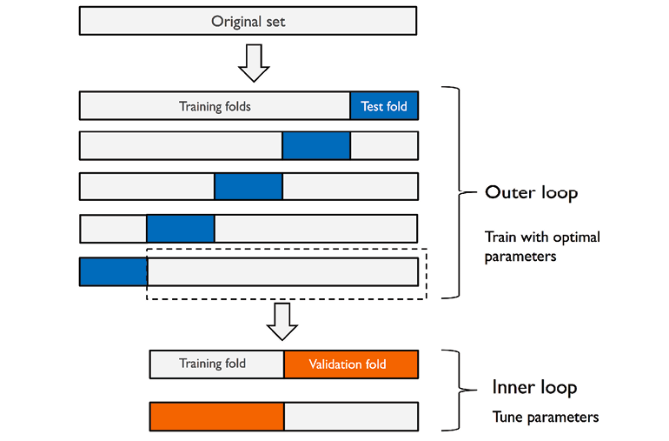
Rule #7: Apply nested cross-validation or multiple comparisons correction when testing multiple models and parameters

Slide 34
Accounting for confounds and interpreting results
Rule #8: check to see if you are predicting what you think you are predicting
  Rule #9: do not expect one model to fit all traits, states, or populations
  Rule #10: remember: interpretability matters

Slide 35
Rule #8: check to see if you are predicting what you think you are predicting
  Confound: an extraneous variable that affects the neuroimaging and/or phenotypic data and systemically differs across individuals in the sample or overall population
    Bias your results
  Nuisance variables: extraneous variable that have an association with the neuroimaging and/or phenotypic data, but have no pertinent neurobiological meaning to the study question
    Increase the variability of results

Slide 36
Rule #8: check to see if you are predicting what you think you are predicting
  How to minimize confounds/nuisance variables?
  Data collection and cleaning
  Exclude individuals with outlying values
  Regress out confounds and nuisance variables
  Explicitly predict the confounds and nuisance variables
  Special challenges for multisite data
    Non-harmonized measures
    Site specific missing data
    Leave one site out cross-validation

Slide 37
Rule #9: do not expect one model to fit all traits, states, or populations
  Different populations may need different models
    Sex
    Age
    Different clinical groups
  Psychological or cognitive state
    For fMRI, task or resting state
    Mood disorders
  A nuisance variables for one study may be of interest in another

Slide 38
Rule #10: remember, interpretability matters
  Models with larger and more complex features may yield better performance
    but may be harder to interpret and use
  Simpler models may be easier to interpret and use
    but not predict as well
  Preference depends on task at hand
  Care when interpreting features

Slide 39
Limitations
  Predictive models are not a cure all
    Traditional analyses are very powerful
  Phenotypic measures are not always the ground truth but themselves suffer from confounds and noise
    Garbage in; garbage out
  Avoid the hype
    Lots of bad studies with machine learning
    Leads to skepticism

Slide 40
Summary
  Validating predictive models with independent data: why and how?
  Measuring model performance
  Accounting for confounds and interpreting results

Slide 41

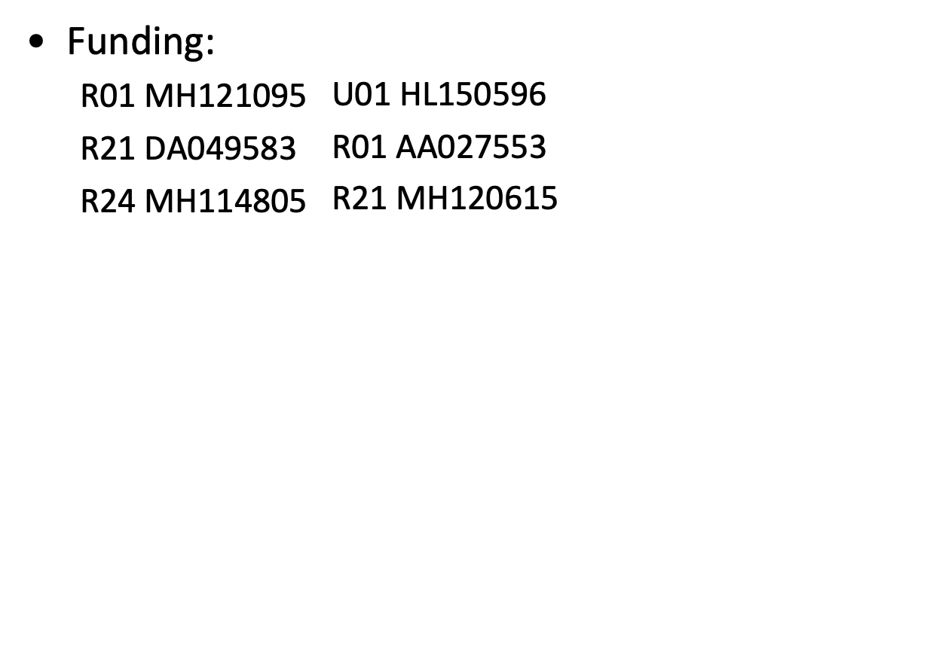
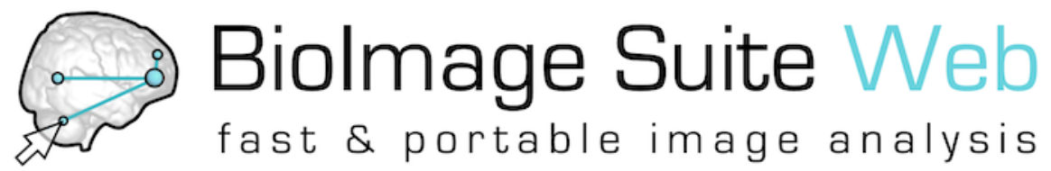
Acknowledgments
Stephanie Noble
Alex Dufford
Mike Farruggia
Qinghao Liang
Link Tejavibulya
Rongtao Jiang
Matt Rosenblatt
Maggie Westwater
Javid Dadashkarimi
Hannah Peterson
Brenden Adkinson
Raimundo Rodriguez
Siyuan Gao
Alice Hahn
Max Rolison
Wei Dai
Jean Ye
https://bioimagesuiteweb.github.io/webapp/index.html

Slide 42

Many thanks!
Questions and Comments

