Slide 1
Nutrition and Osteoporosis:
Lots of Ingredients, Lots of Recipes,
Lots of Cooks and
of course
Lots of Controversy
July 25, 2016
Karl L. Insogna, MD
Ensign Professor of Medicine
Yale School of Medicine

Slide 2
Outline of My Talk
Nutrition and bone: Still a hot topic, still tough to study.
Calcium and bone: a double-edged sword?
Vitamin D: the miracle, a mirage, or somewhere in between?
Isoflavones: the designer estrogen we were eating all along?
Protein: bad to the bone?
Who says one meal doesn’t matter?
Summary

Slide 3
Nutrition and bone:
Still a hot topic, still tough to study

Slide 4
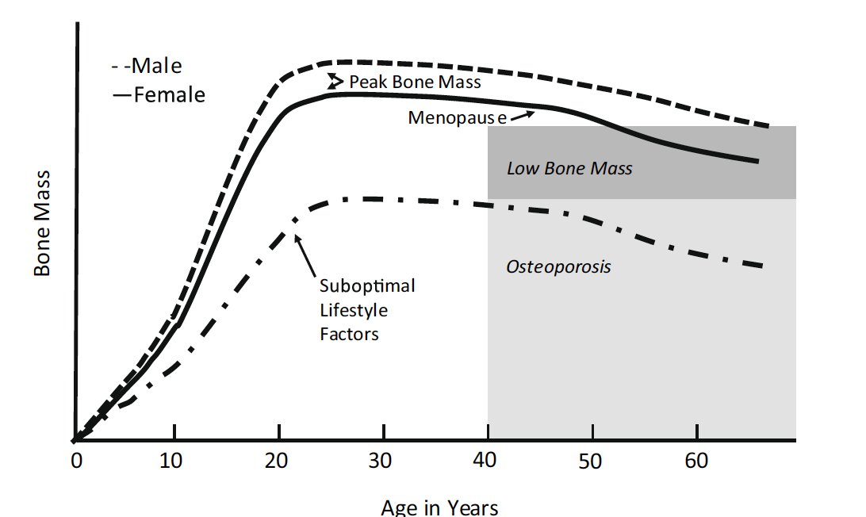
Critical times when nutrition can potentially impact skeletal health
Osteoporosis Int. 27:1281 2016

Slide 5
The Osteoporosis Epidemic
Women
4-6 million, 13-18% Osteoporosis
13-17 million, 37-50% Osteopenia
Men
1-2 million, 3-6% Osteoporosis
8-13 million, 28-47% Osteopenia

Slide 6
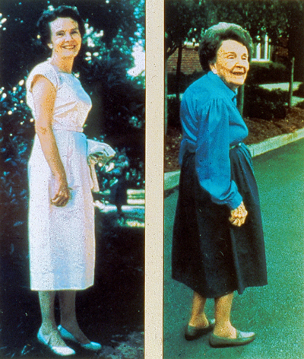
Spinal Osteoporosis is debilitating
Linda
age
50 years
Linda
age
75 years

Slide 7
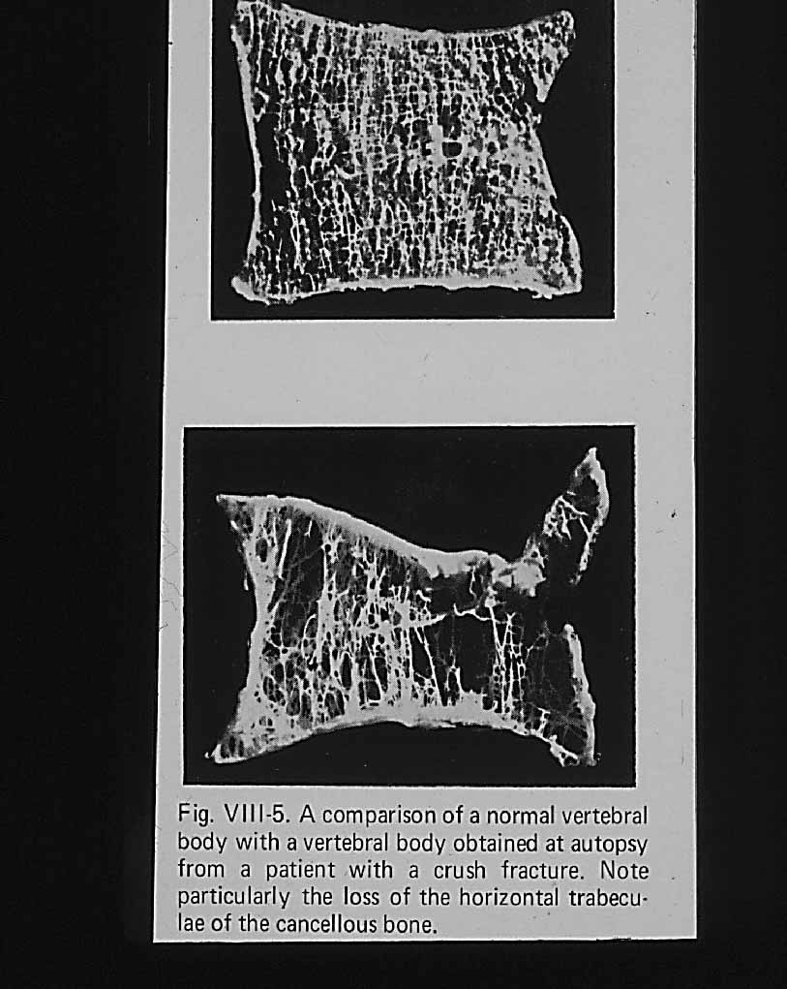
Spinal Osteoporosis causes
vertebral fractures with no trauma

Slide 8
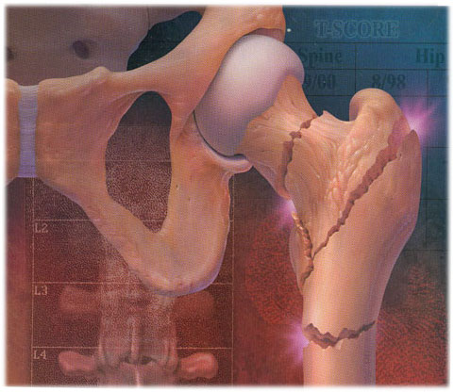
Hip fracture can be lethal:
15-20% of hip fractures patients die
within 1 year of the facture

Slide 9
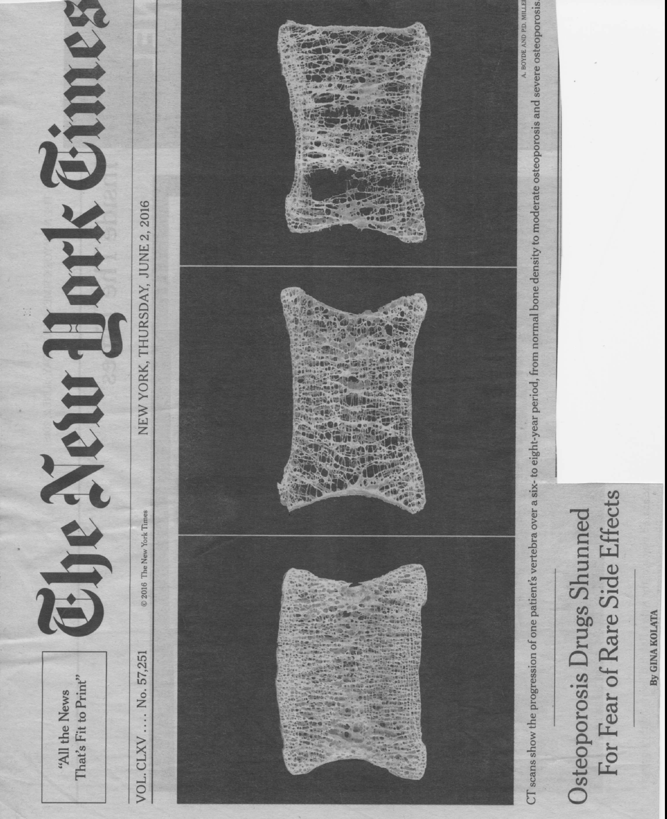
There is great public interest in non-pharmacologic approaches to skeletal health

Slide 10
The Conundrum in Studying
Nutrition and Skeletal Health
Skeletal mass is a largely heritable trait. 70-75% of bone mass (we don’t know about bone quality) is genetically determined.
Of the various environmental factors that comprise the remaining 30%, certainly nutrition is among the most important.
The skeleton responds relatively slowly to genetic and environmental factors - with changes measured over years.
Most prospective, randomized, blinded nutrition studies are conducted over, at most, a few years, and very few have had skeletal end points as their primary outcome.

Slide 11
Calcium and bone:
a double-edged sword?

Slide 12
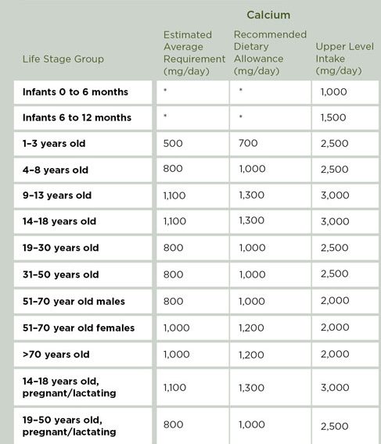
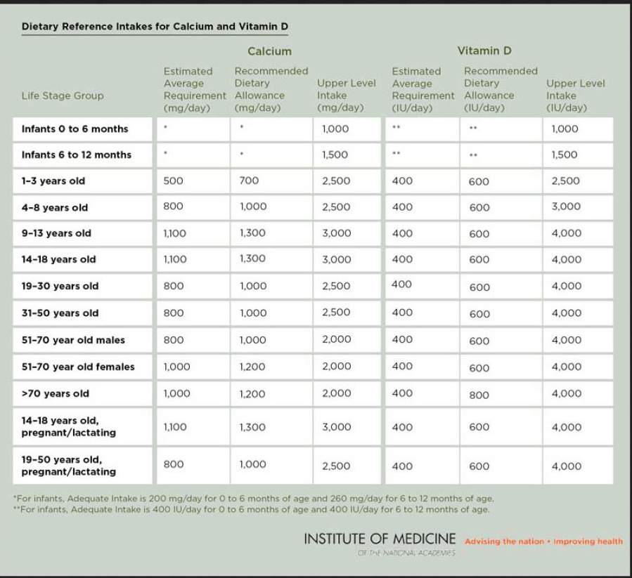
Institute of Medicine’s 2010 DRI for Calcium
*For infants, adequate intake is 200 mg/d for 0-6 months of age and 260 mg/d for 6-12 of age.
Notes:
Estimated Average Requirement (EAR): a nutrient intake value that is estimated to meet the requirement of half the healthy individuals in a group
Recommended Dietary Allowance (RDA): the average daily dietary intake level that is sufficient to meet the nutrient requirement of nearly all (97 to 98 percent) healthy individuals in a group.

Slide 13
Well-Absorbed Dietary Sources of Calcium
Type of Food | Serving Size | Elemental Calcium/Serving mg | Calories/Serving kcal
Dairy Products
Plain low-fat yogurt | 8.0 oz | 448 | 154
Low-fat yogurt with fruit | 8.0 oz | 384 | 238
Mozzarella, part skim | 1.5 oz | 333 | 108
Cheddar cheese | 1.5 oz | 307 | 171
2% Low-fat milk | 1 cup | 293 | 122
Low-fat cottage cheese | 1 cup | 206 | 194
NEJM 369:1537-43, 2013

Slide 14
Well-Absorbed Dietary Sources of Calcium
Type of Food | Serving Size | Elemental Calcium/Serving mg | Calories/Serving kcal
Fruits and Vegetables
Calcium-fortified OJ | 6.0 oz | 261 | 88
Raw kale | 1 cup | 100 | 33
Raw bok choy | 1 cup | 74 | 9
Raw broccoli | 1 cup | 43 | 31
NEJM 369:1537-43, 2013

Slide 15
Well-Absorbed Dietary Sources of Calcium
Type of Food | Serving Size | Elemental Calcium/Serving mg | Calories/Serving kcal
Canned fish
Sardines | 3.0 oz | 325 | 177
Pink salmon | 3.0 oz | 183 | 110
Grains
Fortified, ready-to-eat cereals | 1 cup | 100-1333 | 100-160
Fortified, cooked oat cereals | 1 cup | 187 | 159
Commercially prepared white or wheat bread | 1 slice | 30-73 | 69-74
NEJM 369:1537-43, 2013

Slide 16
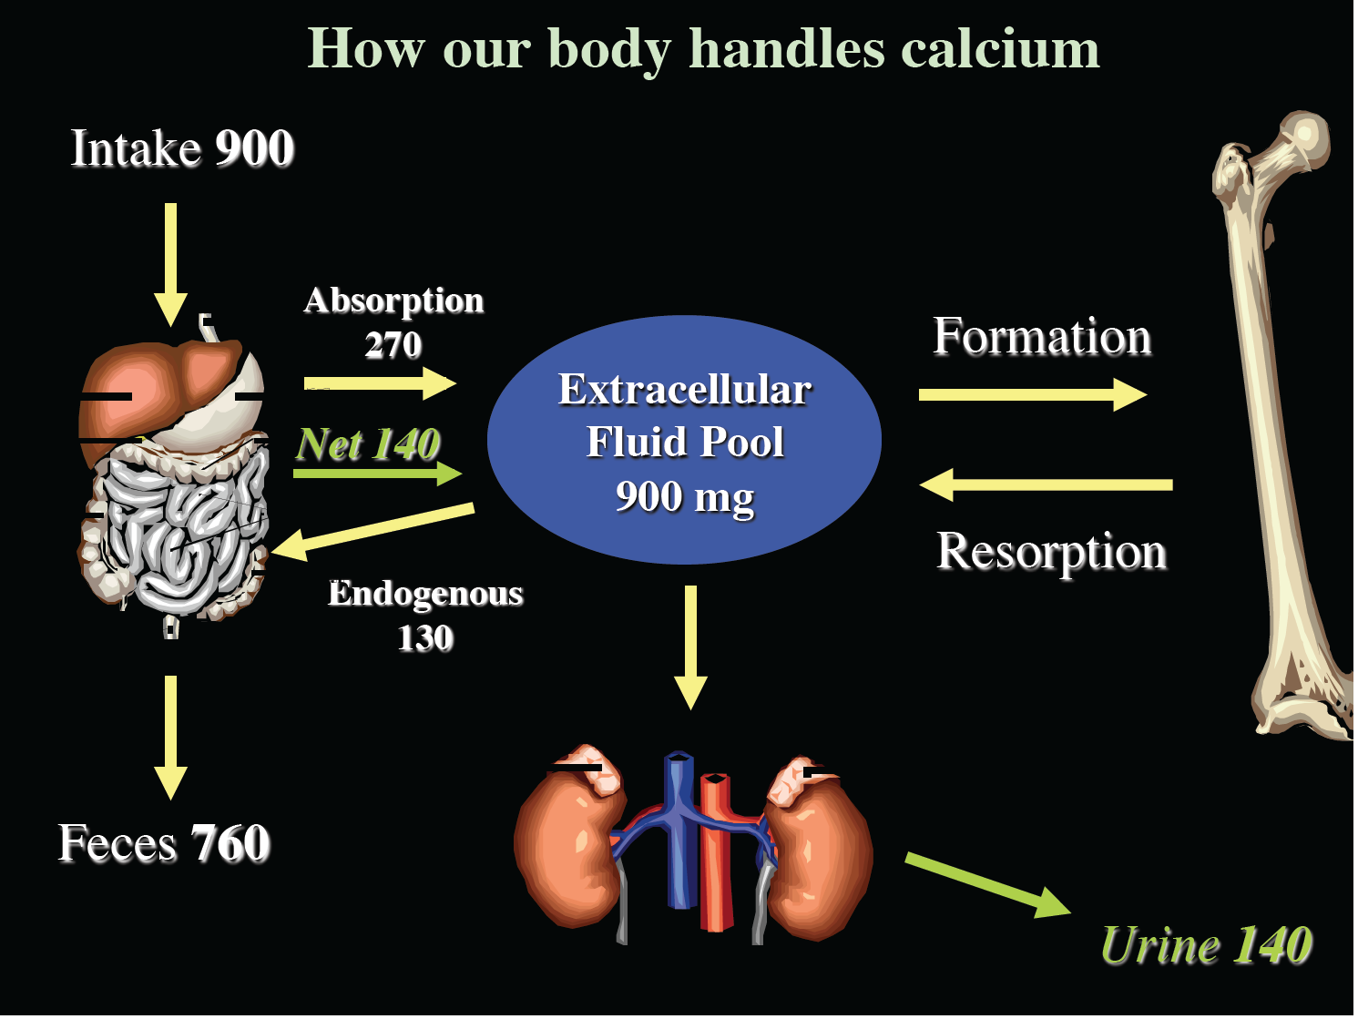

Slide 17
However, there are large parts of the life cycle when calcium economy is not in balance
During periods of skeletal accrual: ages 0 to 16-20
(depending on the skeletal site being analyzed) the system is not in balance and more calcium is required for building new bone.
During later adult life (>55-65, depending on sex) the system may also not be in balance.
Poor dietary intake and impaired absorption from the GI may lead to compensatory hormonal changes that can cause increased bone breakdown.

Slide 18
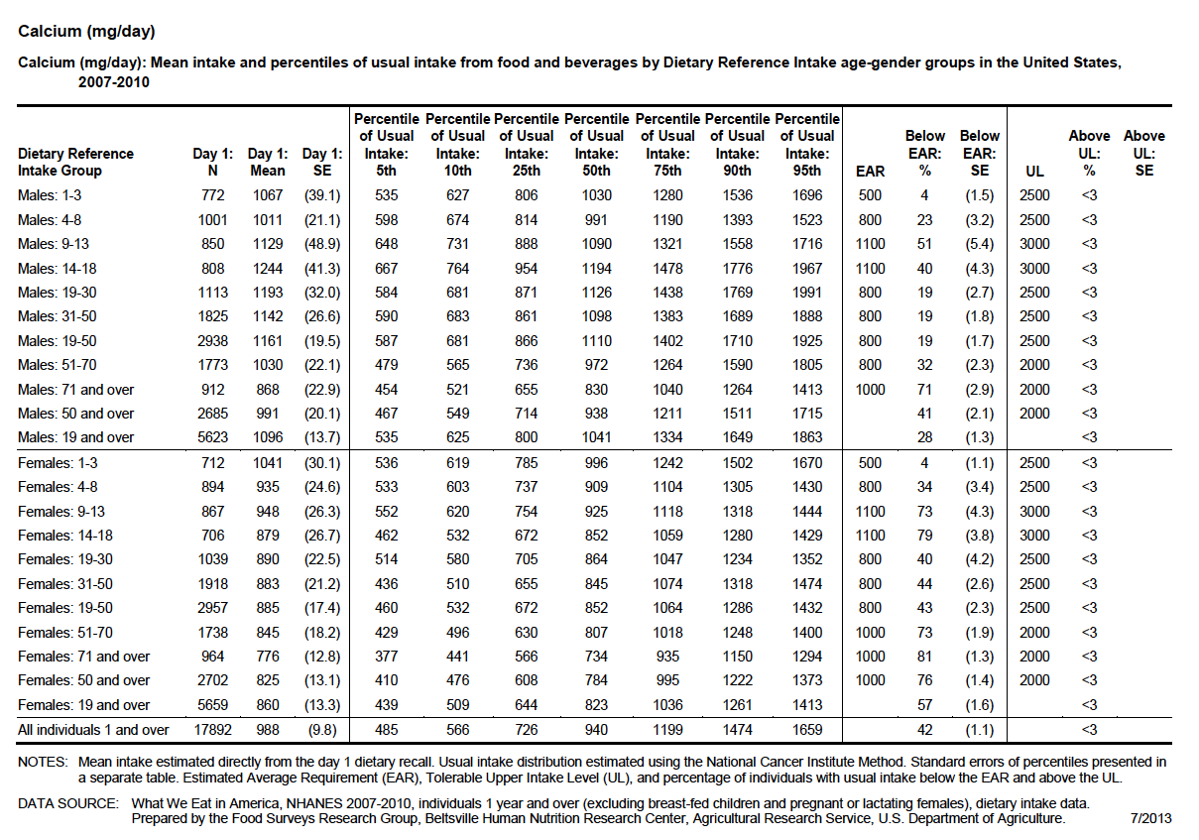
How much calcium do Americans actually consume?
http://health.gov/dietaryguidelines/2015-scientific-report/06-chapter-1/d1-2.asp
Notes:
Recommended Dietary Allowance (RDA): the average daily dietary intake level that is sufficient to meet the nutrient requirement of nearly all (97 to 98 percent) healthy individuals in a group.
Estimated Average Requirement (EAR): a nutrient intake value that is estimated to meet the requirement of half the healthy individuals in a group.

Slide 19
Calcium intake during childhood and
its impact on the rate of
bone mass accrual

Slide 20
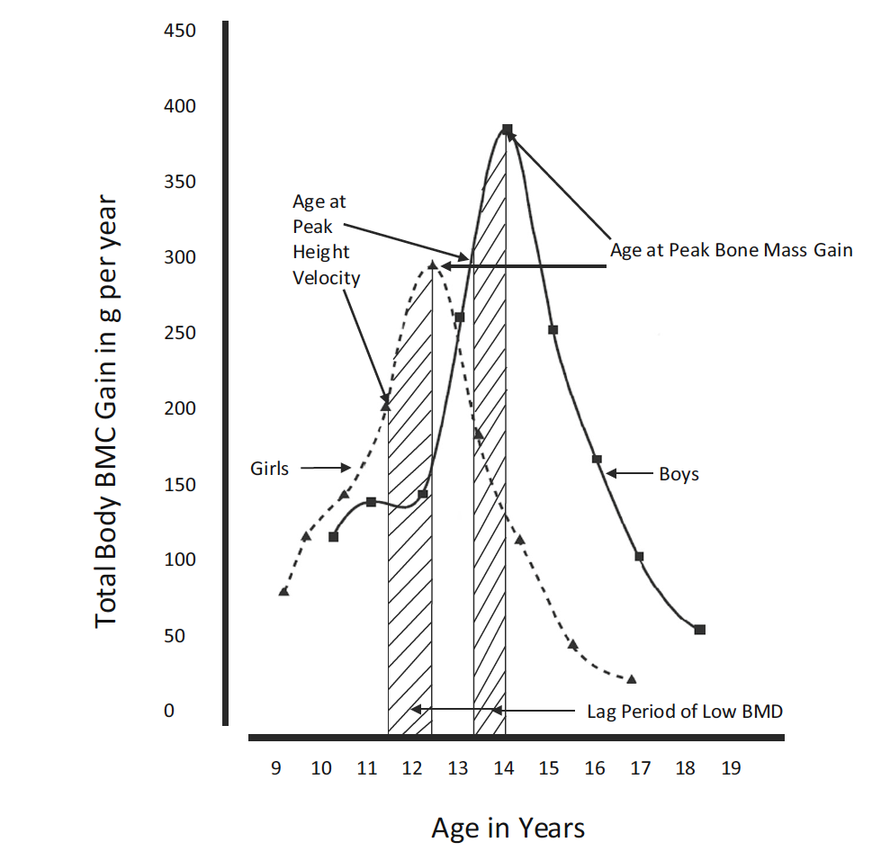
Relationship between peak growth velocity and peak bone mass in children
Osteoporosis Int. 27:1281 2016

Slide 21
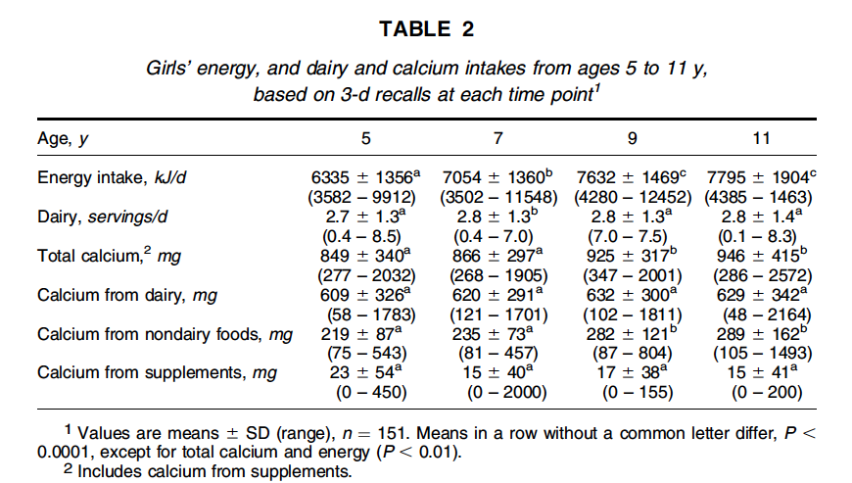
Impact of dietary calcium on bone mass in children: a longitudinal study
J. Nut. 136;1281, 2006
Notes:
We examined longitudinally the association between calcium intake and total body bone mineral content (TBBMC) in 151 non-Hispanic white girls. Intakes of dairy, energy, and calcium were assessed using three 24-h dietary recalls in girls at ages 5, 7, 9, and 11 y. We assessed their total-body bone mineral content with dual energy X-ray absorptiometry at ages 9 and11 y.

Slide 22
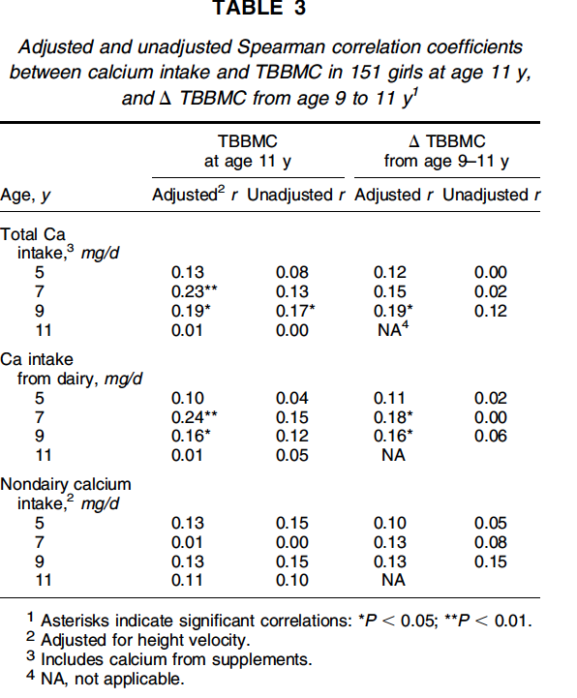
A longitudinal study (cont.)
J. Nut. 136;1281, 2006
Notes:
We examined longitudinally the association between calcium intake and total body bone mineral content (TBBMC) in 151 non-Hispanic white girls. Intakes of dairy, energy, and calcium were assessed using three 24-h dietary recalls in girls at ages 5, 7, 9, and 11 y. We assessed their total-body bone mineral content with dual energy X-ray absorptiometry at ages 9 and11 y.

Slide 23
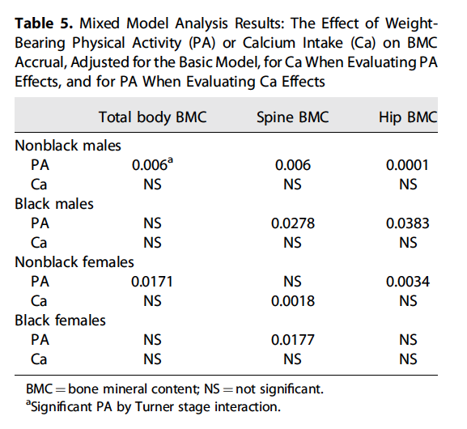
Impact of dietary calcium on bone mass in children: a second longitudinal study
J Bone Min Res. 30:156, 2015,
Notes:
self‐reported dietary calcium intake and weight‐bearing physical activity on bone mass accrual across the five stages of pubertal development in a large, diverse cohort of US children and adolescents. The Bone Mineral Density in Childhood study was a mixed longitudinal study with 7393 observations on 1743 subjects. Annually, we measured BMC by dual‐energy X‐ray absorptiometry (DXA), physical activity and calciumintake by questionnaire, and pubertal development (Tanner stage) by examination for up to 7 years. Mixed‐effects regression models were used to assess physical activity and calcium intake effects on BMC accrual at each Tanner stage

Slide 24
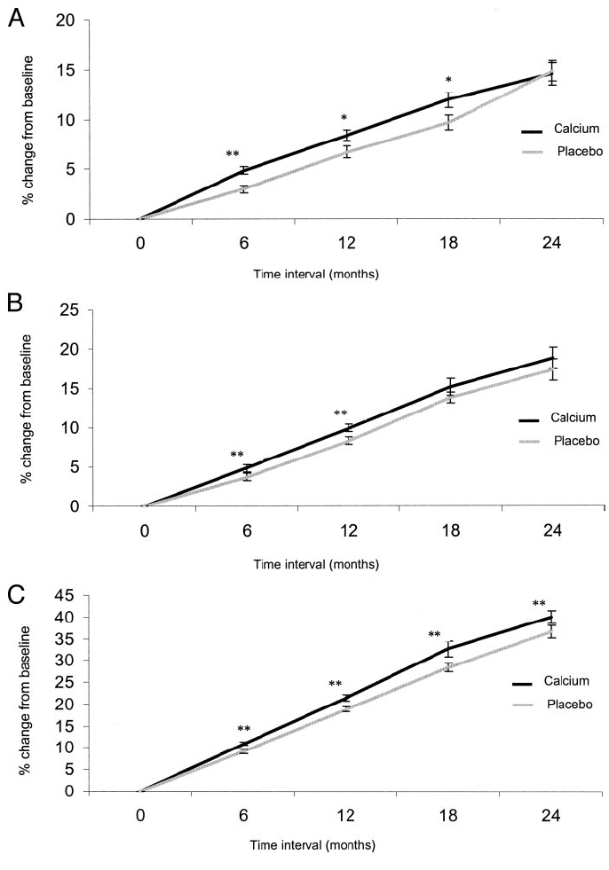
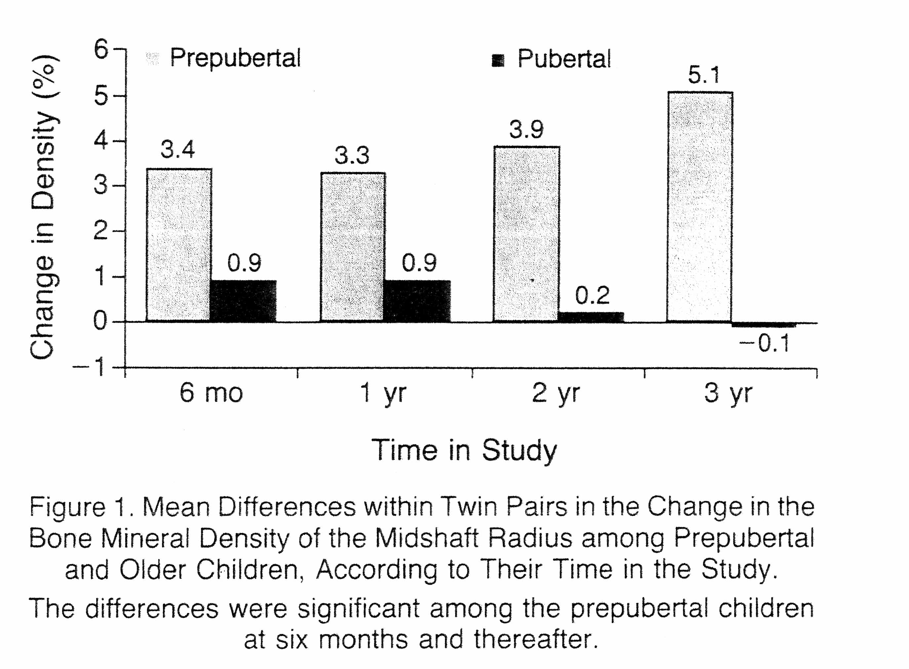
Twin studies using calcium supplements
New Eng J Med 327:82, 1992
J. Clin. Endocriol Metab 89:4916, 2004
Notes:
NEJM: A three-year, double-blind, placebo-controlled trial of the effect of calcium supplementation (100 mg of calcium citrate malate per day) on bone mineral density in 70 pairs of identical twins (mean [±SD] age, 10±2 years; range, 6 to 14). In each pair, one twin served as a control for the other; 45 pairs completed the study. Bone mineral density was measured by photon absorptiometry at two sites in the radius. The mean daily calcium intake placebo was 908 mg, and that of the twins given calcium supplements was 1612 mg
JCEM: Fifty-one pairs of premenarcheal female twins (27 monozygotic and 24 dizygotic; mean SD age, 10.3 1.5 yr) participated in a randomized, single-blind, placebo-controlled trial with one twin of each pair receiving a 1200-mg calcium carbonate. Baseline intake about 715-750 at each Tanner stage
(Caltrate) supplement.

Slide 25
Summary of a systematic analysis of the impact of calcium on accrual of skeletal mass
Level of evidence: A
90% of RCTs using supplement pills found a small, biologically, and statistically significant positive effect on BMD and/or BMC accrual.
Effect largest in children who had the lowest dietary calcium intakes at baseline.
This supports the premise of calcium as a threshold nutrient (i.e., if usual intake of calcium exceeds requirements, then it is unlikely that any benefit of the intervention will be detected.
Osteoporosis Int (2016) 27:1281 2016

Slide 26
Impact of calcium intake on rates of bone loss in later adult life

Slide 27
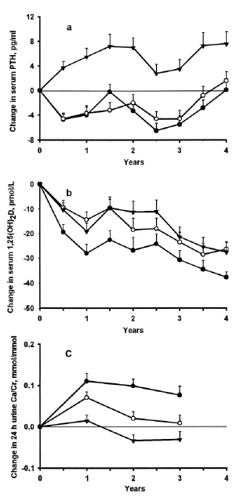
Effect of calcium or vitamin D on secondary hyperparathyroidism
and bone loss in older individuals
. calcium
o 25(0H)D
⧫ placebo
J. Clin. Endo Metab
85:3011, 2000
Notes:
FIG. 3. The effect of calcium (.), 25OH vitamin D3 (o), and placebo ()
on the change in serum PTH (a), 1,25(OH)2 vitaminD (b), and 24-h
urine calcium/Cr (c) with years on supplement (mean and 1 SE). PTH
changes on calcium and 25OH vitamin D3 were different from placebo
(P , 0.001), but not from each other. 1,25(OH)2 vitamin D decreased
on calcium more than on 25OH vitamin D3 (P , 0.002) and placebo
(P , 0.001). Twenty-four-h urine calcium on calcium was higher than
on 25OH vitamin D3 (P , 0.06) and on placebo (P , 0.001) and 25OH
vitamin D3 was different from placebo (P , 0.07). A 24-h urine was
not collected on study at the fourth year visit.

Slide 28
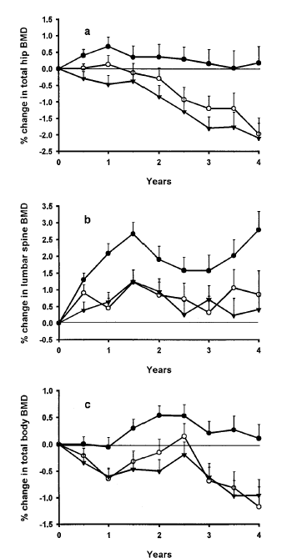
Effect of calcium or vitamin D on secondary hyperparathyroidism
and bone loss in older individuals
. calcium
o 25(0H)D
⧫ placebo
J. Clin. Endo Metab
85:3011, 2000
Notes:
FIG. 1. The effect of calcium (.), 25OH vitamin D3 (o), and placebo () on the change in BMD at the total hip (a),
lumbar spine (b), and total body (c) with years on supplement (mean and 1 SE). Calcium was different from placebo
at the hip (P,0.008), the spine (P,0.02), and at the total body (P , 0.08). 25OH vitamin D3 and placebo did not differ.

Slide 29
Widely available calcium supplements
Formulation | Elemental Calcium Content (percent) | Comments
Calcium Carbonate | 40 | Least expensive and most commonly used supplement;
Calcium Citrate | 21 | Perhaps slightly better absorbed But often more expensive
Calcium Gluconate | 9 | Rarely used
Calcium Lactate | 13 | Rarely used
Bone meal, oyster shell, dolomite | 30 | Primarily contains calcium carbonate but may contain detectable lead and should be avoided during pregnancy
NEJM 369:1537-43, 2013

Slide 30
Does calcium supplementation reduce fracture risk?

Slide 31
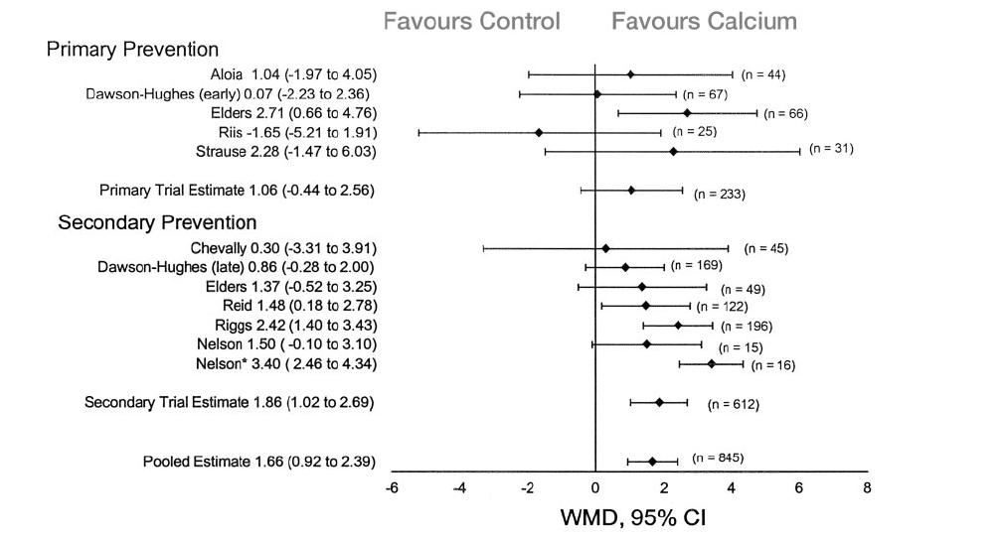
Primary and secondary prevention
of vertebral fractures
Endo Reviews 23:552, 2002

Slide 32
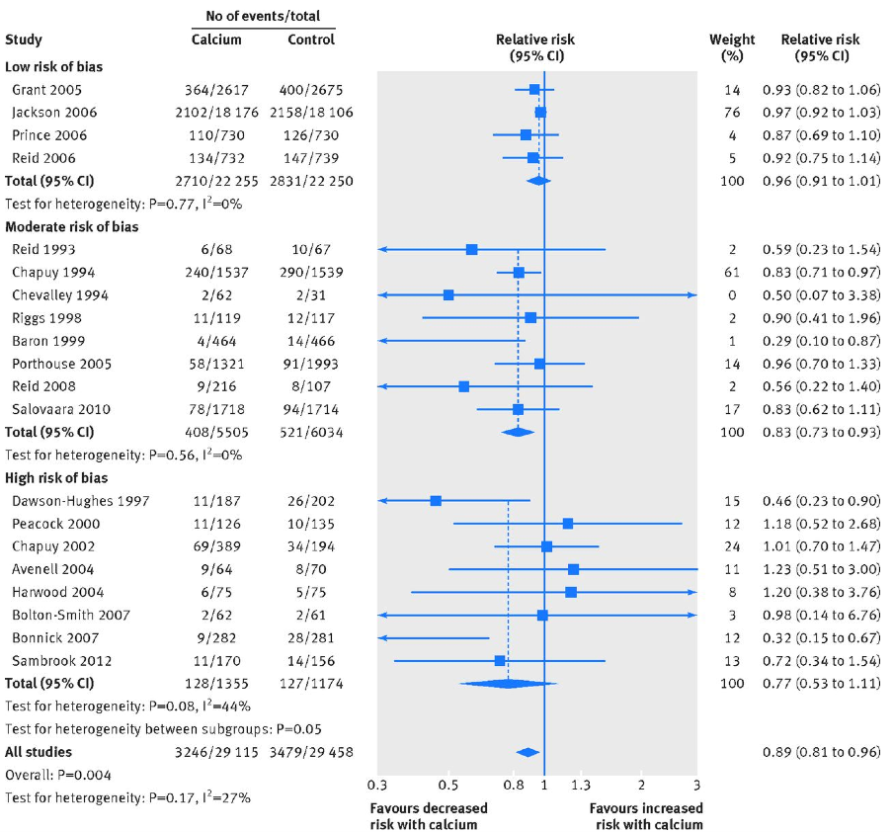
Calcium supplements and the risk of any fracture
British Med. J 351:4580, 2015

Slide 33
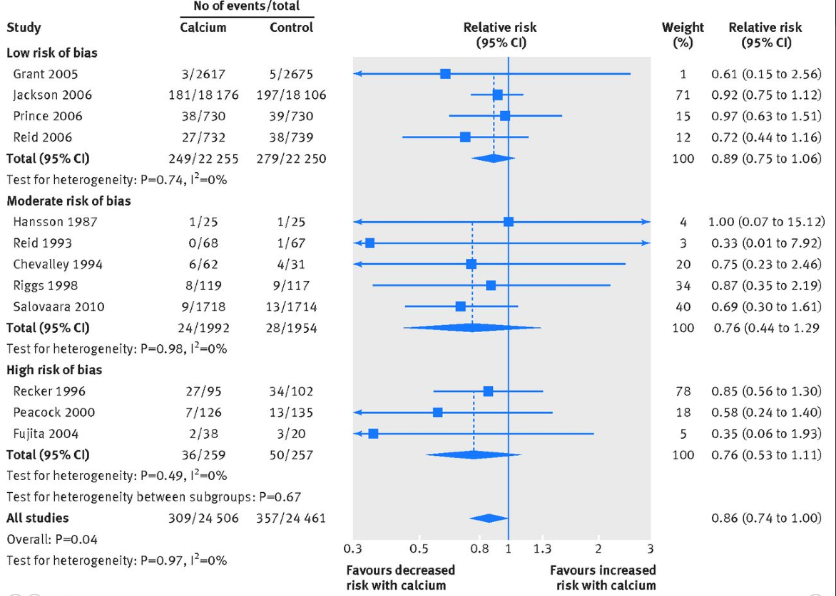
Calcium supplements and vertebral fracture risk: data from a “systematic review”
British Med. J 351:4580, 2015

Slide 34
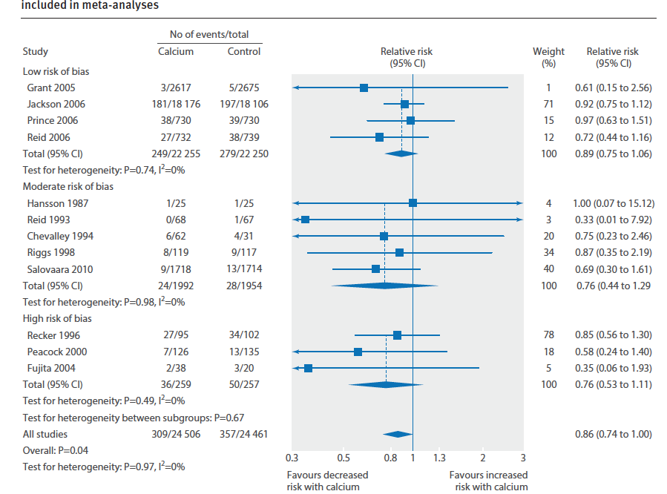
Calcium supplements and the risk of hip fracture
British Med. J 351:4580, 2015

Slide 35
Five year follow up from the
Women’s Health Initiative:
11.9 years of vitamin D and calcium

Slide 36
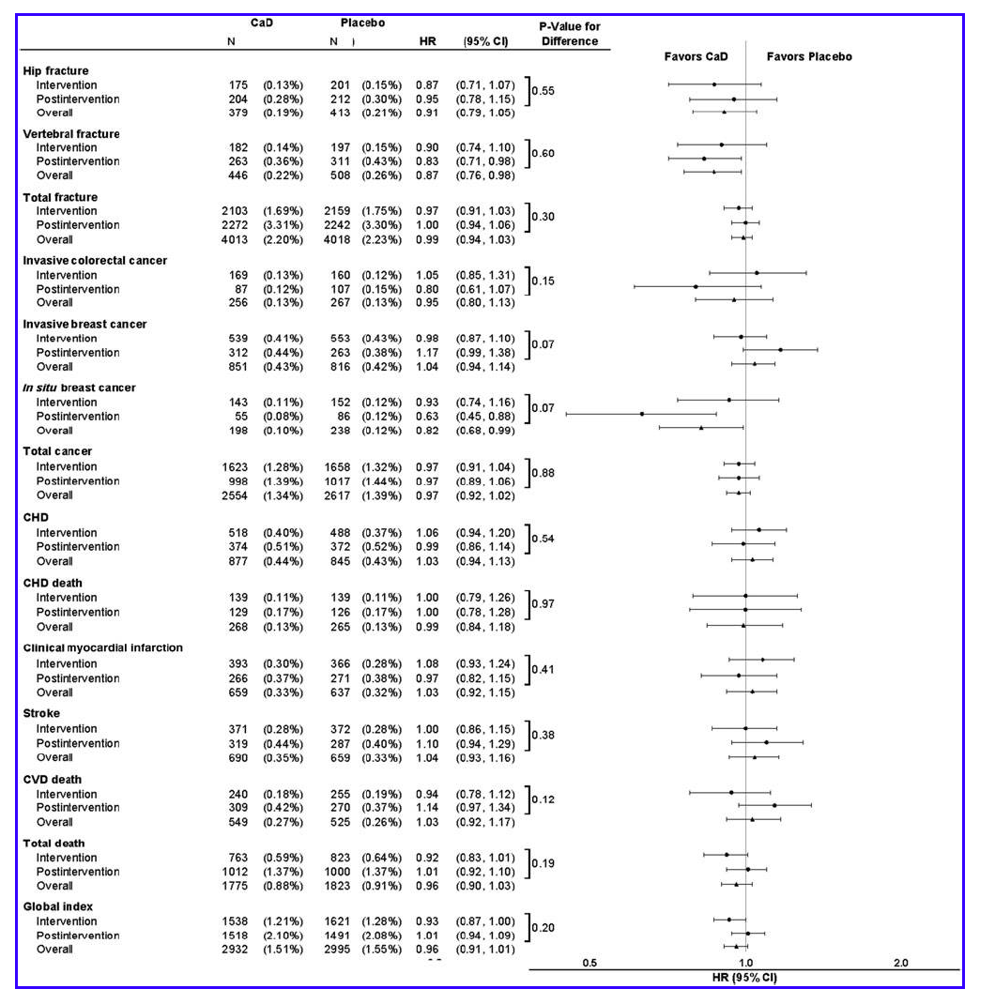
Women’s Health Initiative (11.9 years of
vitamin D and calcium): effect on fracture risk
J. Women’s Health 22:915, 2013

Slide 37
Downside risks of calcium supplementation:
cardiovascular disease?

Slide 38
Five year follow up from the
Women’s Health Initiative:
11.9 years of vitamin D and calcium

Slide 39
Women’s Health Initiative (11.9 years of vitamin D and calcium): effect on CV disease risk and death
J. Women’s Health 22:915, 2013

Slide 40
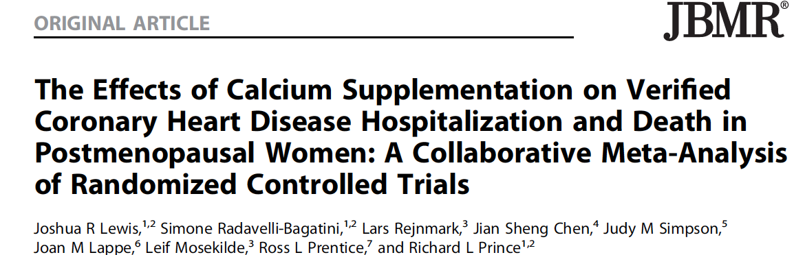

Slide 41
Calcium supplementation and
all cause mortality
JBMR 30,1: 165-175, 2015

Slide 42
Does calcium cause heart attacks?
JBMR 30,1: 165-175, 2015

Slide 43
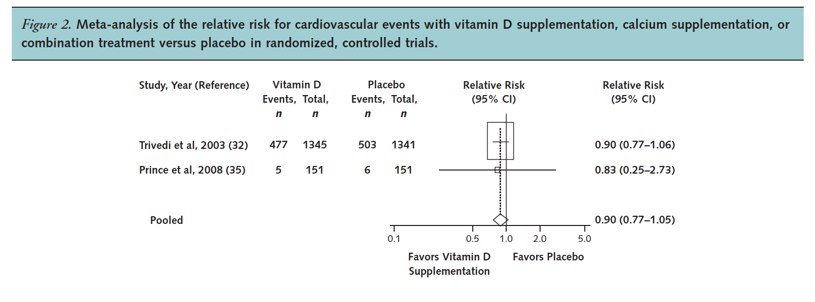
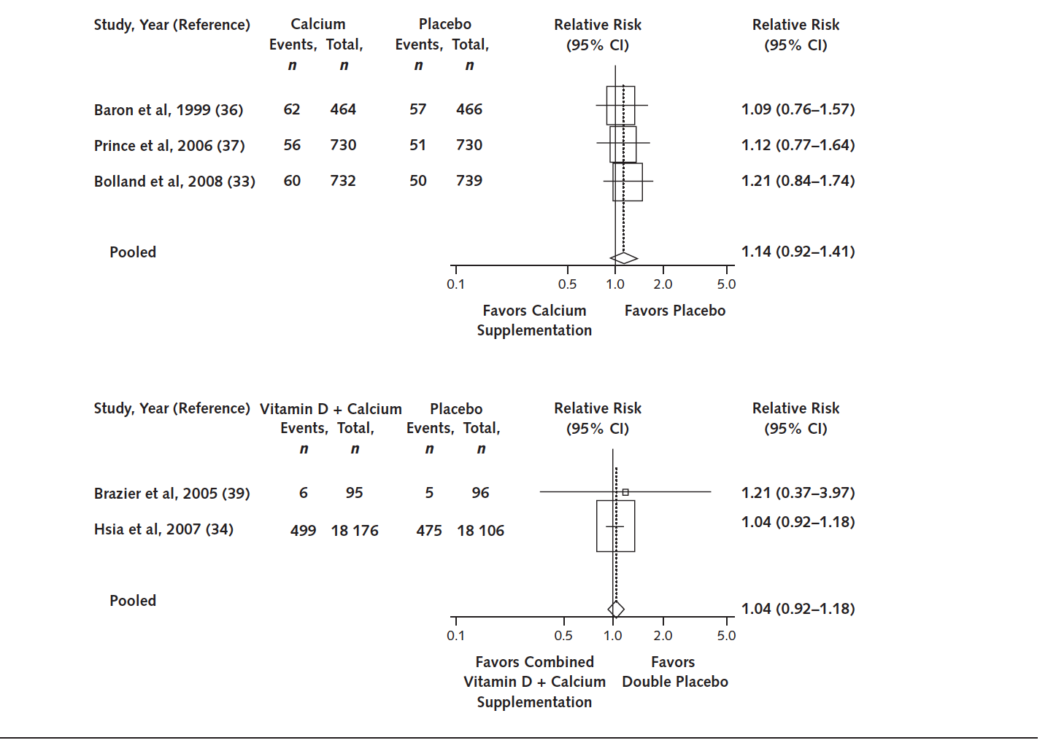
Does calcium cause heart attacks?
Annals Int Med152:315, 2010

Slide 44
Downside risks of calcium supplementation: kidney stones

Slide 45
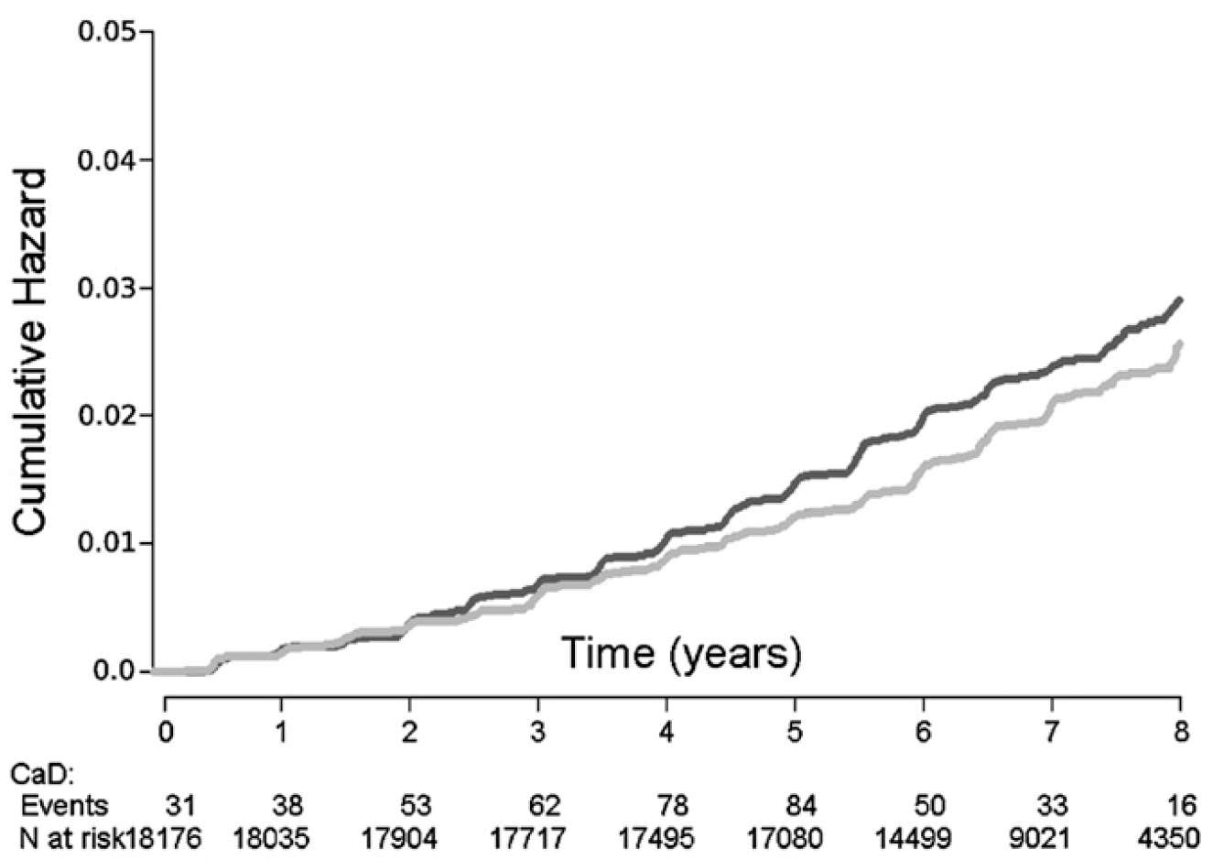
Renal stone disease in the WHI study: ≈18,100 women took
Ca/D and an equal number took placebo: 7 yr. trial
17% increase risk of self reported renal stones
(absolute difference 0.30% of controls and 0.35%
of supplemented women reported stone events)
Amer J Clin Nutr 94:270, 2011

Slide 46
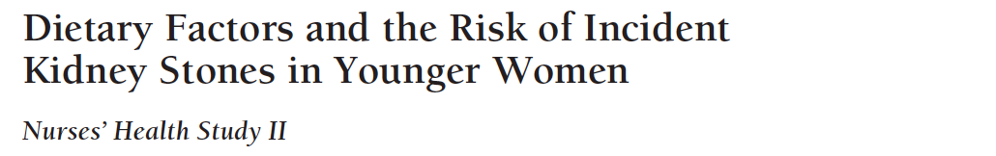
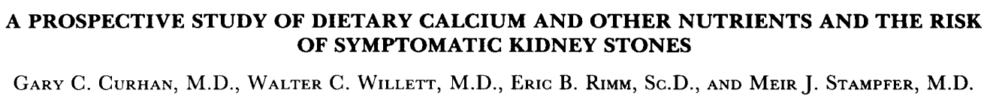
By contrast, dietary calcium intake in the general population does not appear to be associated with an increased risk for stone disease
8 yr. observational study in 96,245 women, 27-44 y.o.
Self administered food frequency questionnaires
This study reported that a higher dietary calcium intake was associated with a lower risk for stone disease
Archives Int Med 164:884, 2004
8 yr. observational study in 45,619 men, 40-75 y.o., w/o a history of stones
One food frequency questionnaire
This study reported that a higher dietary calcium intake was associated with a lower risk for stone disease
NEJM 328:883, 1993

Slide 47
Summary for Calcium
Critical for normal skeletal development.
Dietary intake impacts peak adult bone mass.
Important for preventing secondary hyperparathyroidism that occurs with aging.
Supplements should be used only when DRI cannot be achieved by diet.
Calcium supplements should be taken with food to improve absorption.
May increase the risk of renal stone disease. In my opinion, this risk can be attenuated/avoided by monitoring 24 h urine calcium excretion.
Risk of CV events is unclear. Most studies don’t indicate that there is a risk.
In unselected post-menopausal women, and as a single agent, calcium supplements appear to have a small benefit to reduce fracture risk.

Slide 48
VITAMIN D

Slide 49
Institute of Medicine’s 2010 DRI for Vitamin D
*For infants, adequate intake is 400 IU/d for 0-6 months of age and 400 IU/d for 6-12 months of age.

Slide 50
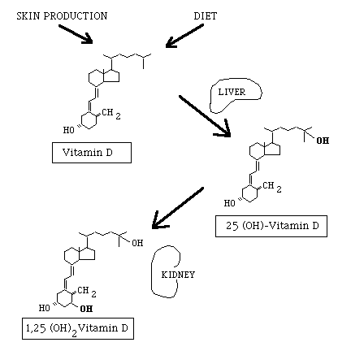
Vitamin D can come from 2 sources

Slide 51
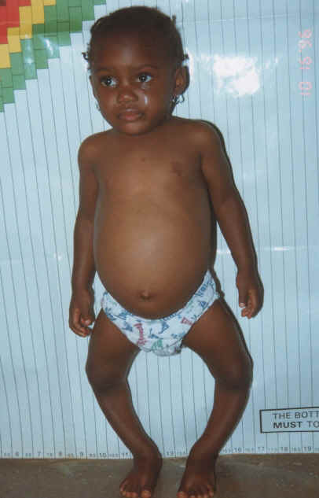
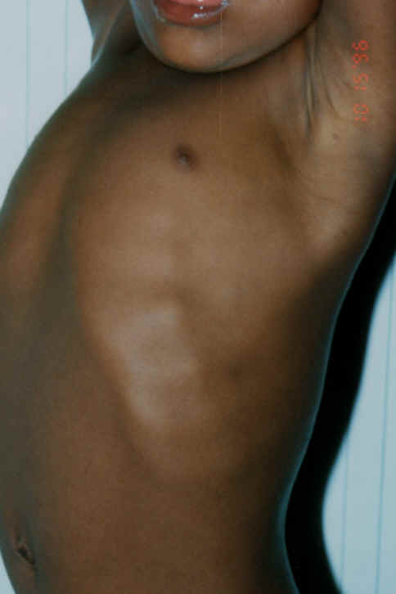
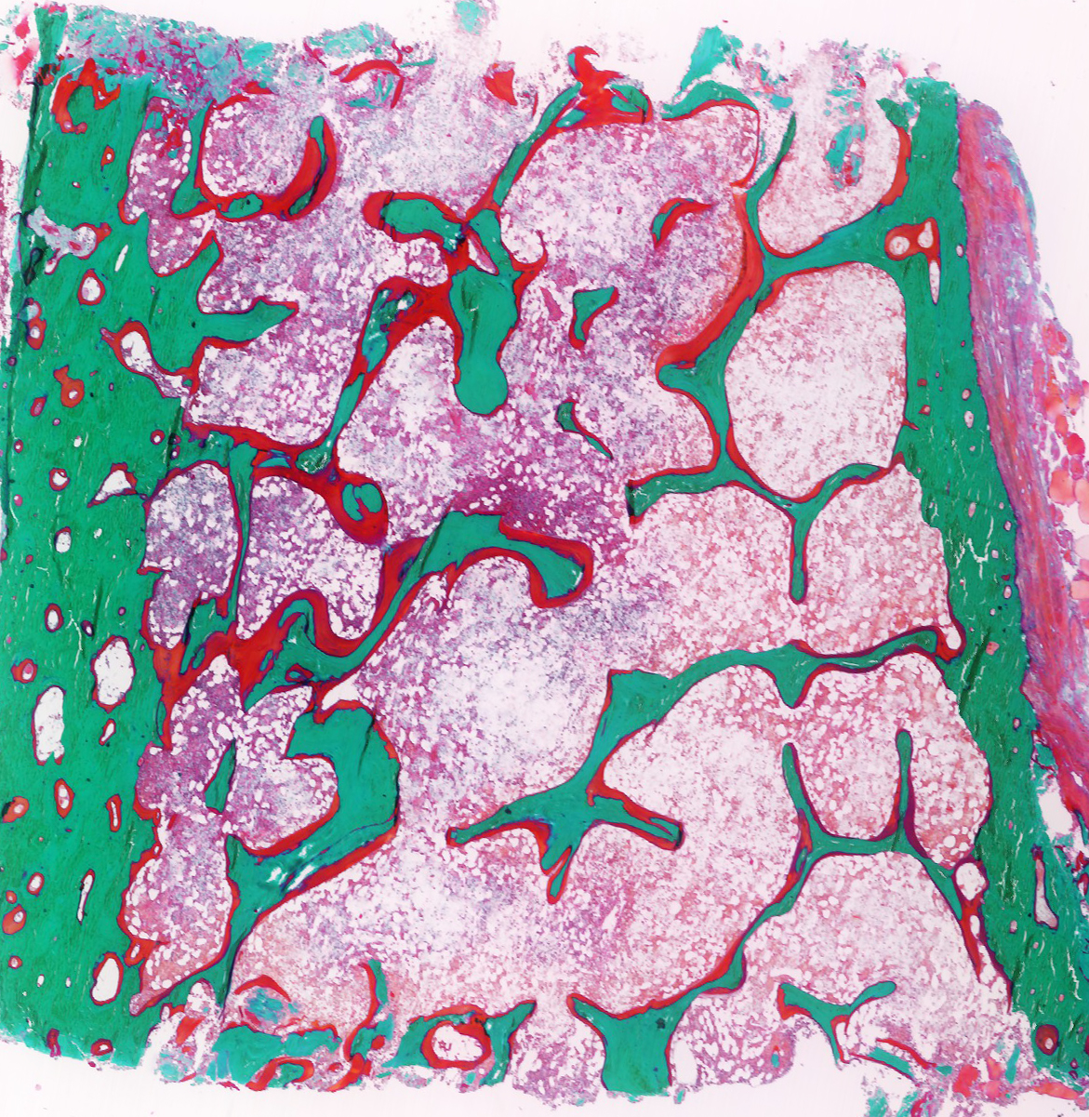
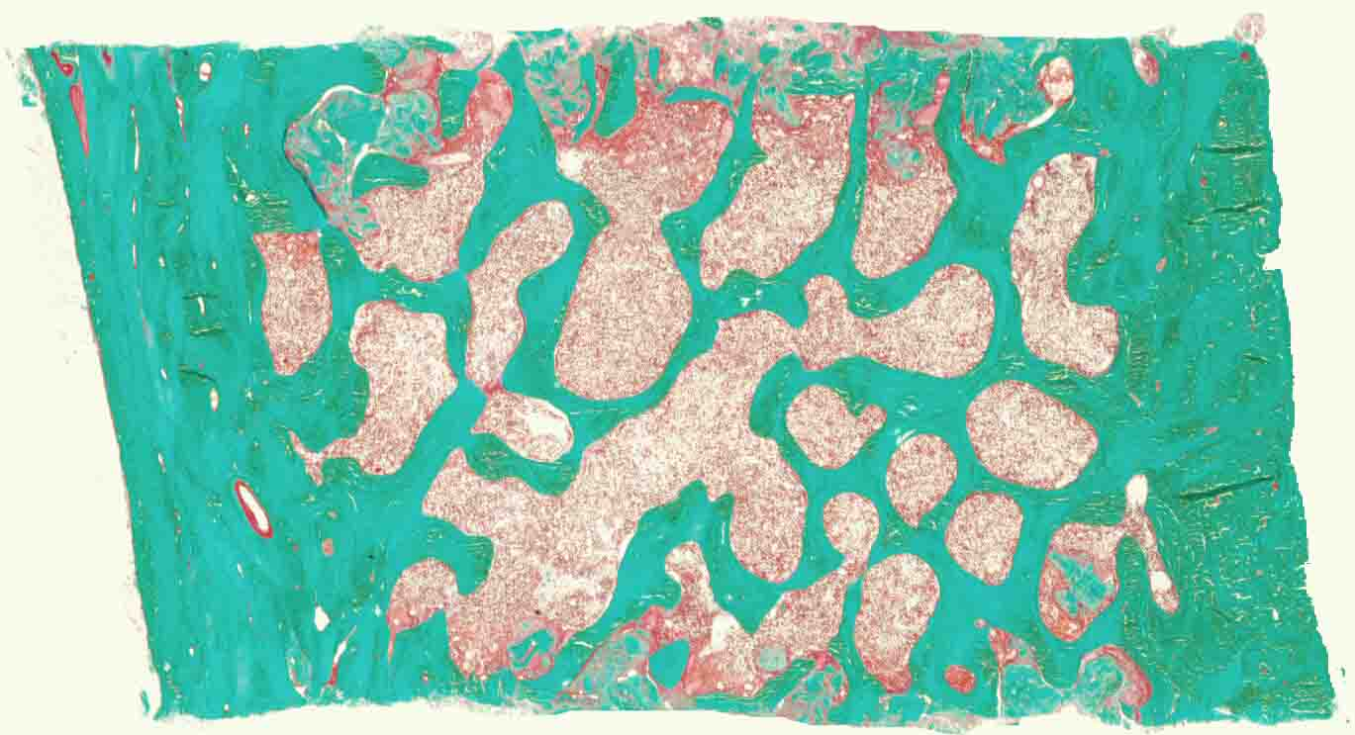
The classic clinical manifestations of
nutritional vitamin D deficiency are rickets in children
and osteomalacia in adults
RICKETS
OSTEOMALACIA
Normal
Osteomalacia

Slide 52
Vitamin D Deficiency
DIET
25-OHD
UV
1,25-(OH)₂D
Ca ABSORPTION
[Ca]_{i}
SECONDARY HYPERPARATHYROIDISM AND CALCIUM INSUFFICIENCY
INCREASE IN BONE RESORPTION/
? REDUCED MUSCLE FUNCTION
BONE LOSS
?INCREASED RISK OF FALLING
Notes:
The most widely recognized cause of nutritional rickets is Vit D deficiency.
Inadequate Vit D acquisition, either through poor dietary intake or through limited sun exposure, results in depletion of Vit D stores, as assessed by 25-OHD levels.
Less 25-OHD is then available to be converted to the active metabolite, 1,25-(OH)2D. This leads to decreased absorption of Ca in the small intestine.
This decreased absorption of Ca, perhaps in combination with low dietary Ca intake, can lead to hypocalcemia and subsequent 2º Hyperparathyroidism.
The elevated PTH activates the formation of the 1,25- active metabolite which, along with PTH, attempts to counteract hypocalcaemia. Low serum Ca and PO4 levels may also contribute to activation of the 1-α−hydroxylase enzyme. In addition, PTH decreases reabsorption of PO4 in the renal tubule.
It should be noted that serum 1,25-(OH)2D levels may be low, normal, or elevated, and are therefore not a reliable marker for Vit D stores.
The decreased availability of Ca and PO4 minerals results in impaired bone mineralization and the clinical manifestations of rickets.

Slide 53
25(OH) vitamin D
The “storage” or “precursor” form of the vitamin.
Produced in the liver.
Circulating levels reflect total body vitamin D stores.
In November 2010, the Institute of Medicine recommended that a serum level ≥20 and ≤50 ng/ml was sufficient to meet the needs of 97.5% the US population.
As one might have predicted, this report has engendered a lot of controversy.
As one might also predict, where there is a lot of controversy, there is a paucity of data.

Slide 54
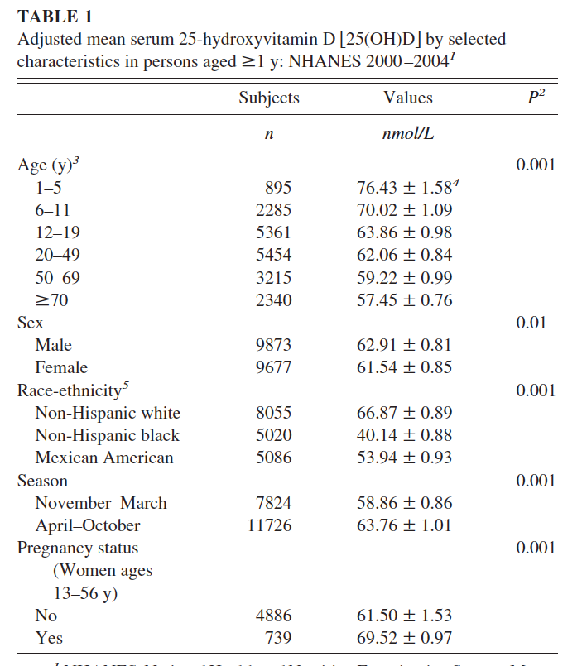
What are average values for serum
25(OH)vitamin D in the US population?
Data from NHANES III
24.8 ng/ml
23.7 ng/ml
23 ng/ml
25.2 ng/ml
24.6 ng/ml
26.8 ng/ml
16.0 ng/ml
21.6 ng/ml
Am J Clin Nutr;
88:1519, 2008

Slide 55
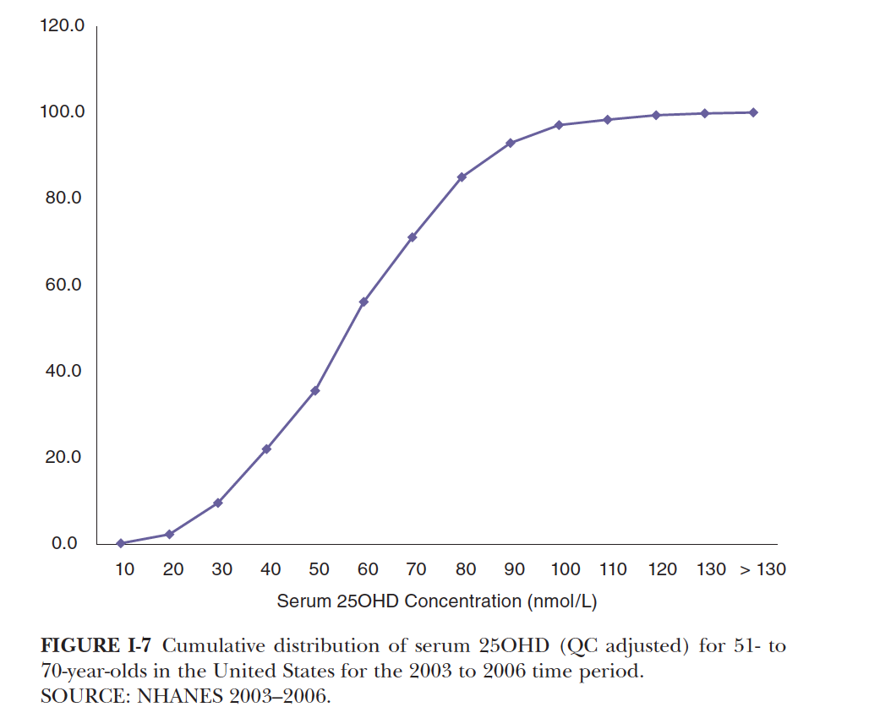
What % of the US population is D-deficient?
Approximately 38% of US citizens 51-70 yo are below 20 ng/ml, but almost 80% are below 30 ng/ml
%
20 ng/ml
30 ng/ml

Slide 56
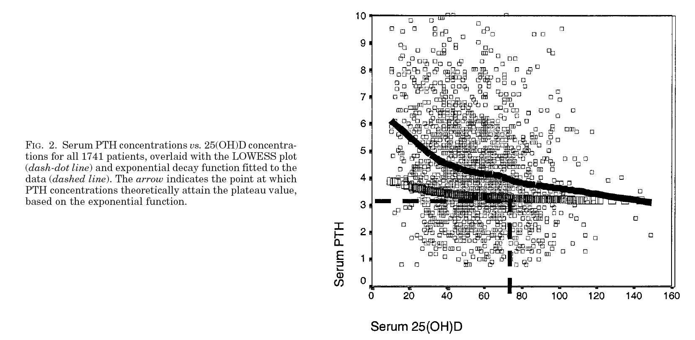
It may take concentrations of 25(OH)D
higher than 20 ng/ml to suppress PTH
29 ng/ml
PTH
Serum PTH concentrations vs. 25(OH)D concentrations for 1741 patients, overlaid with the LOWESS plot (dash-dot line) and exponential decay function fitted to the data (dashed line). The arrow indicates the point at which PTH concentrations theoretically attain the plateau value.
JCEM 88:185, 2003

Slide 57
Vitamin D and Intestinal Calcium Absorption

Slide 58
Relationship between serum 25(OH)vitamin D and fractional calcium absorption
20-35 ng/ml
Heaney RP: Vitamin D: Role in the calcium economy. In: Vitamin D, 2nd Ed., edited by Feldman D, Glorieux FH, Pike JW, San Diego, Academic Press, pp 773–787, 2005

Slide 59
Vitamin D and Osteomalacia
  Priemel et al, 2010
    Post-mortem bone biopsies in 675 individuals ages 20-100.
    No subject had a mineralization defect at serum vitamin D of 30 ng/ml.
  IOM analyzed the data and concluded that at a vitamin D level of 20 ng/ml, more than 97.5% of the population would be protected.
Notes:
Postmorten biopsies in 675 individuals age 20-100.

Slide 60
Vitamin D and the risk of falling
and fracture?

Slide 61
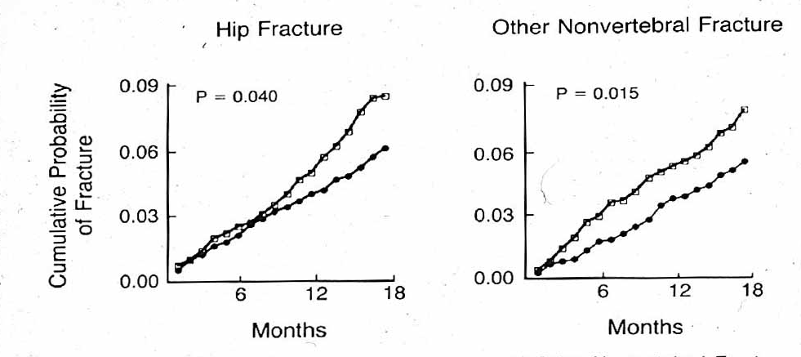
Vitamin D and fracture
3270 ambulatory elderly women in nursing facilities or elderly housing in France
Randomized to 18 months of 800 IU/d of vitamin D and 1200 mg/d of calcium or placebo
At 18 months the mean serum 25(OH)D value was 11 ng/ml in the placebo group and 42 ng/ml in the treatment group
NEJM 327:1637, 1992

Slide 62
Vitamin D and fracture
Double-blind community-based RCT in the UK
2686 individuals (2037 men; 649 women)
100,000 U of vitamin D₃ orally every 4 months for 5 years (mailed to the study subjects, so compliance not confirmed)
p = 0.04
BMJ 236:1

Slide 63
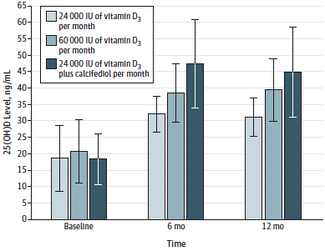
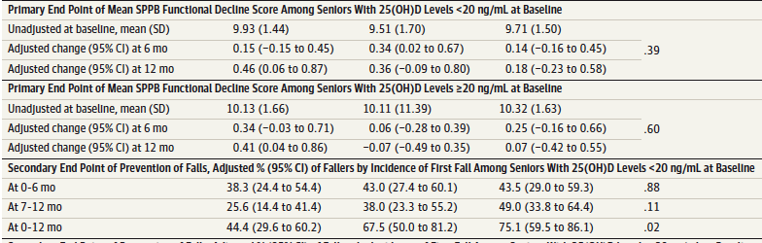
Even among frankly vitamin D-deficient individuals, taking too much of a good thing may not be so good
JAMA Intern Med 176:179, 2016

Slide 64
Summary for vitamin D
Frank vitamin D deficiency (<20 ng/ml) can be associated with elevated circulating levels of parathyroid hormone. This, in turn, can lead to accelerated bone loss.
Serum levels between 20 and 30 ng/ml are sufficient for the majority of healthy adults.
Severe vitamin D deficiency (<10 ng/ml) can be associated with increased risk for fracture in falling.
Supplementation to correct vitamin D deficiency need not be aggressive.
Supplementation in vitamin D deficient patients appears to reduce fracture risk.

Slide 65
Isoflavones
Isoflavones are naturally occurring, plant-derived phytoestrogens that act in a manner similar to, but not identical to, 17β estradiol.
As such, they have been suggested to be Nature’s “designer estrogens,” offering benefit without the untoward side effects of estrogen, such as increased risk of breast cancer and increased risk of endometrial cancer, as well as concerns about adverse cerebral vascular and cognitive effects.
Isoflavones have also been posited to have anti-oxidant properties.

Slide 66
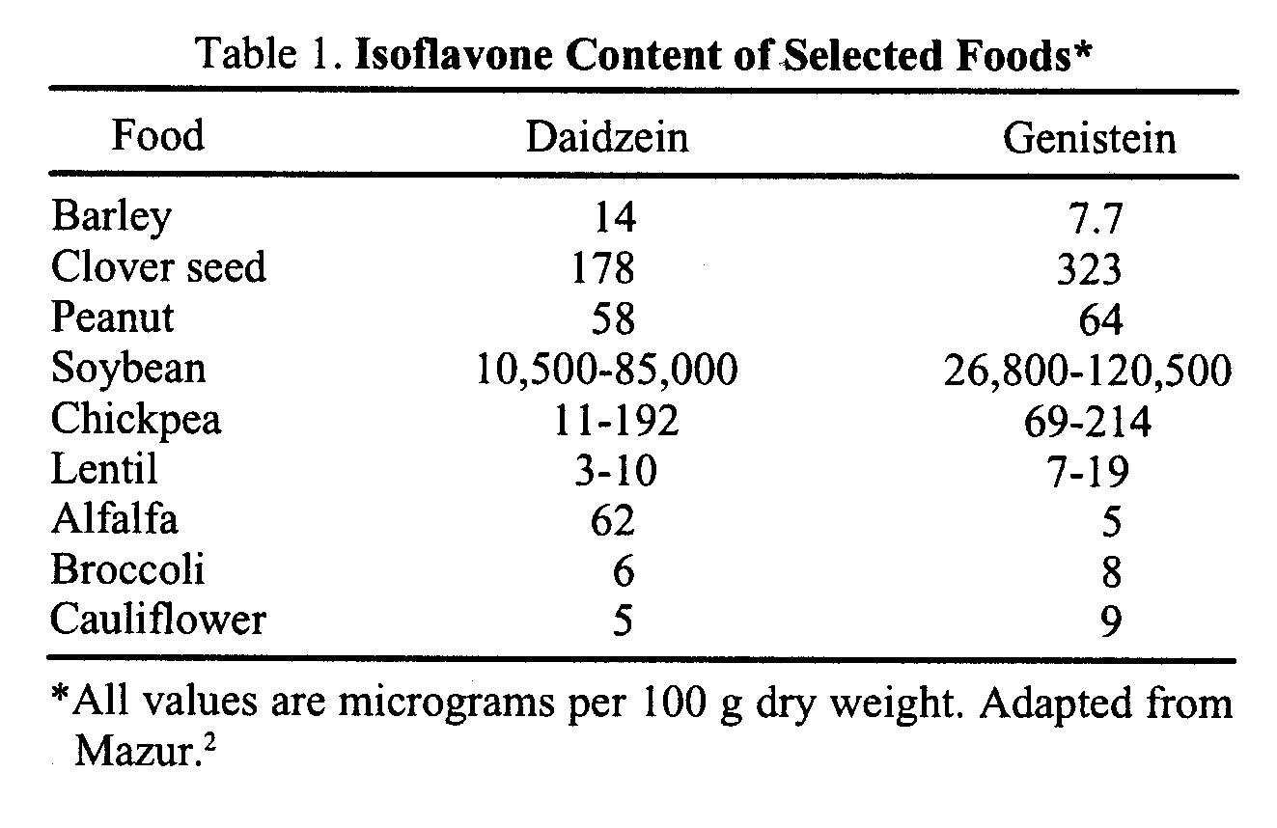

Slide 67
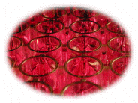

Do isoflavones affect bone health?
Cell culture research:
generally positive results
Animal (rat) research:
generally positive results
But, of course, we treat people… not cells or rats

Slide 68
Cross Sectional Studies
in Women

Slide 69
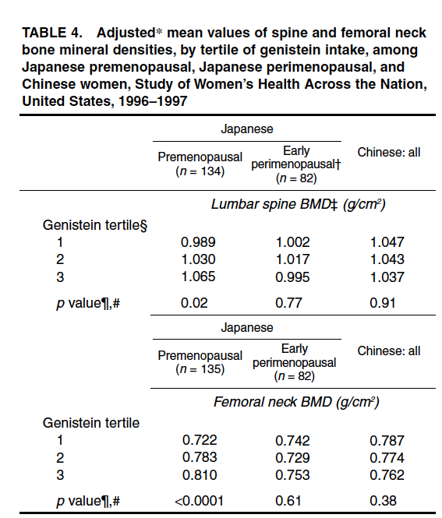
Relationship of isoflavone intake to
cross-sectional BMD in different
racial/ethnic US women
Am J Epidemiol
155:746, 2002
Notes:
Study of Women’s Health Across the Nation, a US community-based cohort study of women aged 42–52 years. Their 1996–1997 analysis included African-American (n = 497), Caucasian (n = 1,003), Chinese (n = 200), and Japanese (n = 227) participants. Genistein and daidzein intakes were highly correlated (r = 0.98); therefore, analyses were conducted by using genistein. Median intakes of genistein
(measured in micrograms/day) by African Americans and Caucasians were too low to pursue relational analyses
further. For Chinese and Japanese women, median genistein intakes were 3,511 and 7,151 μg/day, respectively.
Ethnic-specific, linear models were used to predict BMD as a function of energy-adjusted tertile of intake,
controlled for relevant covariates. For Chinese women, no association between genistein and BMD was found.
Premenopausal, but not perimenopausal, Japanese women whose intakes were greater had higher spine and
femoral neck BMD.

Slide 70
Randomized controlled trials of isoflavone supplementation
in women

Slide 71
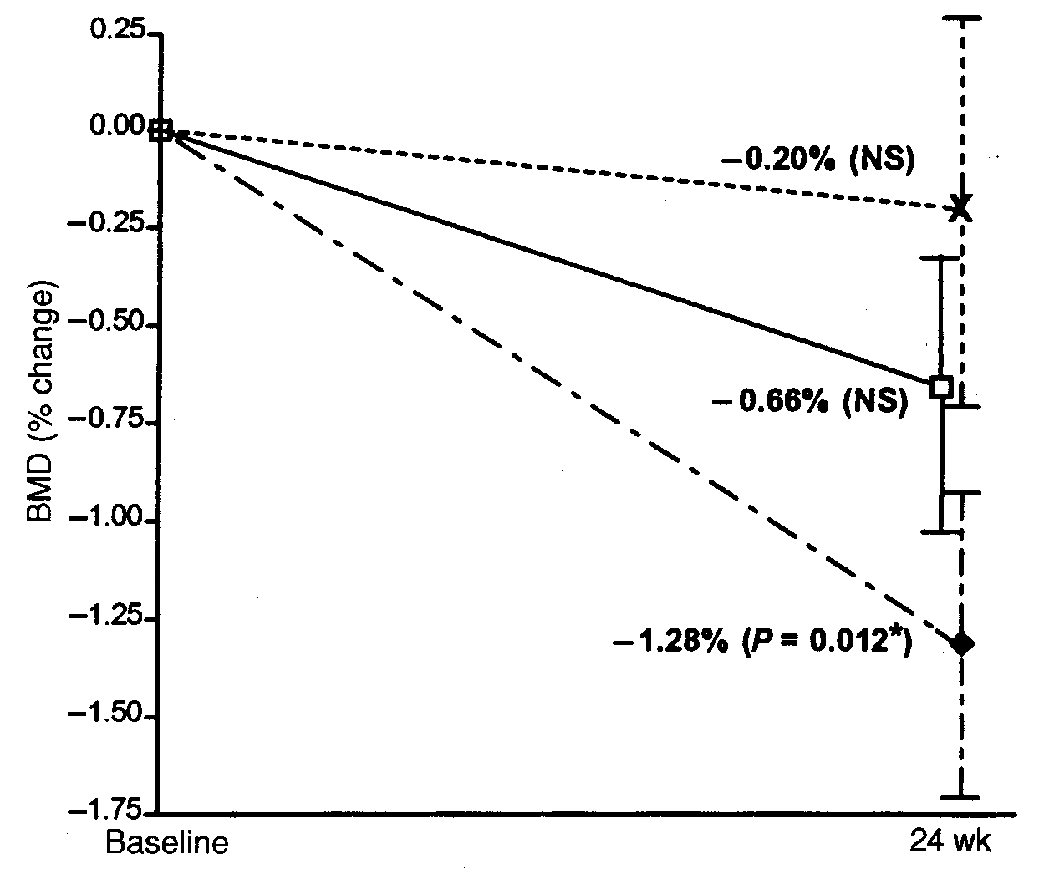
Changes in Lumbar Spine BMD in Perimenopausal Women (n= 21-24)
Soy protein
(with 80 mg
isoflavones)
Soy protein
(with 40 mg
isoflavones)
Control protein
(no isoflavones)
AJCN, 72:844, 2000
Notes:
Perimenopausal subjects were randomly assigned, double blind, to treatment: isoflavone-rich soy (SPI+; n = 24), isoflavone-poor soy (SPI; n = 24), or whey (control; n = 21) protein. At baseline and post treatment, lumbar spine bone mineral density (BMD) and bone mineral content (BMC) were measured by using dual-energy X-ray absorp

Slide 72
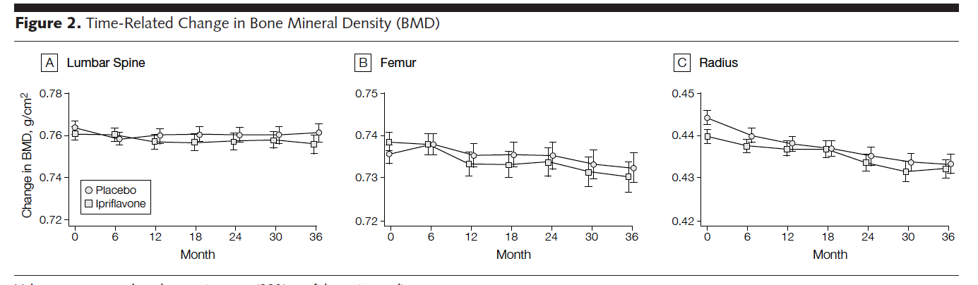
Ipriflavone does not affect rates of skeletal
loss in postmenopausal women
(biggest trial using an isoflavone)
JAMA 285:1482, 2001
Notes:
Prospective, randomized, double-blind, placebo-controlled, 4-year study conducted in 4 centers in Belgium, Denmark, and Italy from August 1994 to July 1998. Participants Four hundred seventy-four postmenopausal white women, aged 45 to 75 years, with bone mineral densities (BMDs) of less than 0.86 g/cm2. Interventions Patients were randomly assigned to receive ipriflavone, 200 mg 3 times per day (n = 234), or placebo (n = 240); all received 500 mg/d of calcium.

Slide 73
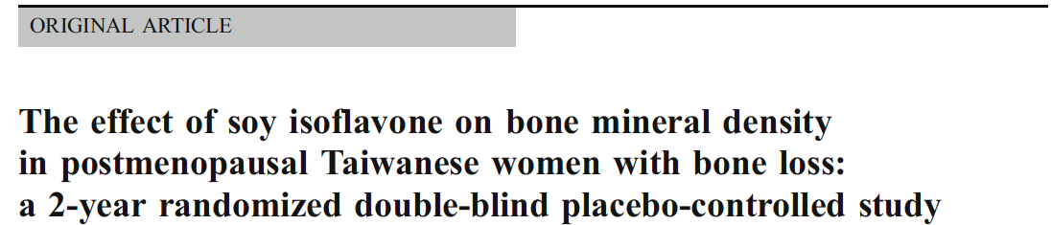
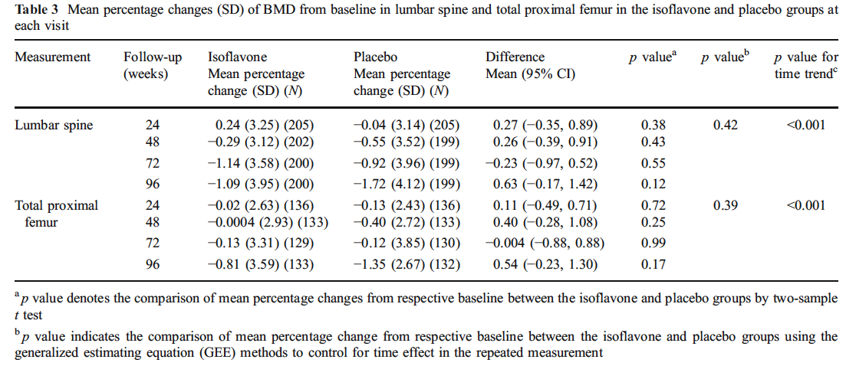
Osteoporosis Int. 23:1571, 2012

Slide 74
Meta analyses of isoflavone trials

Slide 75
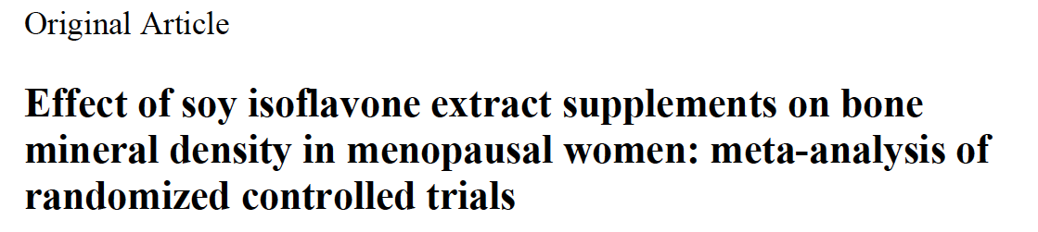
mostly menopausal Asian women
Spine: small effect
Femoral neck: no effect
Asia Pac J Clin Nutr 19:33, 2010

Slide 76
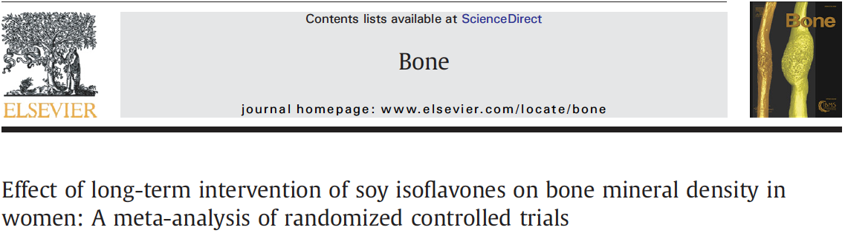
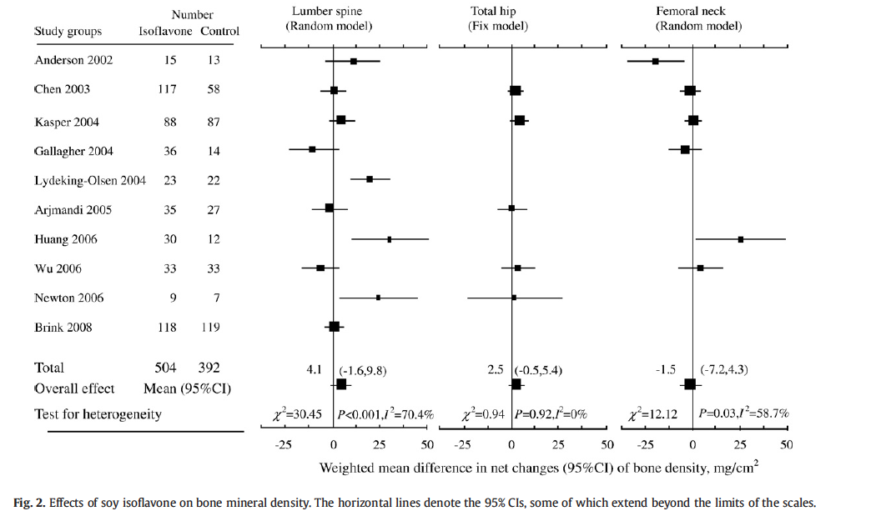
Bone 44: 948, 2009

Slide 77
Summary for Isoflavones
Their Selective Estrogen Receptor Modulator SERM-like activity makes them attractive as having potential skeletal benefit without the associated risks of estrogen.
May have some skeletal benefit in peri-menopausal women
but the bulk of data suggest no effect even at high doses.
We already have one pharmacologic SERM, raloxifene EVISTA with proven anti-fracture efficacy in the spine which also reduces the risk of recurrent breast cancer and does not increase the risk of uterine cancer. It does, like 17 estradiol increase the risk of clots.

Slide 78
Dietary Protein and
Skeletal Health:
Bad to the Bone?

Slide 79
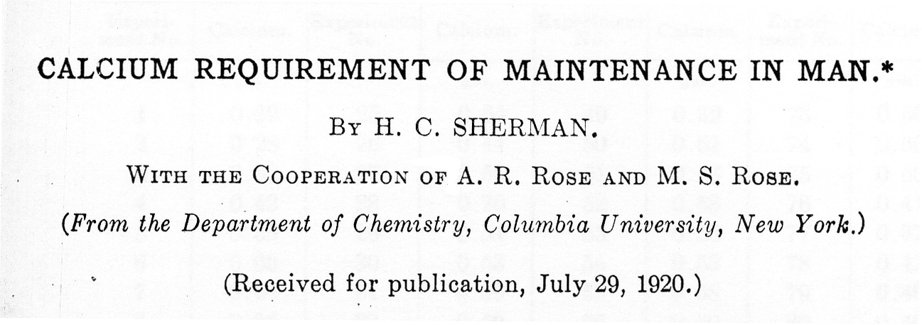
Journal of Biological Chemistry 1920;44:21
“An all meat diet increases urinary calcium in man.”

Slide 80

The association between increasing dietary protein and increasing urinary calcium is linear and strong
26 studies in > 275 adults
Notes:
Since that time, at least 26 separate studies have been conducted where the investigators intentionally manipulated dietary protein while measuring urinary calcium. Each dot represents the mean of one of the groups reported in one of the studies. For each 40 gram increase in dietary protein, there is approximately a 50 mg increase in urinary calcium.
There is general consensus on this relationship. However, when meat is the source of the additional protein in the diet, the attendent phosphorus load serves to blunt the rise in urinary calcium, so the slope of this regression line will not be so steep.

Slide 81

Source of Excessive Urinary Ca ??
1. Diet
2. Intestinal Ca
Absorption
Bone
(Osteoporosis risk)

Slide 82
Source of Excessive Urinary Ca ??
1. Diet
2. Intestinal Ca
Absorption
Bone
(Osteoporosis risk)

Slide 83
AJCN 66:1188, 1997
Notes:
These next 3 slides summarize the important findings from our first study.
Here is the change in urine calcium from baseline, to days 4 and 14. There was the expected rise in urine calcium on the high protein diet. Surprisingly, there was a subtle decrease in urine calcium on the low protein diet at day 4 and lasting until day 14.

Slide 84
Nearly the entire increment in urine calcium could be
explained by the increment in absorbed calcium.
J Clin Endorcinol Metab 90:26, 2005

Slide 85

The effect on urine calcium is seen with soy-based diets and in experiments in which a low protein diet was supplemented with non-sulphur containing amino acids
Aromatic AA
Dibasic AA
J. Nutrition 144:282, 2014

Slide 86
Randomized controlled trials of protein supplementation
in women

Slide 87


Average age: 74
Baseline protein intake: 1.1g/kg
Bottom line:
No harm but no benefit
JBMR 26:2298. 2011

Slide 88

Average age: 69
Baseline protein intake: 1.1g/kg
All healthy and active
J. Clin Endo Metab 100: 2214, 2015

Slide 89
Like the Australian study, we found no change in bone density. But, over the 18 month intervention, we found that the whey protein-supplemented group had preservation of lean body mass

Slide 90
Meta analyses of studies addressing
dietary protein and bone

Slide 91

A J Clin 90: 674,2009

Slide 92

Results from 1st Meta analysis:
No reduction in hip fracture risk

Slide 93

Scientific Reports | 5 : 9151 | DOI: 10.1038/srep09151

Slide 94

Results from 2nd Meta analysis:
slight reduction in hip fracture risk

Slide 95
Summary for Dietary Protein
Adequate dietary protein is obviously important for appropriate skeletal accrual.
Contrary to earlier work, there is no evidence to suggest that dietary protein has an adverse affect on skeletal metabolism.
Based on one study, it appears that even in protein-sufficient individuals, supplementing older individuals with protein may improve body composition, with improved muscle mass and reduced body fat.
A relatively small proportion of the adult US population has dietary protein intakes below the RDA, which is the group in which one might anticipate seeing a beneficial effect. Targeting these individuals for protein supplementation makes the most sense.
Despite that, a recent meta analysis suggests that perhaps there may be a slight beneficial effect on hip fracture risk, with protein supplementation, which may relate to improved muscles, strengthened function, and reducing the risk of fracture.
More studies are needed to clarify the relationship between dietary protein and fracture risk.

Slide 96


High Impact Meals!
Doctors as Cheap Dates!
JAMA Intern Med 10;1001.2016
Notes:
Number of industry sponsored meals over 5 months

Slide 97
Overall Summary and Conclusions
Adequate amounts of calcium, vitamin D, and protein are important for skeletal accrual.
In selected individuals who are deficient in these nutrients, supplementing to current RDAs, as defined by the Institute of Medicine, will likely improve skeletal health and, in targeted groups, may have modest effects to reduce fracture risk.
Over-supplementation exposes individuals who are sufficient in these nutrients, based on their usual dietary intake, to adverse effects without any additional benefits.
The study of isolated nutrients in intervention studies is inherently limited by the fact that the interactions among nutrients are very complex.
Hopefully analyses of large data sets using new approaches such as cluster analysis of dietary food patterns will ultimately provide more guidance in terms of real world interventions.

Slide 98
Thank You for Your Attention !

Slide 99

MILK CAUSES DEATH!
(which must be true, because everyone who drinks milk dies!)
Conclusions: High milk intake was associated with higher mortality in one cohort of women and in another cohort of men, and with higher fracture incidence in women.
Given the observational study designs, with the inherent possibility of residual confounding and reverse causation phenomena, a cautious interpretation of the results is recommended.

Slide 100

A vitamin D-deficient patient
Serum calcium: 8.8 mg/dl, PTH: 79 pg/ml (10-60)
Serum creatinine: 0.7 mg/d
Alk Phos: 256 (30-130 U/L)
Serum 25 (OH)vitamin D: < 10 ng/ml

