Slide 1

X-Linked Hypophosphatemia in Adults
New Biology, New Therapies
September 16, 2016
Karl L. Insogna, MD
Ensign Professor of Medicine/Endocrinology
Yale School of Medicine

Slide 2
Karl Insogna
I am an investigator conducting clinical trials in patients with XLH and TIO sponsored by
Ultragenyx
CONFLICT OF INTEREST

Slide 3
Outline
Review the key clinical and biochemical features of X-linked hypophosphatemia (XLH) in adults.
Summarize the pathogenesis of XLH and the central role of FGF23 in this disease.
Review the efficacy and limitations of treatment with calcitriol and supplemental phosphorus for XLH.
Review the pre-clinical studies that support the use of a blocking antibody to FGF23 in the treatment of XLH.
Report data from phase 2 studies using a recombinant human IgG₁ monoclonal antibody to FGF23 in adults with XLH.
Speculate on future directions for the treatment of this disorder.

Slide 4
Background
FGF23 is a hormone produced by osteocytes that inhibits renal tubular phosphate reabsorption, leading to renal phosphate wasting and hypophosphatemia.
It suppresses production of 1,25(OH)₂vitamin D, which impairs intestinal calcium and, to a lesser extent, phosphate absorption.

Slide 5
Background
FGF23 is overproduced by osteocytes in the genetic disorder X-linked hypophosphatemia, which is characterized by short stature and rickets in children, osteomalacia in adults, and a variety of other skeletal problems.
The genetic basis for XLH is loss of function mutations in the enzyme, PHEX, which is located on the X chromosome.

Slide 6
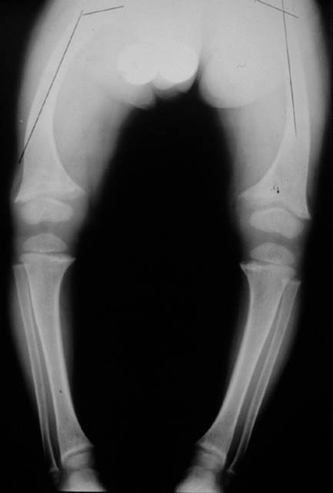
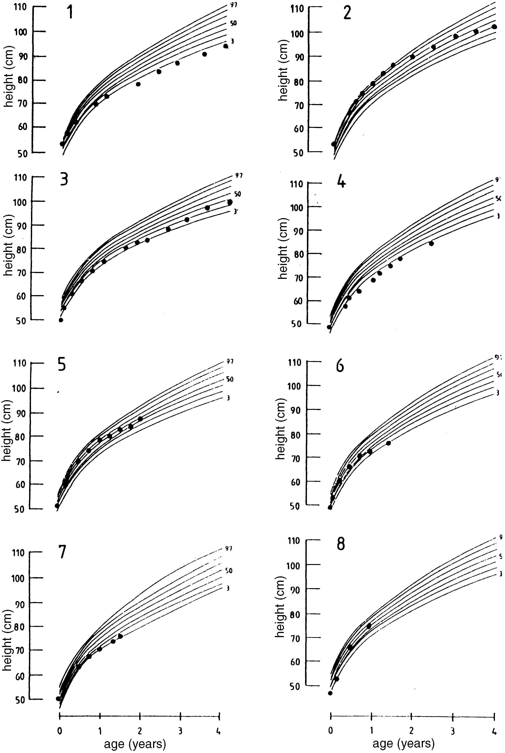
Complications of XLH in Children
that Impact Adults
Limb deformities
Short stature

Slide 7
Cranial anomalies:
Complications of XLH in Children
that Impact Adults
Craniosynostoses
Chiari malformations
Notes:
Figures 1, 2. [1] Patient 1 (7-year-old girl). Sagittal T1-weighted image of the brain (800/20) shows no herniation of the cerebellar tonsils below the foramen magnum (line). There is no calvarial thickening, and the shape of the posterior fossa appears normal without evidence of flattening. [2] Patient 7 (16-year-old boy). Sagittal T1-weighted image of the brain (800/26) shows a definite CM1 associated with market calvarial thickening. Note the flattening of the posterior fossa, decrease in the marrow signal intensity that corresponds to sclerosis seen on plain radiographs, and associated syringohydromyelia.

Slide 8
Complications of XLH : Dental Disease
Normal
XLH
XLH
abnormally
widened pulp
chamber
loss of bone due to a dental abscess

Slide 9
Dental disease with abscesses
(age 15, top; age 23, bottom)

Slide 10
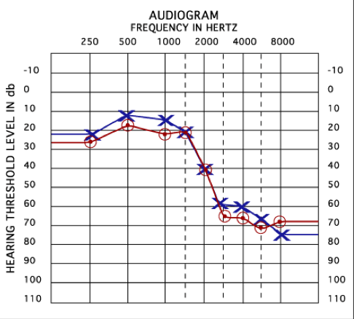
Complications of XLH in adults:
Hearing loss
Normal
Moderate
Severe

Slide 11
Complications of XLH in adults:
A sense of muscle weakness and early fatigability
This may be related to a reduction in muscle ATP synthesis
FASEB J. 2016 Jun 23. pii: fj.201600473R.
[Epub ahead of print]

Slide 12
In a hypophosphatemic patient (with HHRH) correcting the hypophosphatemia improves rates of muscle ATP synthesis
FASEB J. 2016 Jun 23. pii: fj.201600473R.
[Epub ahead of print]

Slide 13
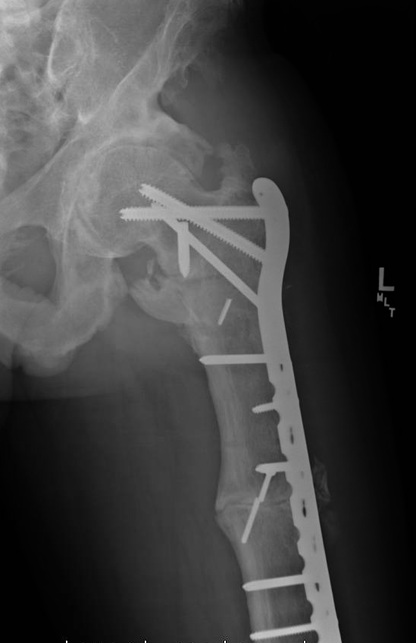
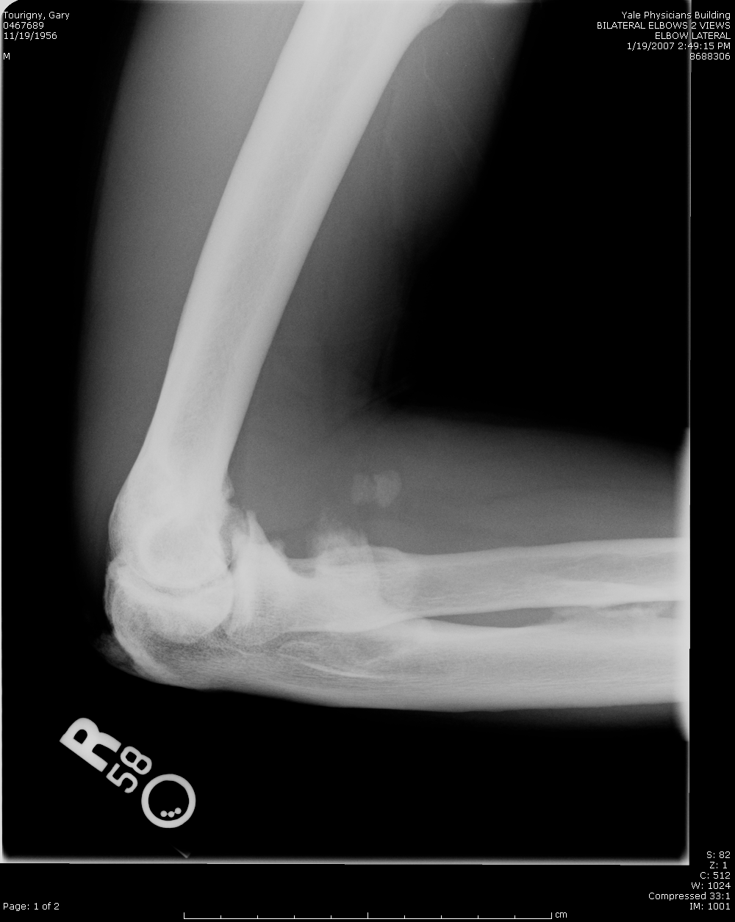
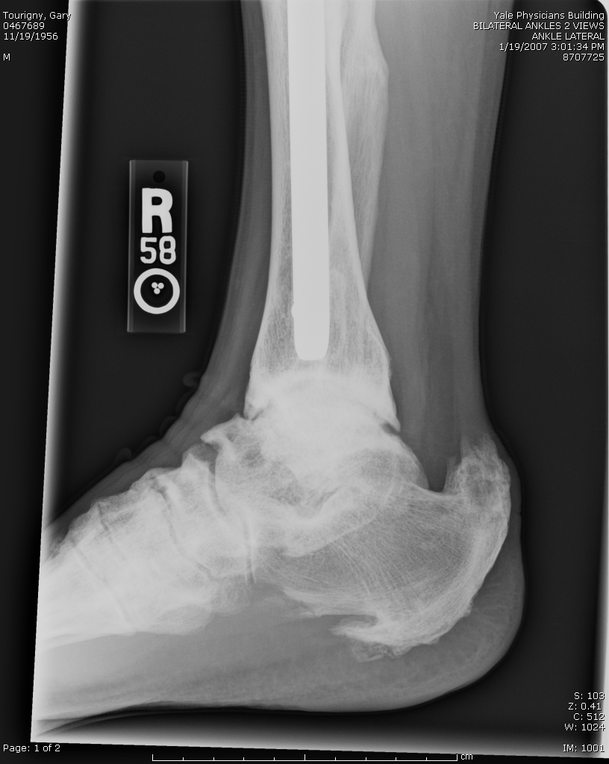
Complications of XLH in Adults:
Fractures and Enthesopathy

Slide 14
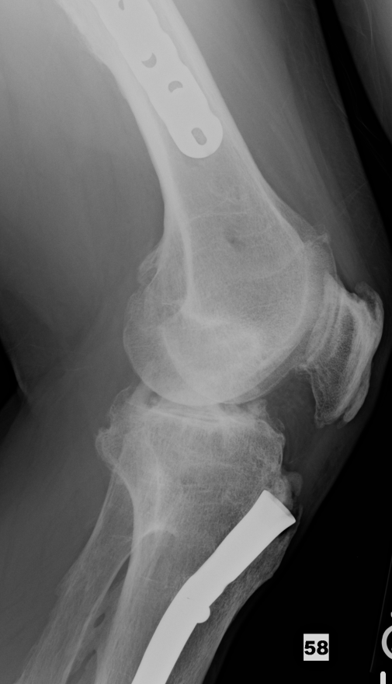
Osteophytes and
Calcified Entheses

Slide 15
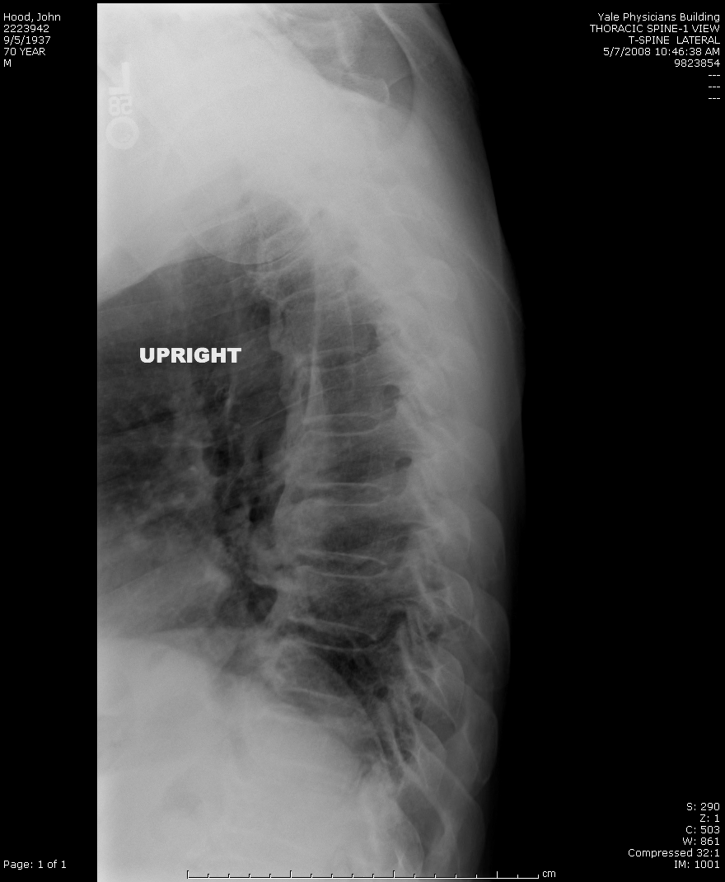
Complications of XLH in Adults:
Spinal Ligament Calcification

Slide 16
Enthesopathy: Sites vs. Age
♦ Male
● Female
JCEM 95:E352, 2010
Notes:
16

Slide 17
Biochemistry in XLH, by Age and Disease
JCEM 95:E352, 2010

Slide 18
XLH Subjects: Correlates of Biochemical Variables
klotho | FGF23 | P | PTH | 1,25D | TMP
Correlation Coefficient (Pearson) | 0.030 | 0.091 | -0.267 | -0.377 | 0.166
P value | 0.888 | 0.653 | 0.178 | 0.053 | 0.407
FGF23 | klotho | P | PTH | 1,25D | TMP
Correlation Coefficient (Pearson) | 0.030 | -0.259 | 0.602 | -0.339 | -0.271
P value | 0.888 | 0.211 | 0.002 | 0.097 | 0.190
JCEM 95:E352, 2010

Slide 19
FGF23 levels correlate with circulating
levels of PTH in XLH
JCEM 95:E352, 2010

Slide 20
Current approaches to treating adult patients
with XLH

Slide 21
Non-Pharmacologic Recommendations
Nutritional counseling
Regular aerobic exercise
Meticulous dental hygiene
Regular auditory examinations

Slide 22
We undertook a prospective trial of therapy in adults with XLH

Slide 23
Characteristics of the 18 adult study subjects

Slide 24
Pre-treatment Biochemical Data

Slide 25
Pre-treatment Histomorphometry

Slide 26
Mean doses of phosphate and calcitriol used in the study

Slide 27
Biochemical Response to Treatment

Slide 28
Biochemical Response to Treatment

Slide 29
Histomorphometric Response to Conventional Treatment with Calcitriol and Pi

Slide 30
1. Conventional treatment does not affect enthesopathy
2. Male sex and obesity portend worse enthesopathy
3. Hyperparathyroidism is a/w worse enthesopathy
JCEM 100:3625, 2015

Slide 31
Conventional treatment does seem to ameliorate dental disease in adults with XLH
JCEM 100:3625, 2015

Slide 32
Conventional treatment does seem to ameliorate dental disease in adults with XLH
JCEM 100:3625, 2015

Slide 33
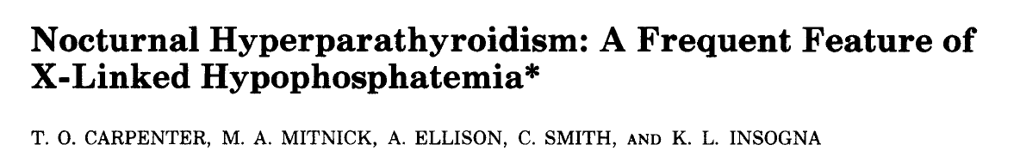
The hyperparathyroidism that so frequently complicates XLH has become an increasing concern for our group
Based on the data I just presented suggesting an association of hyperparathyroidism with the extent of enthesopathy, the association of PTH with higher circulating levels of FGF23 as well as the data from three other studies we have undertaken:
JCEM 78:1378, 1994
JCEM 81:2318, 1996
JCEM 99:3101, 2014

Slide 34
The hyperparathyroidism tends to get worse at night in XLH
JCEM 78:1378, 1994

Slide 35
In patients with significant 2ndary HPT, suppressing PTH with paricalcitol improves serum biochemistries and reduces bone turnover, despite a rise in FGF23
JCEM 99:3103, 2014

Slide 36
Suggested indications for conventional therapy in adults with XLH
Spontaneous fractures
Pending orthopaedic procedures
Biochemical and/or radiographic evidence of severe osteomalacia
  elevated Alk Phos (BSAP)
  metacarpal, metatarsal, tibial compression tenderness
  radiographic evidence of multiple or significant (e.g. femoral neck) insufficiency fractures
Disabling bone pain
JBMR 26:1381, 2011

Slide 37
Efficacy and Limitations of Conventional Therapy
with calcitriol and phosphorus in Adults
Efficacy:
Improves, but does not cure, osteomalacia. (JCEM 75:879, 1992)
Appears to ameliorate dental disease. (JCEM, 100:3625, 2015)
Anecdotally, reduces the risk of clinical fracture, accelerates healing of insufficiency fractures and healing after orthopedic surgery.
If carefully monitored, can correct the hyperparathyroidism in XLH.

Slide 38
Efficacy and Limitations of Conventional Therapy
with calcitriol and phosphorus in Adults
Limitations:
Adherence is difficult.
Proper management requires frequent visits and dose adjustments, so sub-optimal monitoring is often a problem.
Does not improve linear growth in children, which obviously impacts adult height.
Does not prevent dental disease.
Does not prevent hearing loss or enthesopathy.
Frequently accompanied by complications, including secondary and even tertiary hyperparathyroidism and nephrocalcinosis.

Slide 39
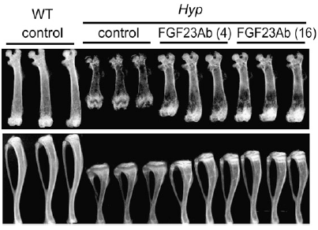
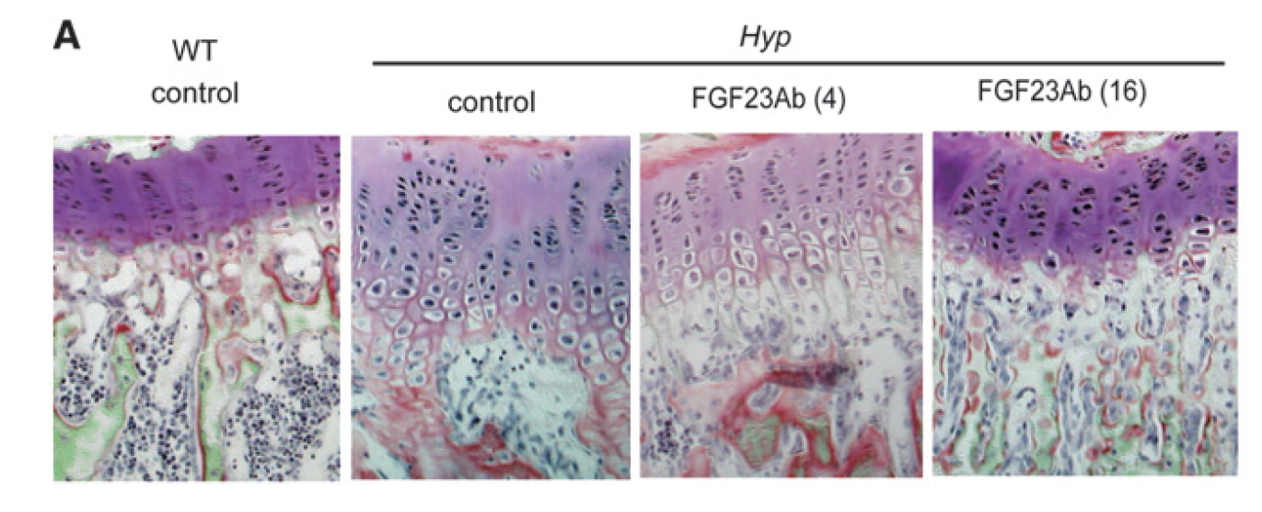
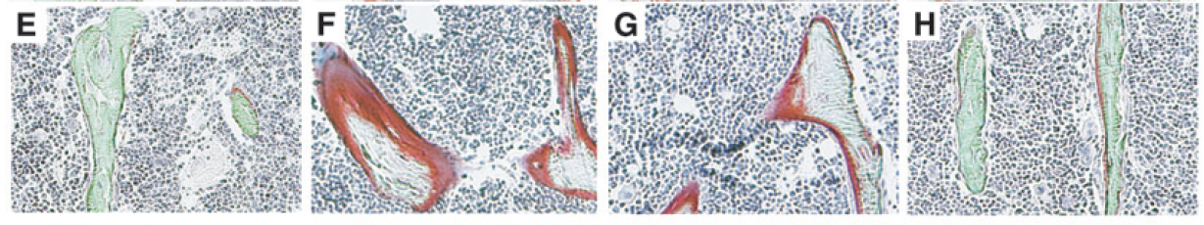
In a preclinical model of XLH (the Hyp mouse), an inhibitory antibody to FGF23 normalized serum Pi and 1,25(OH₎₂D levels and markedly improved bone growth and size… and healed the osteomalacia and growth plate abnormalities.
JBMR 24:1879, 2009
Notes:
Aono
Kyowa Hakko Kirin

Slide 40
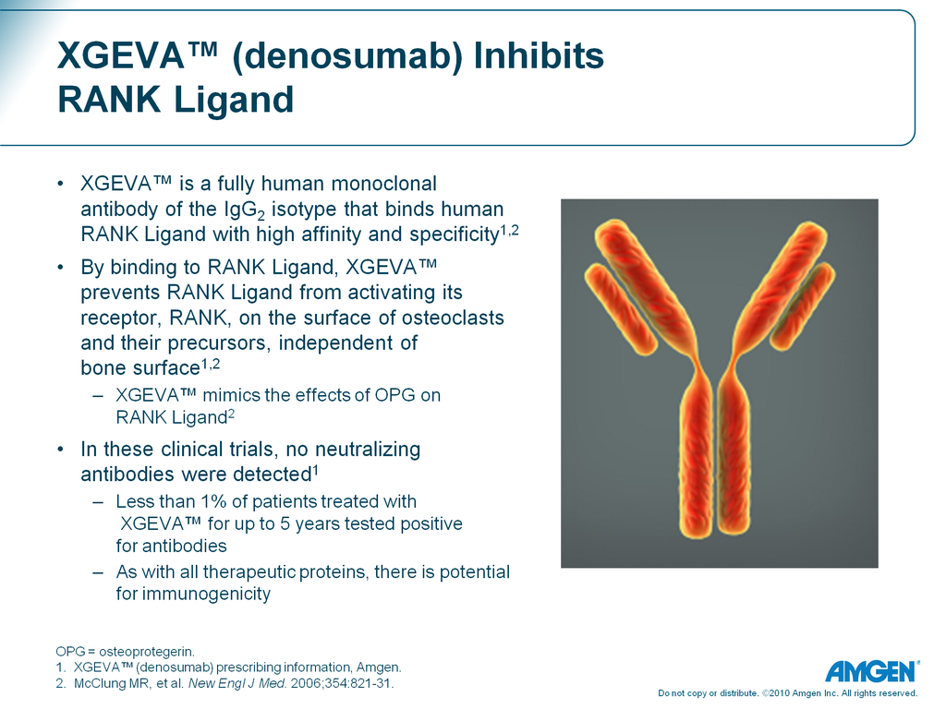
KRN 23: an inhibitory
antibody to FGF23
Kyowa Kirin Pharmaceutical Development, Inc. (KKD) has developed a recombinant human IgG₁ monoclonal antibody to FGF23 that has been tested in phase 1 and phase 2 clinical trials in children and adults with XLH.
Ultragenyx, in partnership with KKD, has ongoing fully enrolled phase 2 extension and phase 3 registration trials in adults with XLH.

Slide 41
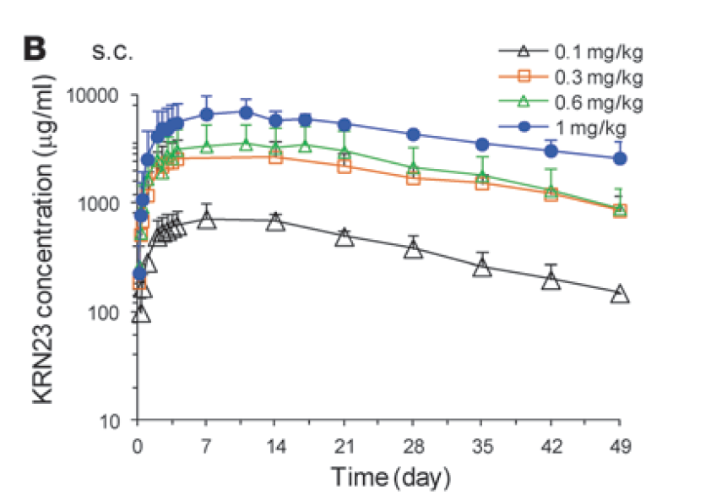
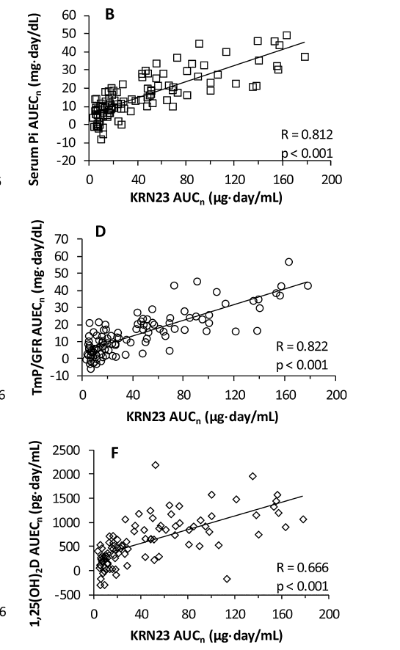
Pharmacokinetics and Pharmacodynamics of KRN23
PK
PD
T_{max}: 7.0 to 8.5 days, T_{1/2}: 16.4 days
J.Clin. Invest. 124:1587, 2014
J Clin Pharmacology 56: 176, 2016

Slide 42
What types of patients are enrolling in the ongoing clinical trials with KRN23?

Slide 43
An adult patient in the phase 3 registration trial
30 yo female ICU nurse whose mother has XLH. Randomized 19-Feb-2016
Sporadically treated with calcitriol and phosphorus from 6mo -6yrs (adherence was a limited by financial constraints).
Ages 12-13: bilateral femur and tibial osteotomies.
Ages 13-20: took medication with varying adherence.
Ages 20-27: off therapy developed a left femoral stress fracture.
Age 27: therapy resumed phosphorus 2250 mg/d and calcitriol 0.25 mcg/Mon-Wed-Fri.
Age 30: (6 months before study entry) noted to have severe 2ndary HPT and
advised to reduce phosphorous to 1000 mg/d and increase calcitriol to 0.25 mcg BID.
Serum calcium: 9.5 mg/dL
Serum phosphorous: 1.0 mg/dL; TmP/GFR: 1.0mg/100 mL GF
PTH: 91 pg/ml (10-69 pg/ml)
eGFR: > 60 mL/min
Bone-Specific Alk Phos: 17 (3-19 ng/ml)
Intact FGF23: 169 pg/ml

Slide 44
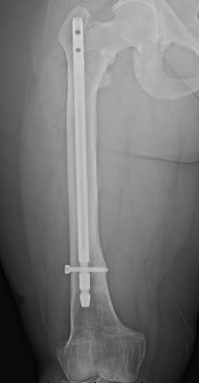
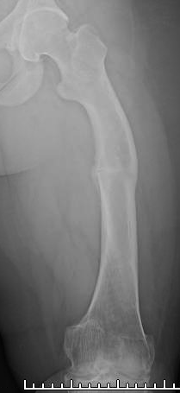
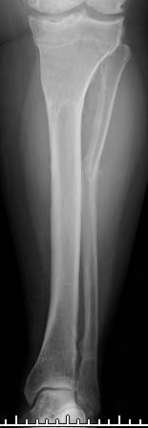

Slide 45
Data from the ongoing and completed studies with KRN23

Slide 46
Data from Adult Studies with KRN23

Slide 47
Cumulative 4-Month Dose Escalation (KRN23-INT-001) and 12-Month Long-Term Extension Study (KRN23-INT-002) in Adults with XLH
  Dose escalation: 28 adults with clinical diagnosis of XLH
    Age ≥ 18 years, intact FGF23 ≥ 30 pg/mL, TmP/GFR < 2.0 mg/dL
    Creatinine clearance ≥ 60 mL/min, serum calcium < 10.8 mg/dL
  Extension: 22 subjects enrolled in the extension study
Notes:
Dose based on serum Pi on day 25/26 after previous dose
Time between last dose on D84 of first study and Day 0 of second study was 53 days (range: 48-65 days)

Slide 48
Effect on serum phosphorus
Escalation Extension
Serum Pi peaked on Day 7 - 14
Escalation: serum Pi increased as dose increased
Extension: serum Pi increased after each dose and returned toward pre-dose level by next dose
Fluctuations between peak and trough serum Pi levels were small after each dose (range: 9.97% - 21.5%)
Notes:
↙, KRN23 dose
*p< 0.05, paired t-test, Bonferoni

Slide 49
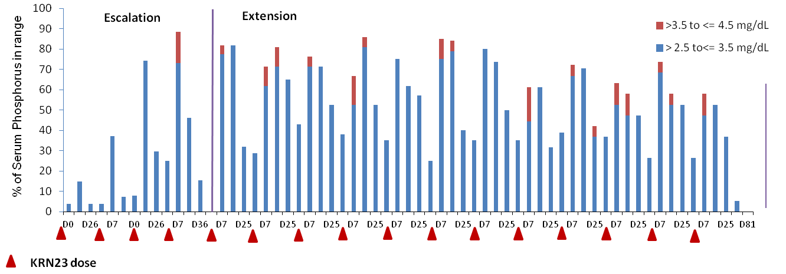
Effect on serum phosphorus (cont.)
Escalation Extension
During each dosing cycle of the extension study, peak serum Pi reached target range:
    > 2.5 and ≤ 3.5 mg/dL in 44.4% - 81.8% of subjects
    > 3.5 to ≤ 4.5 mg/dL in 4.5% - 16.7% of subjects
Serum Pi did not exceed 4.5 mg/dL in any subject

Slide 50
Effect on TmP/GFR
Escalation Extension
TmP/GFR peaked on Day 7- 14
Escalation: TmP/GFR increased as dose increased
Extension: TmP/GFR increased after each dose and returned toward pre-dose level by next dose

Slide 51
Effect on 1,25(OH₂D)
Escalation Extension
Serum 1,25(OH)₂D peaked on Day 3- 7
Escalation: serum 1,25(OH)₂D increased as dose increased
Extension: serum 1,25(OH)₂D increased after each dose and decreased toward pre-dose level by next dose, with tendency to decrease over time

Slide 52
Effects on serum calcium and urine calcium
Urine Calcium ( mg/d)

Slide 53
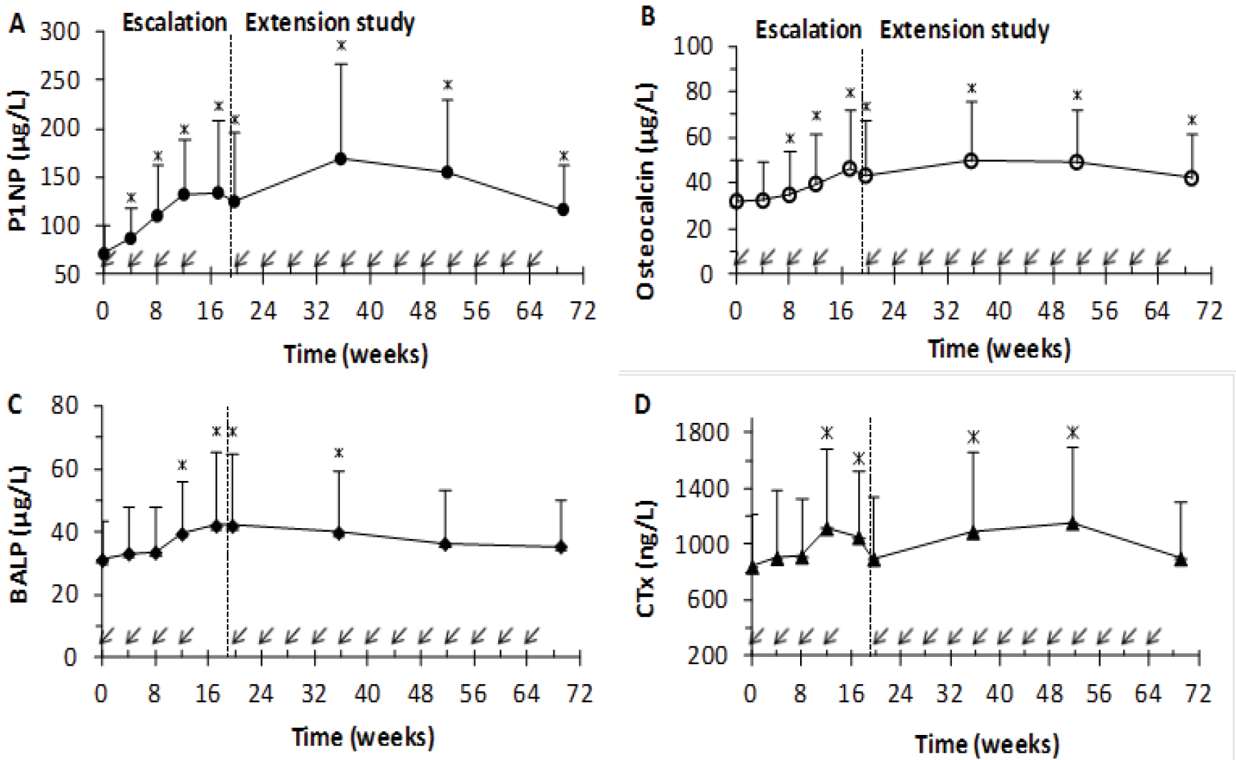
Effects on bone turnover markers

Slide 54
Do these study subjects feel better?

Slide 55
Improvement in Brief Pain Inventory
Short Form Scores Overall
10
Baseline
Week 12
Week 24
p=0.0268
p=0.0141
p=0.0009
8
6
Mean BPI-SF Score ± SE
4
2
0
Worst Pain
Pain Severity
Pain Interference
Ruppe et al, Poster #MO0319
Monday, 9/19 12:30pm-2:30pm
Expo Hall A1

Slide 56
Improvement in WOMAC Scores
100
90
Baseline
Week 12
80
Week 24
70
60
p=0.0228
p=0.0086
p=0.0049
Mean WOMAC Score ± SE
50
40
30
20
10
0
Pain
Stiffness
Physical Functioning
Ruppe et al, Poster #MO0319
Monday, 9/19 12:30pm-2:30pm
Expo Hall A1
100
89%
80
60%
60
Proportion (%)
40
36%
20
0
Overall
N=20
BL BPI-Q3 ≥7
N=9
BL BPI-Q3 >7
N=11

Slide 57
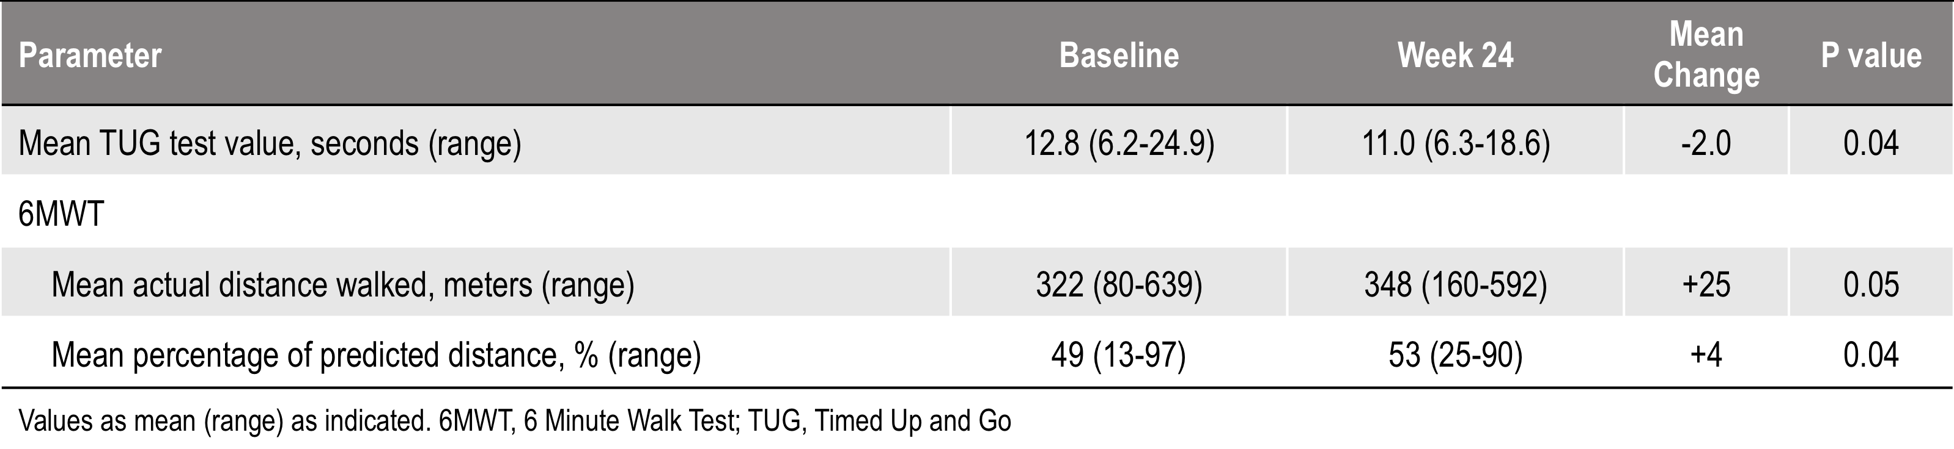
Improvement Balance and Agility (TUG test) and Walking Ability (6MWT)
Ruppe et al, Poster #MO0319
Monday, 9/19 12:30pm-2:30pm
Expo Hall A1

Slide 58
Summary of Phase 2 Adult Study
KRN23 restored phosphate homeostasis in adult patients with XLH.
Blocking FGF23 activity by SC administration of KRN23 every 28 days for up to 16 doses demonstrated good efficacy and a favorable safety profile.
Participants are feeling better in the extension study.
Based on these data, a phase 2 extension study and a fully enrolled phase 3 registration trial are ongoing in adults with XLH.

Slide 59
Follow up on our subject in the
Phase 3 double blind, placebo-controlled adult study
By May 2016, she was feeling more fatigued and felt that her muscles were “weaker.” Her lower back was bothering her more. Her hips were not more symptomatic.
She ended the double-blind portion of the study 8 Aug 2016 and has received two doses of KRN23 in the open label phase of the study: the first on 8 Aug 2016, the second on 7 Sept 2016.
She is feeling markedly better. She feels stronger, has more energy, and less pain. She has to stop much less often to rest at work and when she resumes working no longer feels stiff.

Slide 60
The Future
There are several other genetic disorders, in addition to XLH, that are caused by excess FGF23 and which might be amenable to treatment with KRN23:
Autosomal dominant hypophosphatemic rickets FGF23
Autosomal recessive hypophosphatemic rickets 1 DMP1
Autosomal recessive hypophosphatemic rickets 2 ENPP1
Epidermal nevus syndrome HRAS/NRAS
Raine syndrome related hypophosphatemia FAM20C
Disease
Gene

Slide 61
Back to the Future
We may have something to learn
from calcitonin’s effects on the osteocyte.
Calcitonin appears to be the only drug that actually lowers circulating levels of FGF23 in XLH, at least transiently.
NEJM 364:17, 2011

Slide 62
Summary
XLH is a life-long disease. The notion that treatment is not warranted after epiphyseal closure is an oversimplification.
Many of the most debilitating complications of this disease occur in adults.
Among these are: bone pain, insufficiency fractures, arthritis, dental disease, hearing loss, frequent secondary hyperparathyroidism and, most especially, enthesopathy.
Conventional therapy with calcitriol and phosphorus requires meticulous management by the health care provider and good adherence by the patient, which is difficult to achieve. However, within those limitations conventional therapy can improve bone pain, ameliorate dental disease and likely speed healing of fractures.

Slide 63
Summary (cont.)
Conventional therapy cannot affect the progression of hearing loss or enthesopathy, nor does it appear to affect the symptoms of fatigue and weakness.
In addition to having a more sound therapeutic rationale, thus far KRN23 appears to be superior to calcitriol and phosphorus in correcting the biochemical abnormalities and improving functional status in XLH.
Whether it will prevent or ameliorate the long-term complications of this disease will have to await a much longer clinical experience.
It would be ideal if strategies could be devised to suppress FGF23 production by the osteocyte.

Slide 64
Acknowledgements
These studies would not be possible without:
Investigators and research staff at:
Yale University, Connecticut
    Indiana University, Indiana
    Duke University, North Carolina
    University of Texas-Houston
    University of California San Francisco, California
    Shriners Hospitals for Children, Missouri
    Shriners Hospital for Children, Montreal
    University of Groningen, The Netherlands
Le Kremlin Bicêtre, Paris, France
Birmingham Children's Hospital, UK
Royal Manchester Children's Hospital, UK
Great Ormond Street Hospital, UK

Slide 65
Acknowledgements
These studies would not be possible without
The sponsorship of Ultragenyx in partnership with Kyowa Kirin Pharmaceutical Development, Inc.
Javier San Martin
Matthew Mealiff
and
The altruism of the volunteers with XLH who give of themselves to make this work possible

Slide 66
Thank you for your attention!

