Slide 1
NeuroStack
DEMO
Presenter: Hailey D’Silva

Slide 2
Agenda
01
02
03
AWS Basics
NeuroStack
(AFNI)
NeuroStack
(FreeSurfer)
A primer on AWS
A simple example of converting file types
Processing a subject in FreeSurfer

Slide 3
01 – AWS Basics
A Primer on AWS

Slide 4
What is AWS?
AWS is a cloud computing platform
Scalable, no need to buy and maintain local infrastructure
Large research datasets are increasingly being hosted on cloud platforms, especially AWS
Notes:
Cloud computing delivers computing services without the need to build infrastructure locally. Users pay for only the resources they need, and computing is scalable, dramatically reducing the time involved for data processing. Many large datasets are being made available on the cloud. Expanding the use of cloud computing for access and analysis of NIH data is a primary objective in the NIH’s Strategic Plan for Data Science.

Slide 5
Relevant Services
EC2
Lambda
Batch
IAM
Compute
Event-driven computing
Access Management
S3
CloudFormation
Storage
Batch computing
Infrastructure automation
Notes:
AWS has over 200 services

Slide 6
Install NeuroStack
Log into your AWS account
Click
Continue choosing “Next”
Accept that IAM permissions will be created
Create Stack
Notes:
Show what AWS account looks like before installing NeuroStack

Slide 7
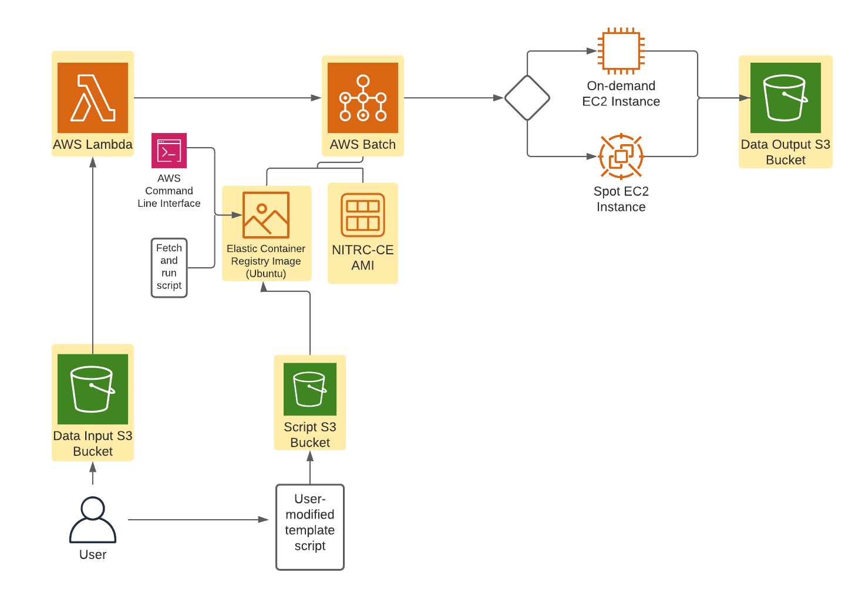
How does NeuroStack work?

Slide 8
02 - NeuroStack (AFNI) A simple example of converting file types
Add neurostack_script.sh to the neurostack-script S3 bucket
Add test.nii to the neurostack-input S3 bucket
(Optional) Watch your job process through Batch
After several minutes, your processed data will be automatically uploaded to the neurostack-output S3 bucket

Slide 9
NITRC-CE Software
FSL
SPM
AFNI
FreeSurfer
PLINK
3D Slicer
MRIcron
Connectome Viewer
DIPY Diffusion Imaging Analysis
BrainSuite
DTIPrep
Scikit-learn
C-PAC
MaCH
NEURON
Mrtrix
NIPY File IO
NIPY Structural and Functional
NIPY Pipeline and Interfaces
DWI/DTI Quality Control Tool
Solar Eclipse Imaging Genetics Tools

Slide 10
03 -NeuroStack (FreeSurfer) Using NeuroStack to process a subject in FreeSurfer
Add neurostack_script.sh (from the freesurfer folder) to the neurostack-script S3 bucket
Add license.txt to the neurostack-script S3 bucket
Add test.nii to the neurostack-input S3 bucket
(Optional) Watch your job process through Batch
After a few hours, your processed data will be automatically uploaded to the neurostack-output S3 bucket

Slide 11
Clean Up Once everything is done
Delete everything in your NeuroStack S3 buckets
Delete NeuroStack from your CloudFormation stacks

Slide 12
THANKS
Project Authors: Hailey D’Silva Christian Haselgrove Joan Bosson-Heenan, MPH Jeffrey Gruen, MD | Funding From: The Amazon Web Services (AWS) Promotional Credit Program The Manton Foundation The Eunice Kennedy Shriver National Institute of Child Health and Human Development (P50HD027802) | Presentation Credits: Presentation template by Slidesgo Icons by Flaticon Infographics by Freepik
A Special Thank You to the Gruen Laboratory

