Slide 1
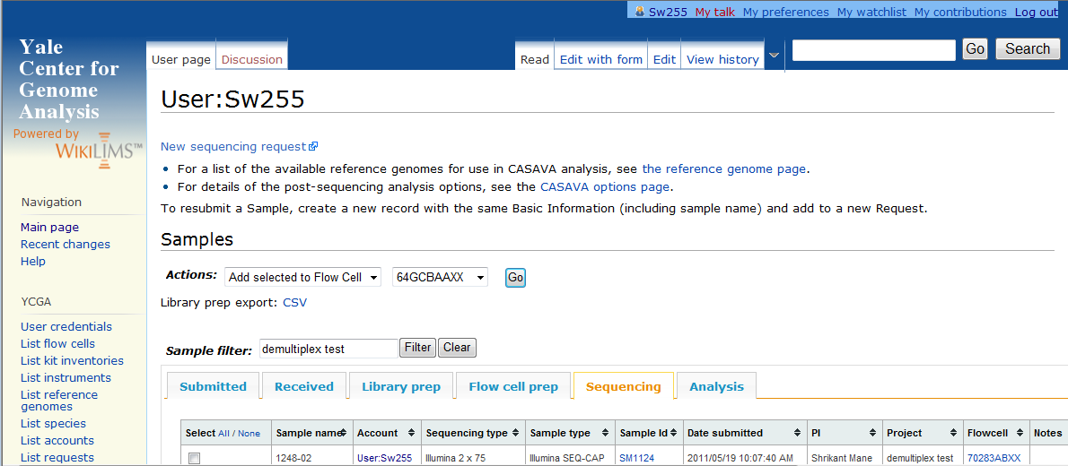
Key parts of your account page in wikiLIMS
Your netID is your account page bookmark.
Click here to make a new sequencing request.
Add a filter to your samples to view a subset.
Browsable tabs of workflow stages.

