Slide 1
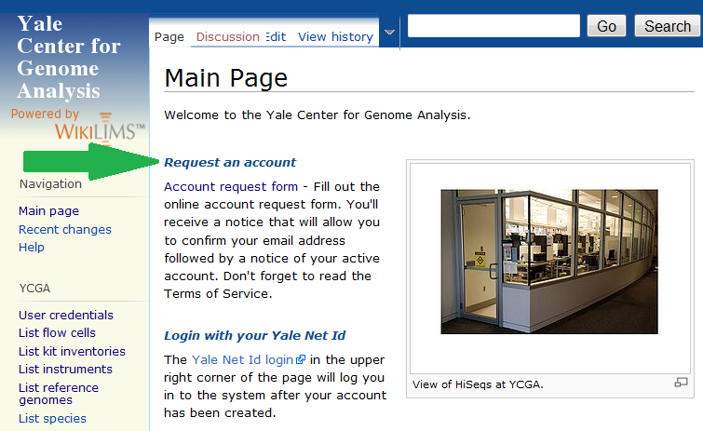
How to request an account in wikiLIMS
1. Request an account at: http://wikilims.ycga.yale.edu/wiki/index.php/Main_Page

Slide 2
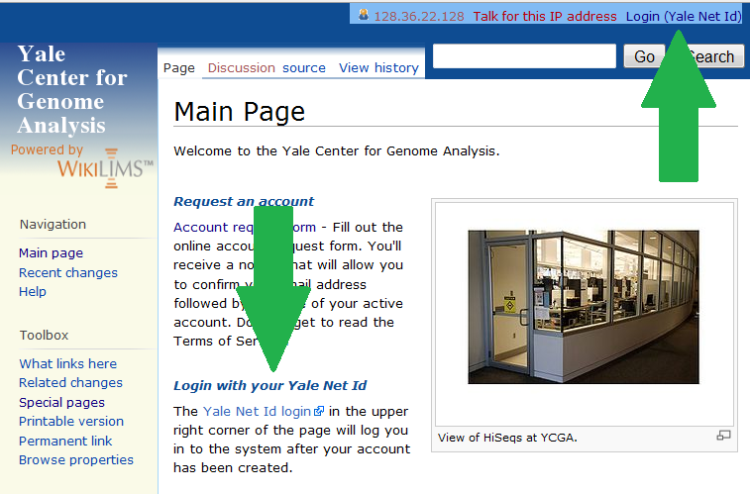
How to login to wikiLIMS
2. Once you have received a confirmation email (usually 24-48 hrs later), login with your netid:

