Slide 1
Developing an ED-Initiated Buprenorphine Program
Kathryn Hawk, MD, MHS
Gail D’Onofrio, MD
Department of Emergency Medicine
Yale University School of Medicine

Slide 3
The 24/7/365-day Option To Fight the Opioid Crisis

Slide 4
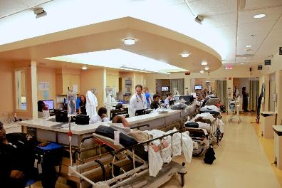
Why focus on the ED?
Because that’s where the patients are
Overdose
Seeking Treatment
Screening

Slide 5
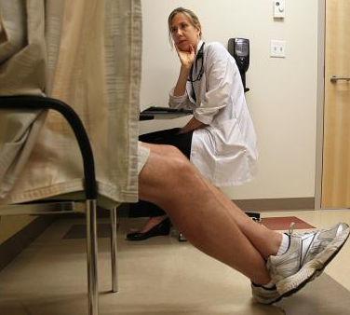
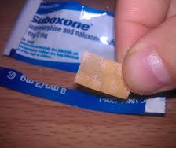
EDs and Emergency Physicians can…
Identify patients with OUD
Provide treatment
Initiate buprenorphine
Overdose education and naloxone distribution
Directly link patient to continued opioid agonist therapy & preventive services

Slide 6
NIDA 5R01DA025991
JAMA. 2015;313(16):1636-1644.

Slide 7
ED-Bup: 2x More Likely to be Engaged in Addiction Treatment at 30 Days
P<0.001
Referral
Brief Intervention
Buprenorphine

Slide 8
Translating Research into Practice
Initiating
Treatment
Direct Linkage

Slide 9
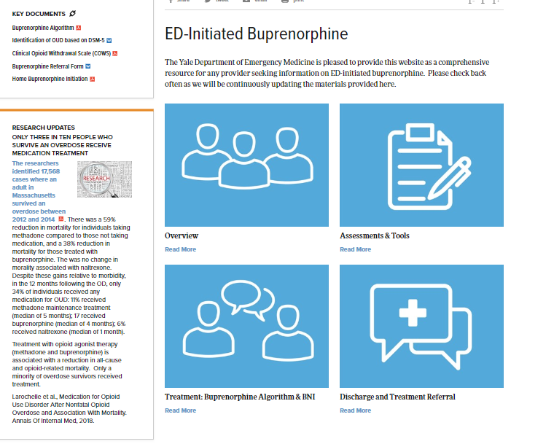
Resources
https://www.drugabuse.gov/ed-buprenorphine
https://medicine.yale.edu/edbup/

Slide 10
How do I start buprenorphine in the ED?

Slide 11
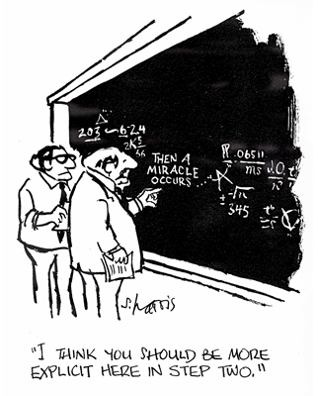

Slide 12
Buprenorphine Integration Pathway
① ED presentation
② Assess
③Treat
-Seeking Treatment
-Screen Positive
-Complication of Drug Use
Withdrawal
Overdose
Infection
-Identified during the course of the visit
For OUD
Identification of OUD based on DSM-5
④ Discharge
& Refer to Treatment
BNI
Buprenorphine algorithm
Clinical Opioid
withdrawal Scale
(COWS)
For Withdrawal

Slide 13
Formally assess for opioid use disorder
Formally assess the severity of opioid withdrawal (COWS)
Assess patient willingness for BUP
Provide ED-initiated buprenorphine (ED or home induction)
Overdose education and naloxone distribution (OEND)
Provide formal referral for ongoing opioid agonist treatment

Slide 14
DSM-5 criteria for diagnosis of Opioid Use Disorder
At least 2 criteria must be met within a 12 month period
1. Take more/longer than intended
2. Desire/unsuccessful efforts to quit opioid use
3. A great deal of time taken by activities involved in use
4. Craving, or a strong desire to use opioids
5. Recurrent opioid use resulting in failure to fulfill major
role obligations
6. Continued use despite having persistent social
problems
7. Important activities are given up because of use.
8. Recurrent opioid use in situations in which it is
physically hazardous (e.g. driving)
Use despite knowledge of problems
Tolerance
11. Withdrawal
Severity
Presence of Symptoms
Mild: 2-3
Moderate: 4-5
Severe: >6

Slide 15
Formally assess for opioid use disorder
Formally assess the severity of opioid withdrawal (COWS)
Assess patient willingness for buprenorphine
Provide ED-initiated buprenorphine (ED or home induction)
Overdose education and naloxone distribution (OEND)
Provide formal referral for ongoing opioid agonist treatment

Slide 16
COWS
Score:
5-12= Mild
13-24= Moderate
25-36= Moderately Severe

Slide 17
Formally assess for opioid use disorder
Formally assess the severity of opioid withdrawal (COWS)
Assess patient willingness for buprenorphine
Provide ED-initiated buprenorphine (ED or home induction)
Overdose education and naloxone distribution (OEND)
Provide formal referral for ongoing medication assisted treatment

Slide 18
Title 21, Code of Federal Regulations, Part 1306.07(b)
72-hour rule
Anyone Can Treat Opioid Withdrawal with Buprenorphine
Title 21, Code of Federal Regulations, Part 1306.07(b)
Allows to administer (but not prescribe) narcotic drugs for the purpose of relieving acute withdrawal symptoms while arranging for the patient's referral for treatment
Not more than 1-day's medication may be administered or given to a patient at one time
Patient must return to ED each day for no more than 72 hours
This 72-hour period cannot be renewed or extended.

Slide 19
How do you motivate patients to accept treatment?

Slide 20
What makes people take action?
Autonomy
(freedom)
Engaging
Talk
Hearing
Themselves
Making a
Plan

Slide 21
People only really listen to
1 person…
THEMSELVES!

Slide 22
Brief Negotiation Interview BNI
Raise The Subject
Establish rapport
Raise the subject of drug use
Assess comfort
Provide Feedback
Review patient’s alcohol and/or drug use and patterns
Make connection between AOD use and negative consequences; (e.g. impaired judgment leading to injury/unprotected sex/sharing needles)
Make a connection between AOD use and ED visit

Slide 23
BNI (continued)
Enhance Motivation
Assess readiness to change: One a scale 1 to 10 how ready are you to stop using, cut back or enroll in program???
(Why didn’t you pick a lower number?)
Negotiate And Advise
- Negotiate goal
- Give advice
Summarize and complete referral/prescription form
Thank patient for their time
D’Onofrio G, Pantalon MV, Degutis LC, Fiellin DA, O’Connor PG. Development and implementation of an emergency practitioner-performed brief intervention for hazardous and harmful drinkers in the emergency department. Acad Emerg Med 2005;12:249-256.

Slide 24
Formally assess for opioid use disorder
Formally assess the severity of opioid withdrawal (COWS)
Assess patient willingness for buprenorphine
Provide ED-initiated buprenorphine (ED or home induction)
Overdose education and naloxone distribution (OEND)
Provide formal referral for ongoing medication assisted treatment

Slide 25
Algorithm

Slide 27
Formally assess for opioid use disorder
Formally assess the severity of opioid withdrawal (COWS)
Assess patient willingness for buprenorphine
Provide ED-initiated buprenorphine (ED or home induction)
Overdose education and naloxone distribution (OEND)
Provide formal referral for ongoing opioid agonist treatment

Slide 28
Those at Highest Risk for Overdose
Prior non-fatal opioid overdose
Opioid use disorder leaving controlled settings (e.g. residential treatments, detoxification, incarceration) who have lowered opioid tolerance
Prescribed doses of opioid analgesics greater than 90 milligram morphine equivalents (MME) per day
Taking (co-prescription or co-use) opioids and benzodiazepines
Alcohol and opioids
Injecting opioids
Exposed to high potency opioids (fentanyl, W-18)
Low levels of physical tolerance (new initiates)
Sleep disordered breathing (e.g. sleep apnea)
CORE
CORE

Slide 29
Harm Reduction Strategies
Carry naloxone
Never use alone
Don’t combine opioids with other substances
(alcohol, benzodiazepines or other sedatives)

Slide 30
Formally assess for opioid use disorder
Formally assess the severity of opioid withdrawal (COWS)
Assess patient willingness for buprenorphine
Provide ED-initiated buprenorphine (ED or home induction)
Overdose education and naloxone distribution (OEND)
Provide formal referral for ongoing opioid agonist treatment

Slide 31
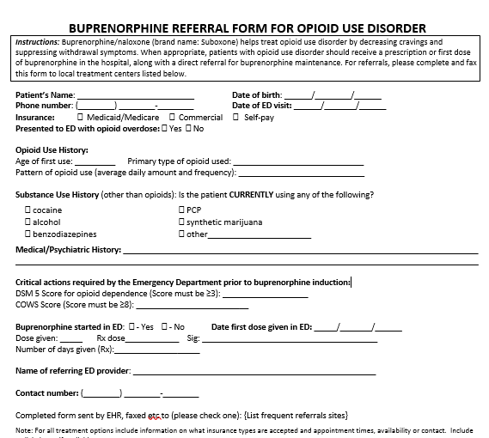
Buprenorphine referral form

Slide 32
How do I set up a program?

Slide 33
Local champions
Community Partners
Leadership Buy-In
Anticipate Barriers
Protocols
Success Stories
Know your Resources

Slide 34
Community Partners
Is there an OTP, primary care practice, resident clinic, FQHC that will take a “warm handoff”?
What services do they offer?
Insurance?
Waitlist or mandatory waiting period?
Anyone willing to run a Bridge or Transition Clinic?
Notes:
Psych, dual diagnosis? Benzos? --

Slide 35
Local Champions
Administration, Faculty, Residents, Nursing…
How are you going to get providers waivered?
How are you going to get waivered providers to prescribe?
Do you need to consider other models?
Know your allies
In the hospital and out
Social work/navigators/Health Promotions Advocates
Pharmacy!

Slide 36
Anticipate Challenges
Buprenorphine
Waiver Requirements
Formulary/ED Pyxis
Insurance Prior Authorization?
Local pharmacy
Patient
ID
Insurance
Transportation

Slide 37
Additional Challenges
Anticipate resistance, particularly around ANY increased workload across all staff
How can you offload some of the work?
What motivates different key players?
Reducing repeat ED visits or psych holds
Staff safety
LOS
Patient satisfaction

Slide 38
Making Progress
Engaging stakeholders helps change culture
It will not happen overnight
Perfect is the enemy of good
- Don’t wait for a perfect protocol or system!
Make is as easy as possible for providers and patients
“This is about improving patient care”

Slide 39
Access to MAT
Reduce OD Risk
Reducing the stigma
Safe prescribing
Reduce
OD Deaths
Data Sharing
Increase Access to Naloxone

Slide 40
Barriers & Myths
“Drug use is a moral failing”
“You are just substituting one drug for another”
“I'm just going to add more drugs to the
community, they have enough”
“Patients are going to flock here if we
start offering medications like Bup”

Slide 41
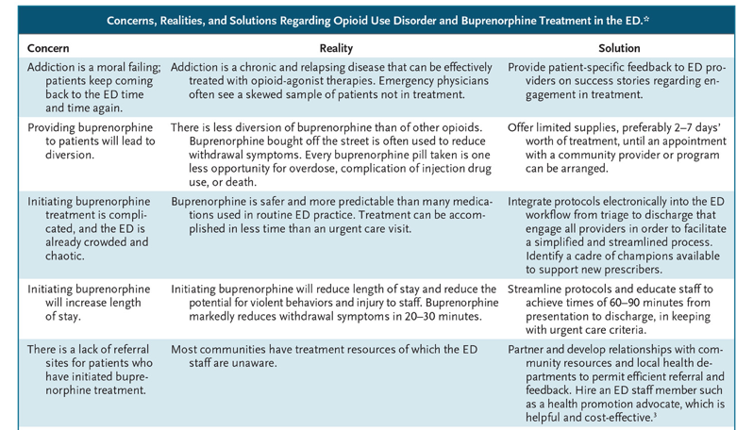
G D’Onofrio et al. N Engl J Med 2018;379:2487-2490.

Slide 42
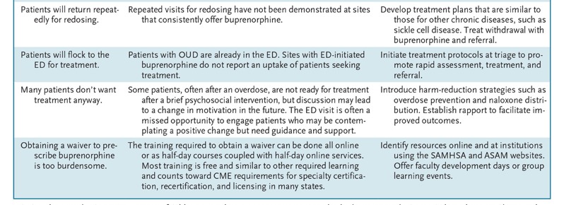
G D’Onofrio et al. N Engl J Med 2018;379:2487-2490.

Slide 43
Opportunity
Embrace science
based treatments
Engage emergency
practitioners
Change the trajectory of
the opioid epidemic

Slide 44
Questions?
kathryn.hawk@yale.edu
gail.donofrio@yale.edu

